Slide 1
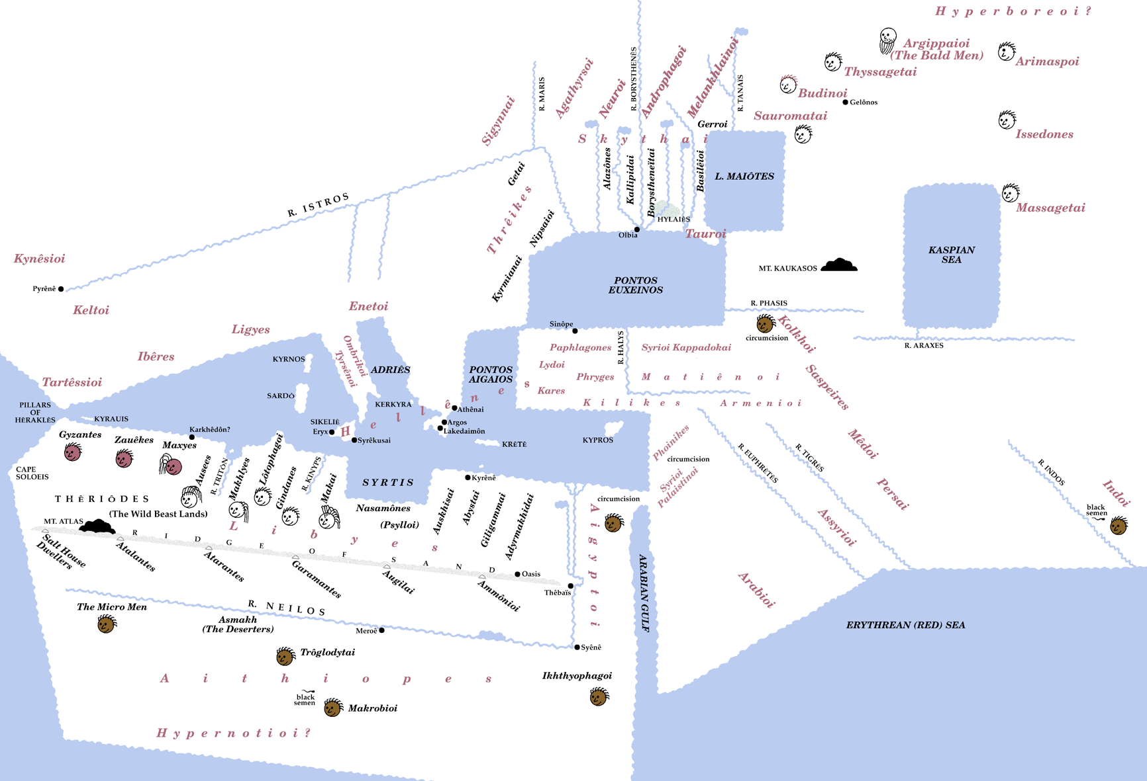
DIAMETRICAL OPPOSITION
PHENOTYPES
Greek norm vs. ruddy or pale

Slide 2
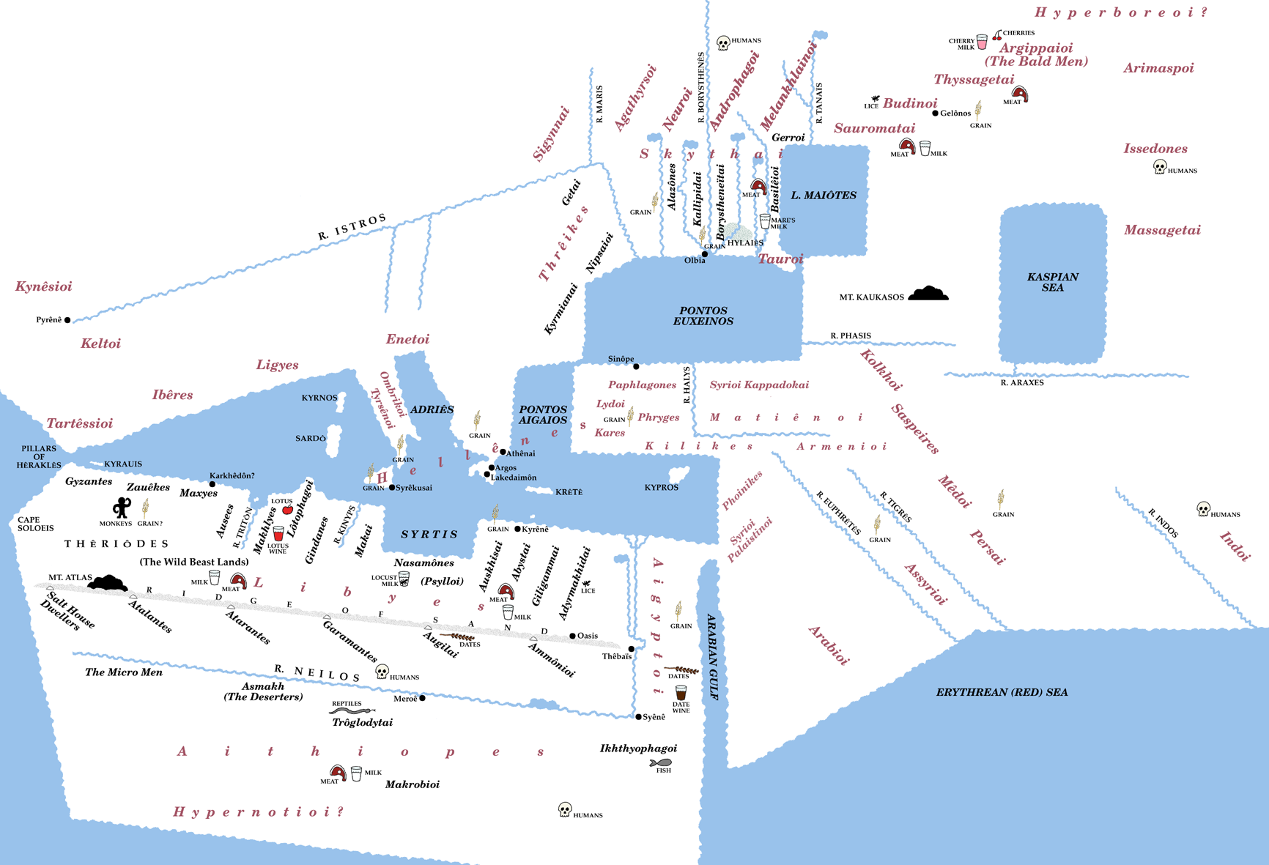
DIAMETRICAL OPPOSITION
FOOD
Greek norm (grain & wine)
vs. meat & milk

Slide 3
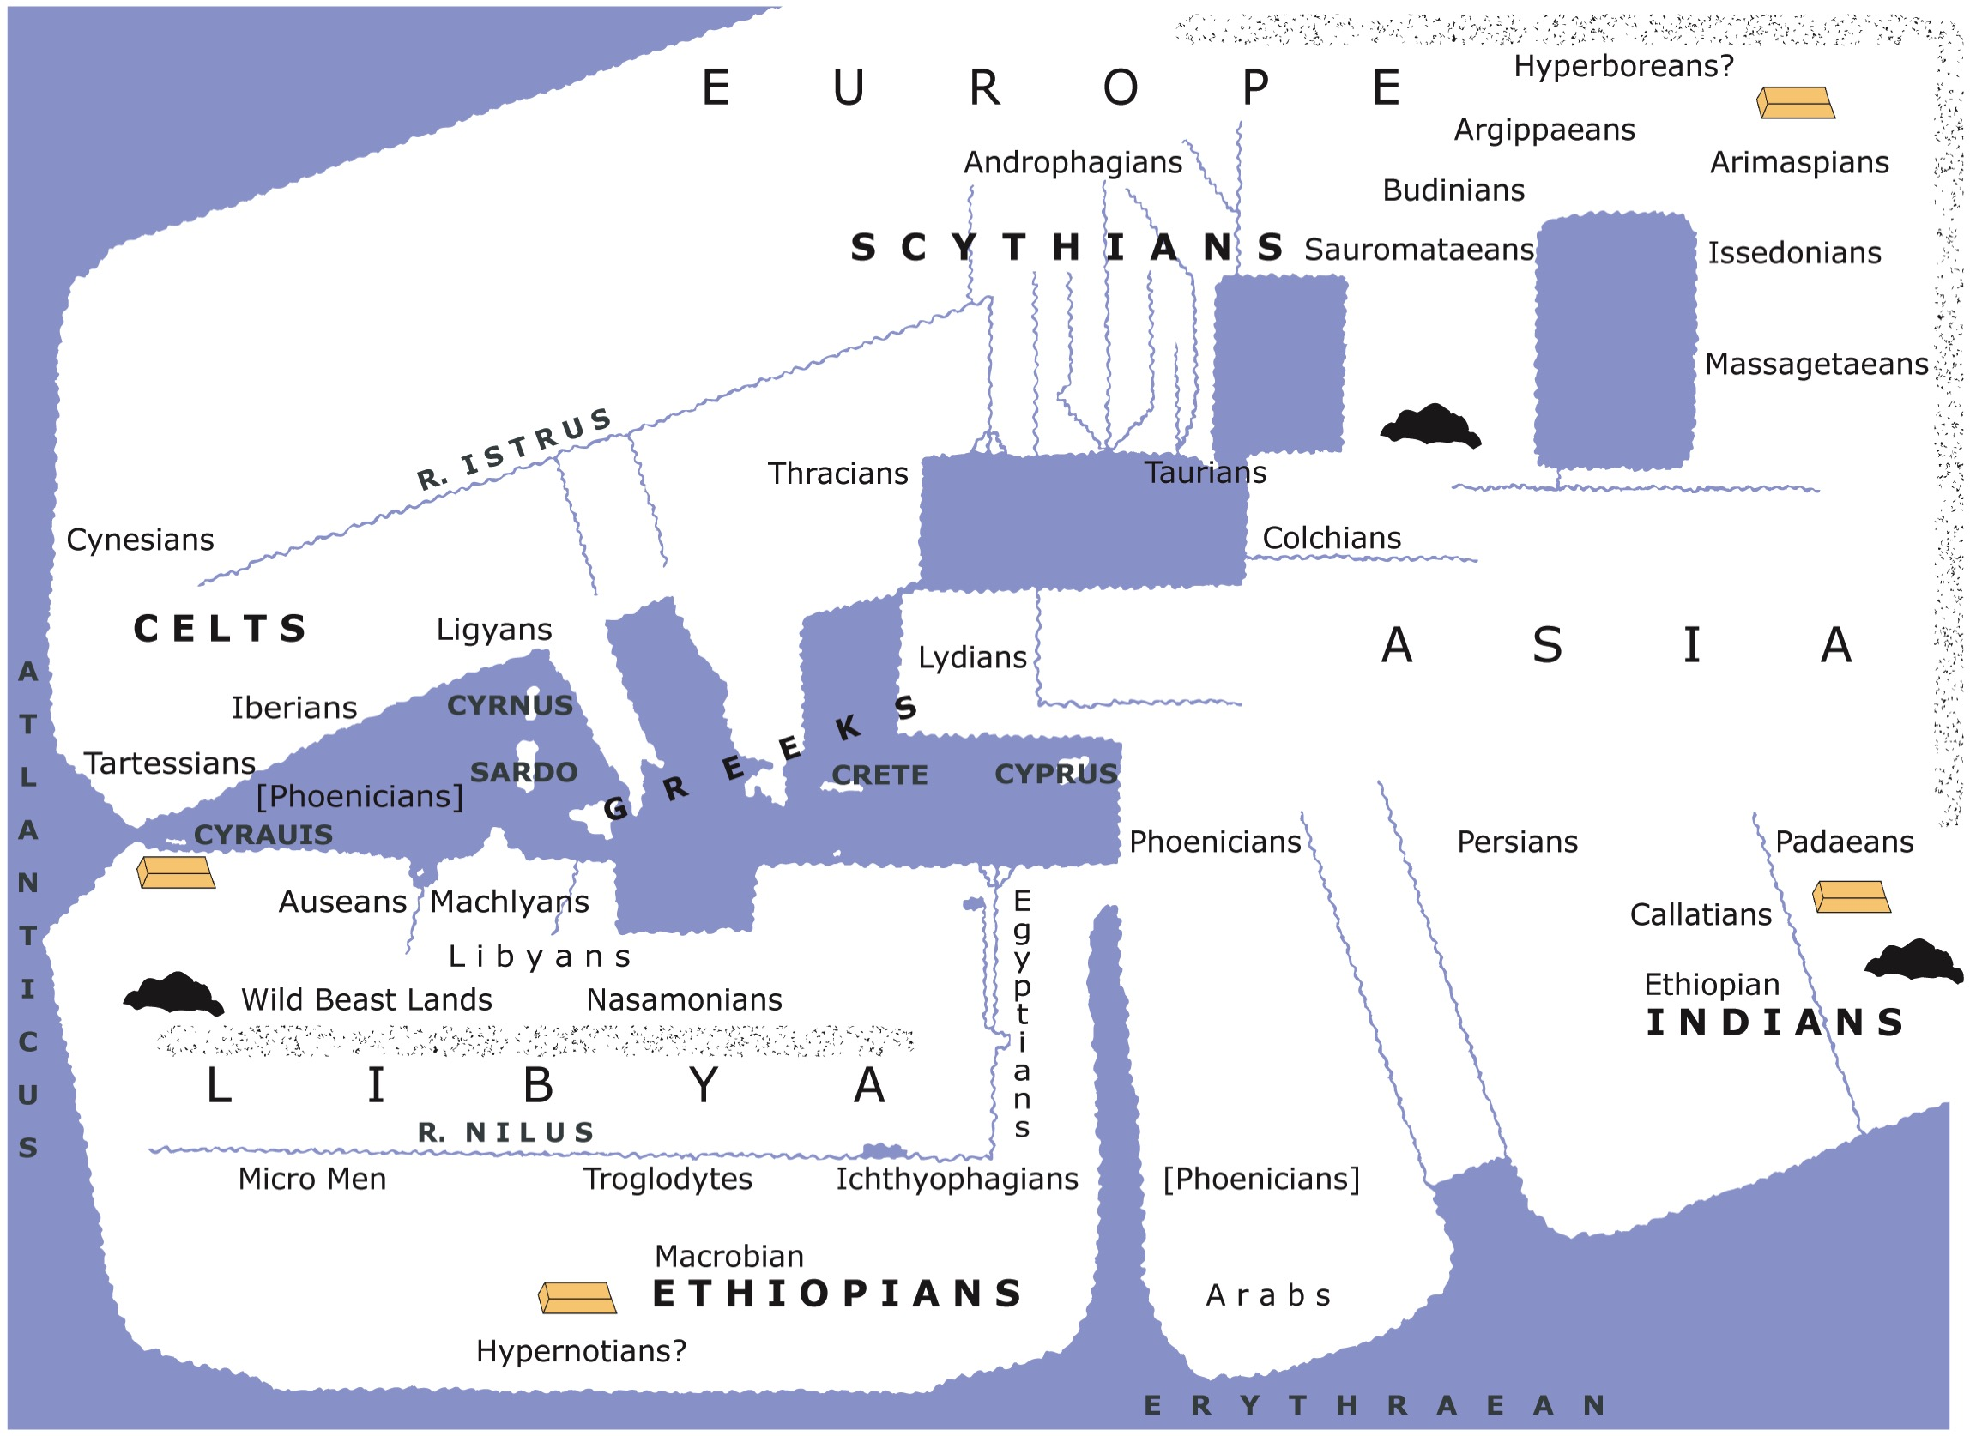
SYMMETRICAL BALANCE

Slide 5


Slide 6
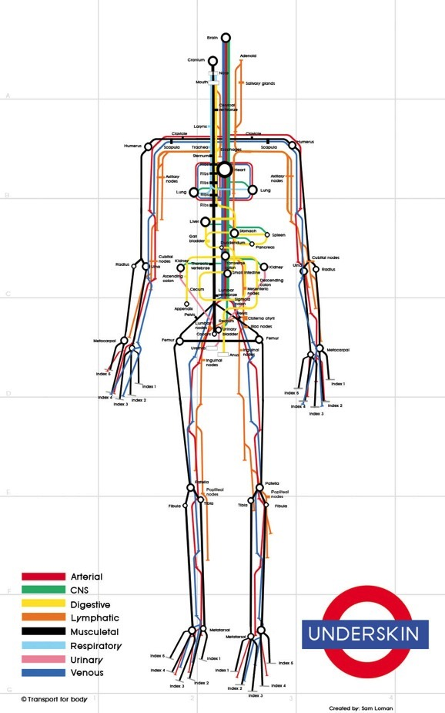
Herodotus
II.28-34, 103-5
III.98-116
IV.16-45, 168-199
focus on dietary and
sexual customs

