Slide 1
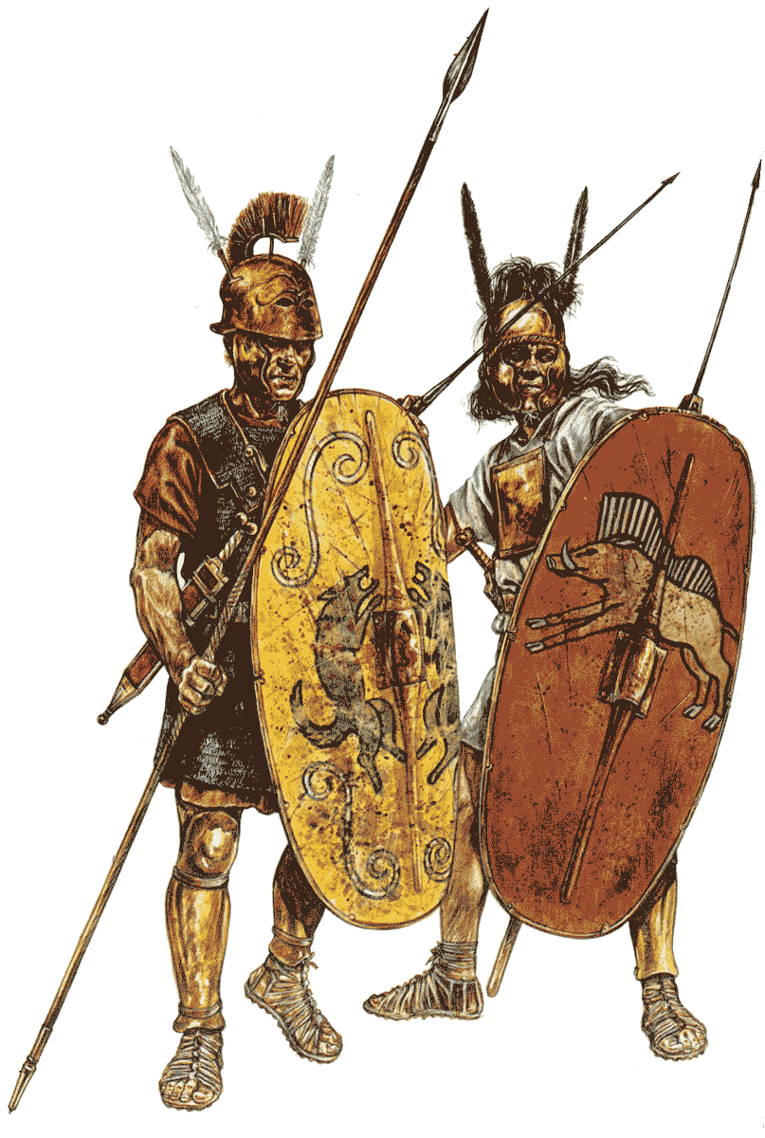
THE FACE OF BATTLE

Slide 2
PROBLEMS OF SUPPLY
food & fodder
restraints
• live off land
• coastal supply bases, mule-train supplies
derived from tributum of provinces (Sicily, Africa)
• mule trains multiply fodder needs

Slide 3
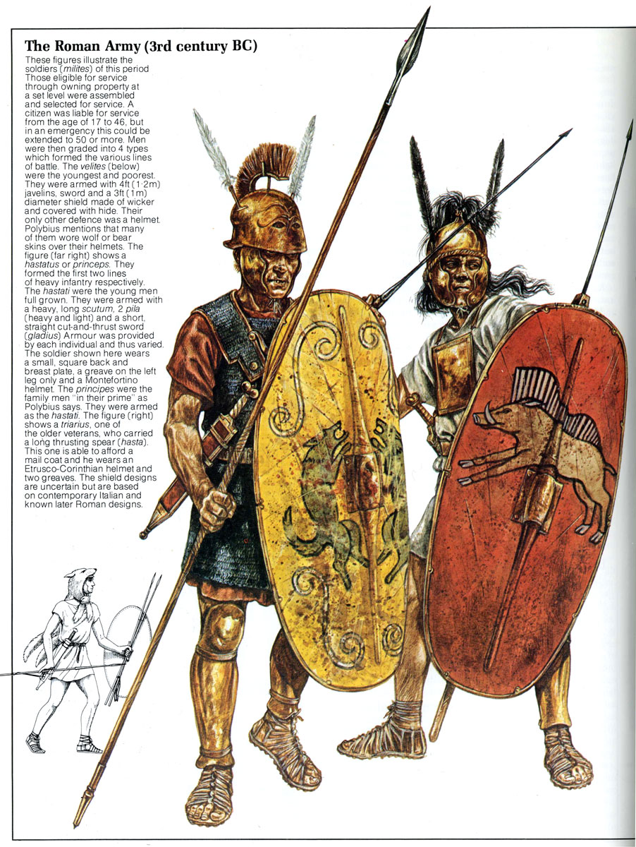
WEAPONS
leves (“light armed”)
or velites (“skirmishers”)
-4ft javelins (pila)
-round wicker shield
-helmet/skin

Slide 4
WEAPONS
antepilani
(“fore-fighters”)
1. hastati (“spearmen”)
2. principes (“prime”)
-curved shield (scutum)
[[-2x javelin (pilum) ]]
-thrusting spear (hasta)
-sword (gladius)
cut & thrust
-body armor
-helmet
-greave(s)
varied in quality/quantity

Slide 5
WEAPONS
vexillae
(“standard-bearers”)
3. triarii (“third rank”)
veterans, rear guard
-curved shield (scutum)
-thrusting spear (hasta)
-sword (gladius)
cut & thrust
-body armor
-helmet
-greave(s)

Slide 6
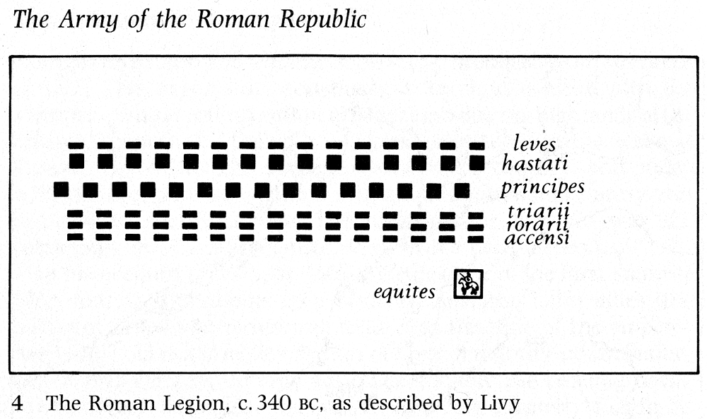
FACE OF BATTLE
10-15 maniples - flexible sub-units of century

Slide 7
FACE OF BATTLE
PROBLEMS
• duration of battle
many hours of swordplay?
rugby scrum (othmisos)?

Slide 8
FACE OF BATTLE
PROBLEMS
• duration of battle
• casualties
symmetrical (ca.5%) vs
assymetrical

Slide 9
FACE OF BATTLE
PROBLEMS
• duration of battle
• casualties
symmetrical (ca.5%) vs
assymetrical
Pydna – Philip 25,500 troops
8,000 dead
5,000 POWs
vs
100 Roman dead

Slide 10
FACE OF BATTLE
PROBLEMS
• duration of battle
• casualties
• mobility
manipular formation >
rotation of fresh troops

Slide 11
FACE OF BATTLE
PROBLEMS
• duration of battle
• casualties
• mobility
• supporting ranks

Slide 12
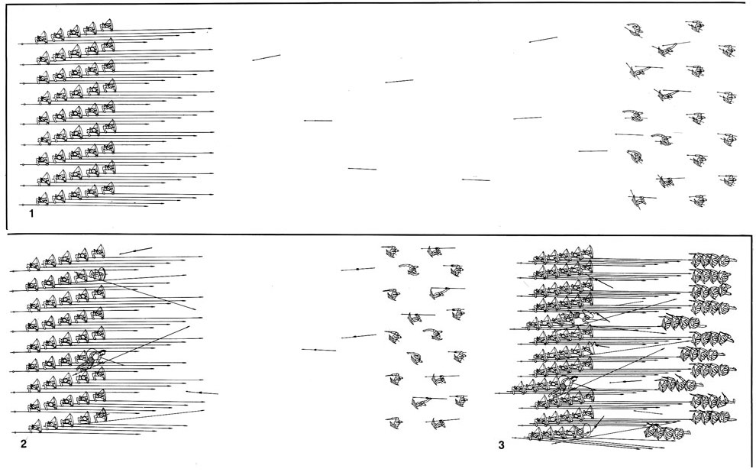
PROBLEMS
• supporting troops
role of velites?
FACE OF BATTLE

Slide 13
FACE OF BATTLE
PROBLEMS
• duration of battle
• casualties
• mobility
• supporting ranks
• if not decided by the first clash, contest
could drag on for hours before one side
broke and fled.
• losers could suffer appalling causalities,
victors 5% or less
• fighting lines could shift over hundreds
of yards as one side withdrew or was
pushed back
• Romans had a practical system for the
passage of line, replacing troops

Slide 14
FACE OF BATTLE
PROBLEMS
• psychology of battle
purpose: not fighting but victory
• not othismos (“rugby scrum”)
• not continual swordplay
stand-off model (Philip Sabin)
• lulls with lines separate by space
of few meters
• repeated volley and charge,
then withdrawals
• initial stand off > eventual swordplay
minutes/seconds to be decisive

Slide 15
FACE OF BATTLE
PROBLEMS
• duration of battle
• casualties
• mobility
cohort formation >
rotation of fresh troops

Slide 16
FACE OF BATTLE
SUCCESS
• resources
• organization
• manpower
• discipline
• weapons
• leadership
• training

