Slide 1
ROMAN ARMY • VIRTUS
Besides the speaker over the body about to be buried, after having finished the panegyric of this particular person, starts upon the others whose representatives are present, beginning with the most ancient, and recounts the successes and achievements of each. By this means the glorious memory of brave men is continually renewed; the fame of those who have performed any noble deed is never allowed to die; and the renown of those who have done good service to their country becomes a matter of common knowledge to the multitude, and part of the heritage of posterity. But the chief benefit of the ceremony is that it inspires young men to shrink from no exertion for the general welfare, in the hope of obtaining the glory that awaits the brave.
Polybius VI.54

Slide 2
ROMAN ARMY • VIRTUS
The story goes that Horatius Cocles (“One-Eyed”), while fighting with two enemies at the head of the bridge over the Tiber, which is the entrance to the city on the north, seeing a large body of men advancing to support his enemies, and fearing that they would force their way into the city, turned round and shouted to those behind him to hasten back to the other side…he remained at his post receiving numerous wounds, and checked the progress of the enemy…When the bridge had been broken down, the attack of the enemy was stopped, and Cocles threw himself into the river with his armor on and deliberately sacrificed his life…Such is the enthusiasm and emulation for noble deeds that are engendered among the Romans by their customs
Polybius VI.55

Slide 3
ROMAN ARMY • VIRTUS
The story goes that Horatius Cocles (“One-Eyed”), while fighting with two enemies at the head of the bridge over the Tiber, which is the entrance to the city on the north, seeing a large body of men advancing to support his enemies, and fearing that they would force their way into the city, turned round and shouted to those behind him to hasten back to the other side…he remained at his post receiving numerous wounds, and checked the progress of the enemy…When the bridge had been broken down, the attack of the enemy was stopped, and Cocles threw himself into the river with his armor on and deliberately sacrificed his life…Such is the enthusiasm and emulation for noble deeds that are engendered among the Romans by their customs
Polybius VI.55
…Then Cocles cried, “Father Tiber, may you, I humbly pray, receive these arms and this soldier into your favoring stream.” Thereupon he leapt into the Tiber in full armor and, with many spears raining down, swam in safety to his comrades on the shore, a bit of daring that posterity was to find more praiseworthy than credible.
Livy II.10

Slide 4
ROMAN ARMY • VIRTUS
BRITAIN (Free Celts)
The soil bears crops, except for the olive and the vine and other natives of warmer climes, and has an abundance of cattle.
Tacitus Agricola 12
GERMANY (Free Germans)
It is fertile for sown crops but will not grow fruit trees. It is rich in livestock, but these are mostly undersized.
Tacitus Germania 5

Slide 5
ROMAN ARMY • VIRTUS
BRITAIN (Free Celts)
The soil bears crops, except for the olive and the vine and other natives of warmer climes, and has an abundance of cattle.
Tacitus Agricola 12
GERMANY (Free Germans)
It is fertile for sown crops but will not grow fruit trees. It is rich in livestock, but these are mostly undersized.
Tacitus Germania 5
longue durée: Mediterranean triad – olive, vine, grain (wheat, barley)
poverty of conquered territories > donative paid at decommission rather than land

Slide 6
ROMAN ARMY • VIRTUS
BRITAIN (Free Celts)
The soil bears crops, except for the olive and the vine and other natives of warmer climes, and has an abundance of cattle.
Tacitus Agricola 12
GERMANY (Free Germans)
It is fertile for sown crops but will not grow fruit trees. It is rich in livestock, but these are mostly undersized.
Tacitus Germania 5
It is no use trying to escape their arrogance by submission or good behavior. They have pillaged the world: when the land has nothing left for men who ravage everything, they scour the sea. If the enemy is rich, they are greedy, if he is poor, they crave glory. Neither East nor West can sate their appetite. They are the only people on earth to covet wealth and poverty with equal craving. They plunder, they butcher, they ravish, and call it by the lying name of “empire” (imperium)—they make a desert and call it “peace.”
Tacitus Agricola 30

Slide 7
PRINCIPATE
Julio-Claudians Emperors
Imp. CAESAR AUGUSTUS
TIBERIUS Caesar Augustus
CAIUS* Caesar Augustus Germanicus (CALIGULA)
Ti. CLAUDIUS Caesar Augustus Germanicus
Imp. NERO* Claudius Caesar Augustus Germanicus
Flavian Emperors
T. Flavius Vespasianus > Imp. Caesar VESPASIANus Augustus
Imp. TITUS Caesar Vespasianus Augustus
Imp. Caesar DOMITIANus* Augustus
Adoptive (“Good”) Emperors
Imp. Caesar NERVA Augustus
M. Ulpius Nerva Traianus > Imp. Caesar Nerva TRAJANus Augustus
Imp. Caesar Trajanus HADRIANus Augustus
Imp. Caesar T. Aelius Hadrianus ANTONINUS Augustus PIUS
Imp. Caesar LUCIUS Aurleius VERUS Augustus
Imp. Caesar MARCUS AURELIUS Antoninus Augustus
Imp. Caesar M. Aurelius COMMODUS Antoninus Augustus
* bad emperors

Slide 8
PRINCIPATE
Severan Emperors
Imp. Caesar L. SEPTIMIUS SEVERUS Pertinax Augustus
Imp. Caesar M. Aurelius Antoninus Augustus (CARACALLA)
Imp. Caesar P. Septimius GETA Augustus
Imp. Caesar M. Opellius MACRINUS Augustus
Imp. Caesar M. Opellius Antoninus DIDUMENIANUS Augustus
Imp. Caesar M. Aurelius Antoninus Augustus (ELAGABALUS)*
Imp. Caesar M. Aurelius SEVERUS ALEXANDER Augustus
bad emperors
Septimius Severus’ advice to his sons (Geta and Caracalla):
Do not disagree with each other, enrich the soldiers, despise everyone else.
Dio LXXVI.15
Edict of Caracalla (212 CE)– citizenship for all (adult, male, free) in empire
in order to collect tax on inheritance, tax on manumission of slaves
Dio LXXIX.9

Slide 9
THIRD CENTURY CRISIS • 235-284 CE
era of soldier emperors
February/March 235 to March/April 238
Maximinus Thrax • murdered by troops
early January/March 238 to late January/April 238
Gordian I • committed suicide
early January March 238 to late January/April 238
Gordian II • killed in battle
early February 238 to early May 238
Pupienus Maximus • murdered by the Praetorian Guard
early February 238 to early May 238
Balbinus • murdered by the Praetorian Guard
May 238 to February 244
Gordian III • killed by Persians
240
Sabinianus • killed in battle
February 244 to September/October 249
Philip the Arab • killed in battle by Decius
248
Pacatianus • murdered by his own soldiers
248
Jotapianus • killed by his own soldiers
248
Silbannacus • death unknown

Slide 10
THIRD CENTURY CRISIS • 235-284 CE
era of soldier emperors
249 to June 251
Decius • killed in battle
249 to 252
Priscus • murdered
250
Licinianus • murdered
early 251 to 1 July 251
Herennius Etruscus • killed in battle
251
Hostilian • died of the plague
June 251 to August 253
Trebonianus Gallus • murdered by his own soldiers
July 251 to August 253
Volusianus • murdered by his own soldiers
August 253 to October 253
Aemilianus • murdered by his own soldiers
253 to June 260
VALERIAN • captured by Persians: died in captivity
253 to September 268
Gallienus • murdered
260
Saloninus • murdered

Slide 11
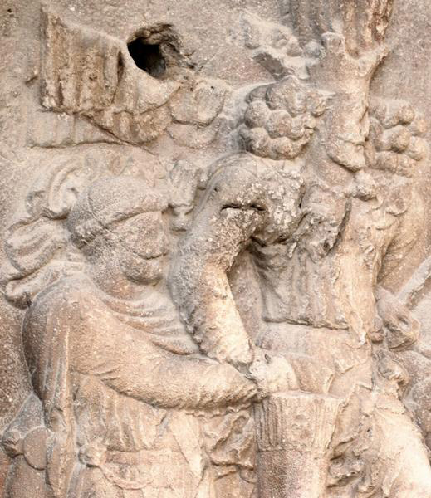
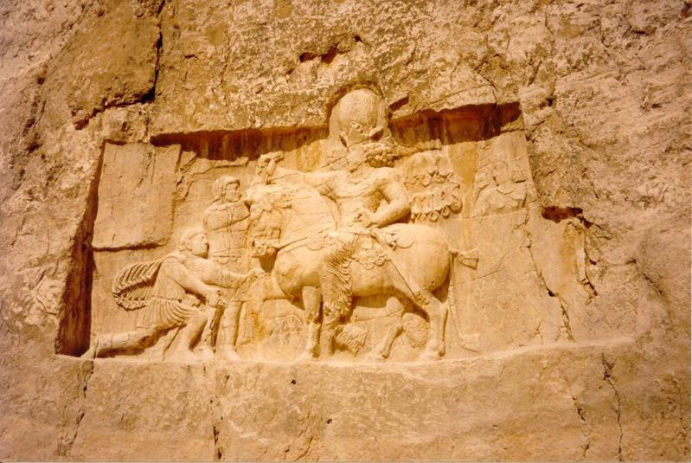
THIRD CENTURY CRISIS • SASSANID PERSIA • 226-651CE
emperor VALERIAN (253-260 CE)
prisoner of SHAPUR I (241-272 CE)

Slide 12
THIRD CENTURY CRISIS • 235-284 CE
era of soldier emperors
258 or June 260
Ingenuus • killed in battle
260
Regalianus • killed by his own people
260 to 261
Macrianus Major • defeated and killed in battle
260 to 261
Macrianus Minor • defeated and killed in battle
260 to 261
Quietus • murdered
261 to 261 or 262
Mussius Aemilianus • strangled while being held captive
268 to 268
Aureolus • surrendered to Claudius II Gothicus; killed by Praetorian Guard

Slide 13
THIRD CENTURY CRISIS • 235-284 CE
era of soldier emperors
Imp. Caesar Domitius AURELIANus Augustus, 270-275 CE
political power
• “Gallic Empire” of Postumus, 260-274 CE
• defeats queen ZENOBIA of Palmyra, 260-272 CE
• abandons province of Dacia

Slide 14
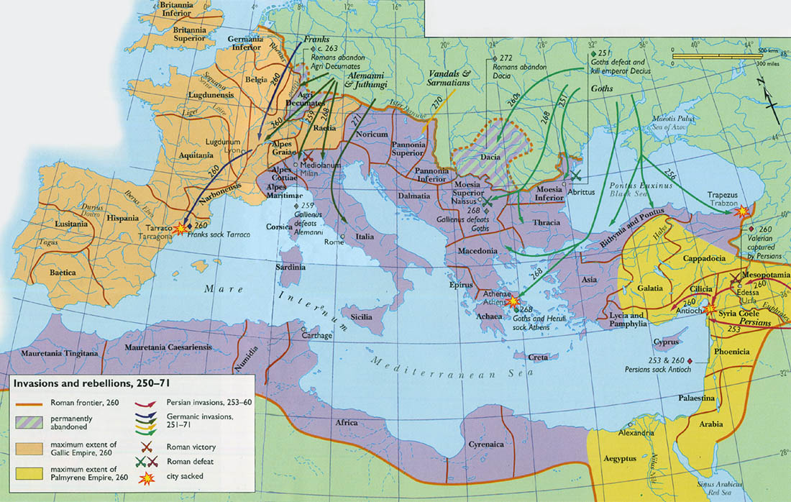
ROMAN EMPIRE, 250-271 CE
●
PALMYRA

Slide 15
THIRD CENTURY CRISIS • 235-284 CE
era of soldier emperors
Imp. Caesar Domitius AURELIANus Augustus, 270-275 CE
political power
• “Gallic Empire” of Postumus, 260-274 CE
• defeats queen ZENOBIA of Palmyra, 260-272 CE
• abandons province of Dacia
• builds wall around Rome

Slide 16
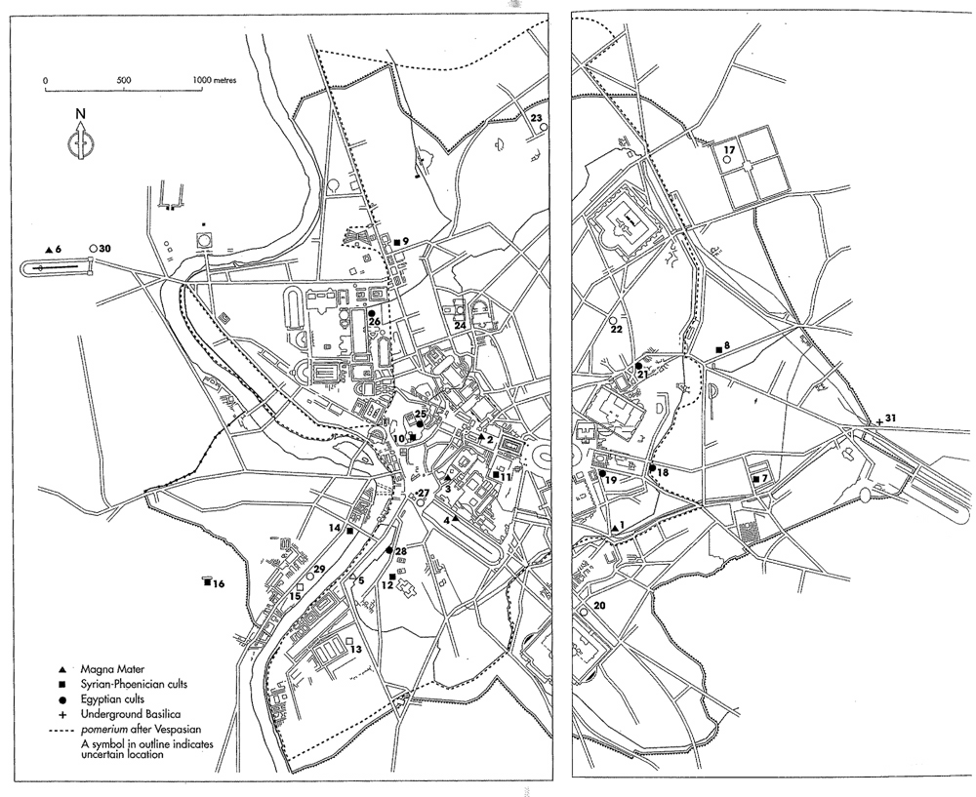
SEVERAN WALL

Slide 17
AURELIAN WALL

Slide 18
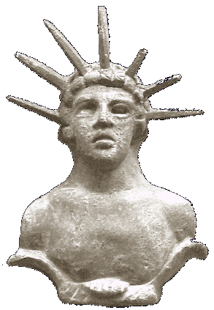
THIRD CENTURY CRISIS • 235-284 CE
era of soldier emperors
Imp. Caesar Domitius AURELIANus Augustus, 270-275 CE
political power
• “Gallic Empire” of Postumus, 260-274 CE
• defeats queen ZENOBIA of Palmyra, 260-272 CE
• abandons province of Dacia
• builds wall around Rome
ideological power
• encourage henotheism, cult of Sol Invictus

Slide 19
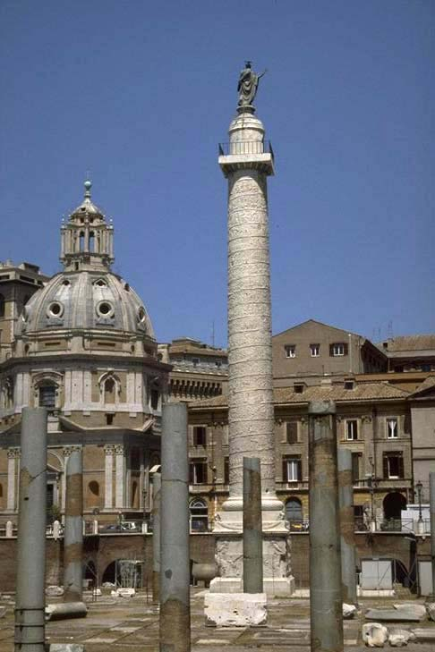
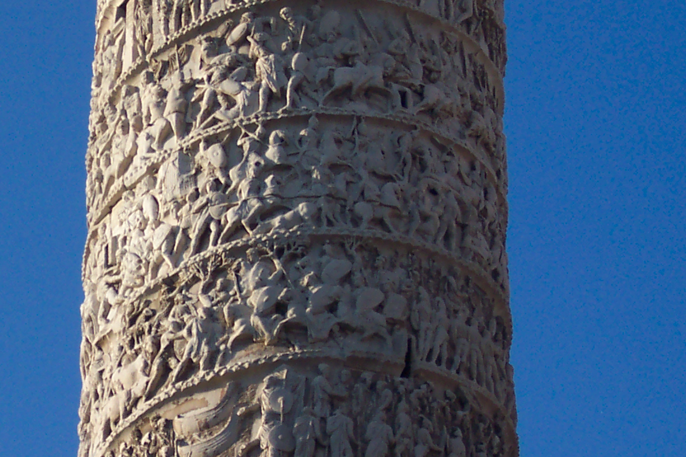
TRIUMPH • Imperial monopoly
Arch of Augustus
Arch of Titus
Column of Trajan

Slide 20
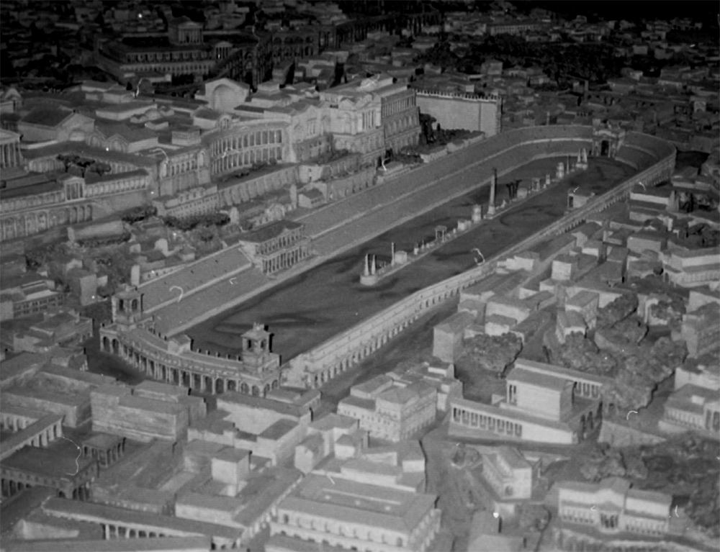
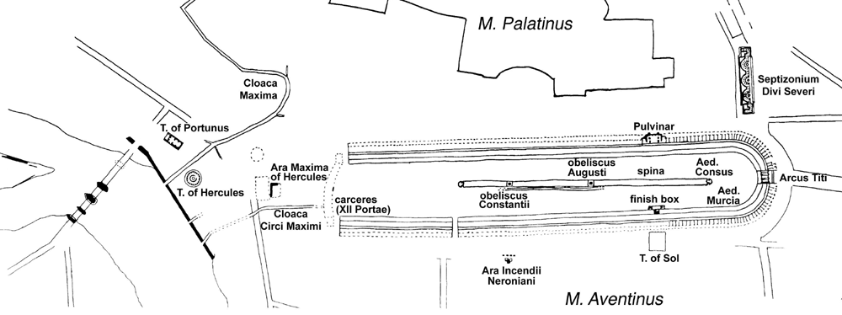
CIRCUS MAXIMUS
Arch of Titus

Slide 21
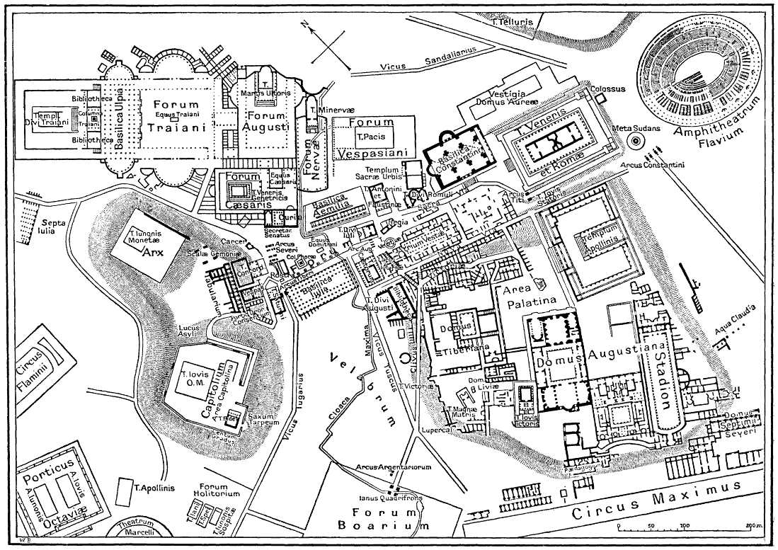
TRIUMPHAL COMMEMORATION • Imperial monopoly
IMPERIAL FORA
TRAJAN’S
COLUMN
AUGUSTUS
FLAVIAN
AMPHITHEATER
TITUS
ROMAN
FORUM
FORUM
BOARIUM
CIRCUS MAXIMUS

Slide 22
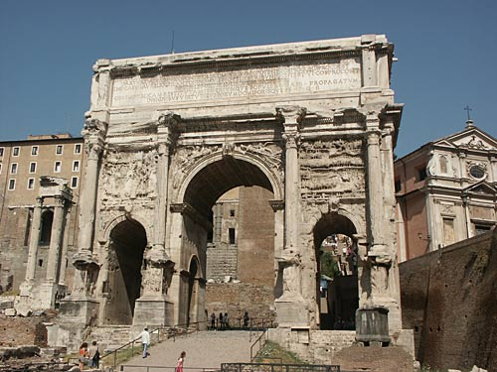
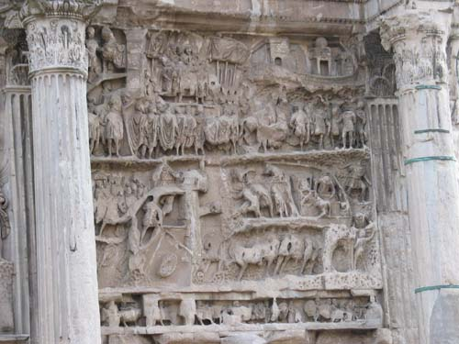
TRIUMPH • Imperial monopoly
Arch of Augustus
Arch of Titus
Column of Trajan
Arch of Septimius Severus

Slide 23
TRIUMPHAL COMMEMORATION • Imperial monopoly
IMPERIAL FORA
TRAJAN’S
COLUMN
AUGUSTUS
FLAVIAN
AMPHITHEATER
TITUS
SEPTIMIUS
SEVERUS
ROMAN
FORUM
FORUM
BOARIUM
CIRCUS MAXIMUS

Slide 24
TRIUMPHAL COMMEMORATION • Imperial monopoly
FORUM OF AUGUSTUS • Temple of Mars Ultor • tyrranicides
FORUM OF VESPASIAN • Temple of Peace • First Jewish War

Slide 25
TRIUMPHAL COMMEMORATION • IMPERIAL FORA
AUGUSTUS
VESPASIAN
FLAVIAN
AMPHITHEATER
ROMAN
FORUM
FORUM
BOARIUM
CIRCUS MAXIMUS

Slide 26
TRIUMPHAL COMMEMORATION • Imperial monopoly
FORUM OF AUGUSTUS • Temple of Mars Ultor • tyrranicides
FORUM OF VESPASIAN • Temple of Peace • First Jewish War
FORUM OF TRAJAN • Temple of divus Vespasianus, Greek and
Latin Libraries (Column), Basilica Ulpia, Markets • Dacian Wars

Slide 27
TRIUMPHAL COMMEMORATION • IMPERIAL FORA
TRAJAN
AUGUSTUS
VESPASIAN
FLAVIAN
AMPHITHEATER
ROMAN
FORUM
FORUM
BOARIUM
CIRCUS MAXIMUS

Slide 28
SEVERAN WALL

Slide 29
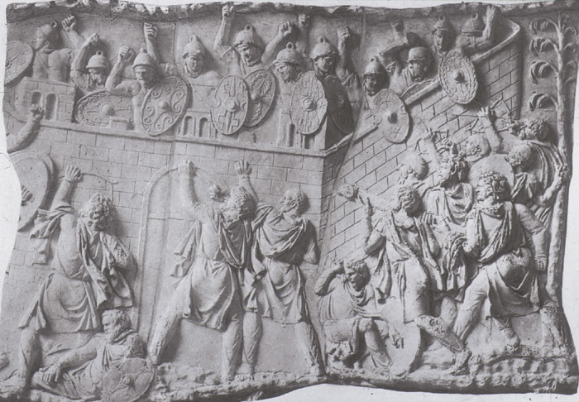
DACIAN WARS • 101-102, 105-106 CE
Imp. Caesar Domitianus Augustus vs. Dacians, 87-89 CE
• king Decabalus becomes Roman client

Slide 30
DACIAN WARS • 101-102, 105-106 CE
Imp. Caesar Nerva Trajanus Augustus vs. Dacians
• king Decabalus non-compliant client
• gold mines
First Dacian War, 101-102 CE

Slide 31
DACIAN WARS • 101-102, 105-106 CE
Imp. Caesar Nerva Trajanus Augustus vs. Dacians
• king Decabalus defeated, but gains logistical support
Second Dacian War, 105-106 CE • siege of Sarmizegetusa

Slide 32
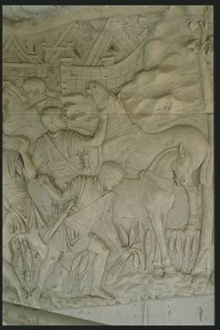
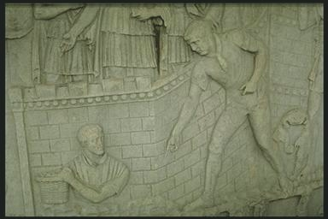
TRAJANS COLUMN
^ harvesting sickle
< earth-moving basket

Slide 33
Those foot-men also that are chosen out from the rest to be about the general himself have a lance and a buckler, but the rest of the foot soldiers have a spear and a long buckler, besides a saw and a basket, a pick-axe and an axe, a thong of leather and a sickle, with provisions for three days, so that a footman has no great need of a mule to carry his burdens.
Josephus Jewish Wars III.5.5 [93]
^ harvesting sickle
< earth-moving basket

Slide 34
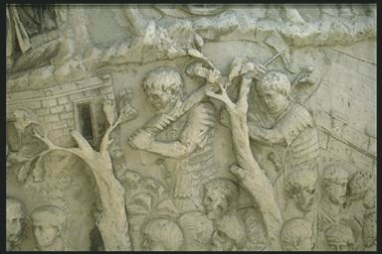
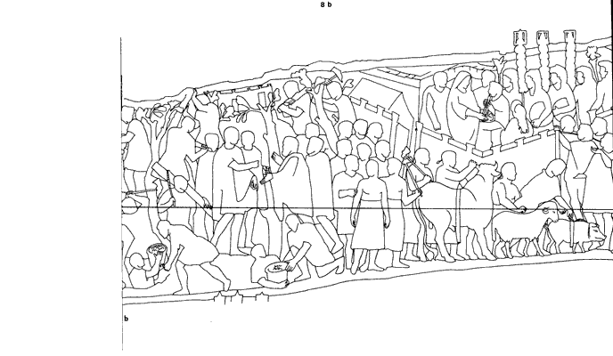
ECONOMY
clearing forest

Slide 35
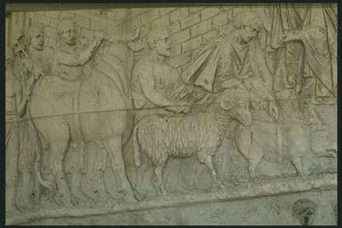
IDEOLOGY
lustratio of the camp

