Slide 1
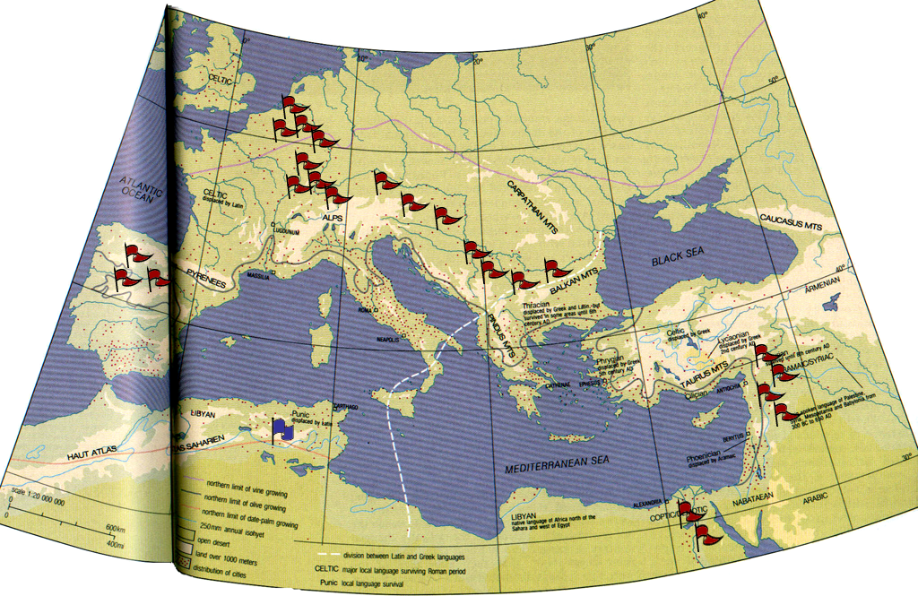
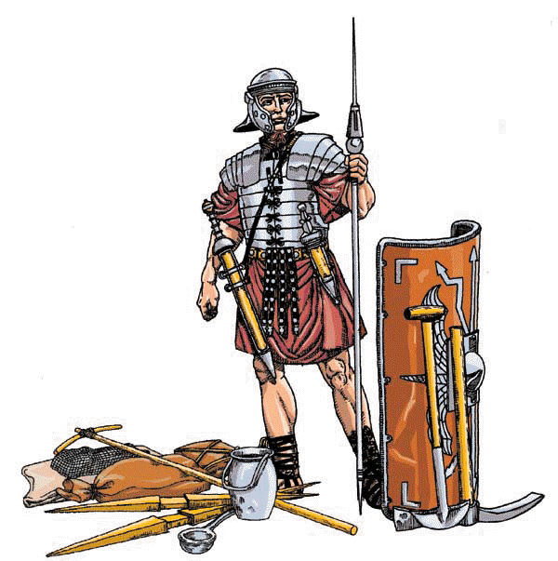
MILITARY POWER
• economic
• political
• ideological
ARMY & VIRTUS
THIRD CENTURY CRISIS

Slide 2
MILITARY POWER

Slide 3
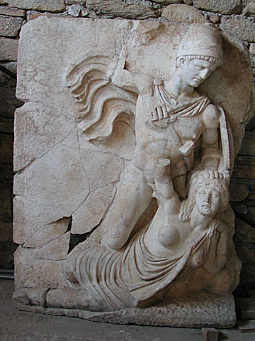
PAX ROMANA • 27 BCE—180 CE
Edward Gibbon 1776-1788
The History of the Decline and Fall of the Roman Empire
ARGUMENT
• generals pressing expansion
(e.g. Germanicus, Agricola)
checked and recalled by the
Emperors during their victories
• favored consolidation
• piracy suppressed
• interior of the Empire largely
untouched by (civil) warfare
• commerce thrived
Claudius defeats Britannia

Slide 4
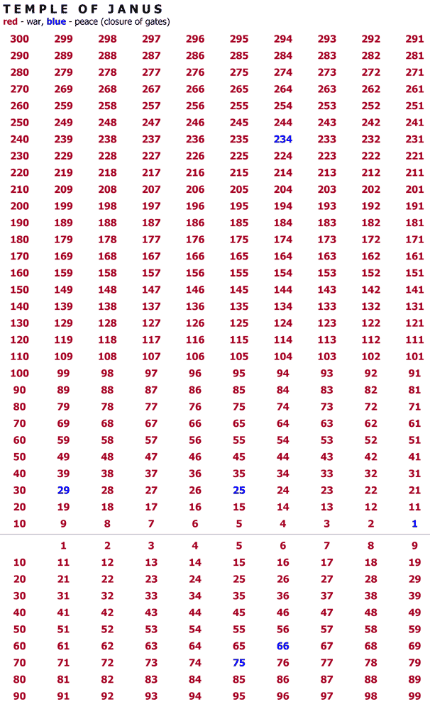
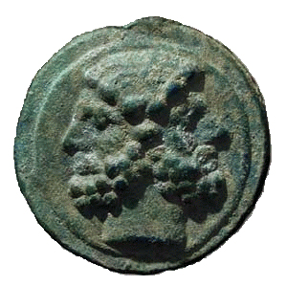
PAX ROMANA • 27 BCE—180 CE
closed doors • Temple of Janus
M. Atilius & T. Manlius •
Caesar Augustus • •
•
Nero •
Vespasian •

Slide 5
PAX ROMANA • 27 BCE—180 CE
Edward Gibbon 1776-1788
The History of the Decline and Fall of the Roman Empire
ARGUMENT
• generals pressing expansion
(e.g. Germanicus, Agricola)
checked and recalled by the
Emperors during their victories
• favored consolidation
• piracy suppressed
• interior of the Empire largely
untouched by (civil) warfare
• commerce thrived
COUNTER ARGUMENT
• exceptions Claudius (Britain)
Trajan (Dacia, Parthia),
Marcus Aurelius (Germany)
• rebellions & border skirmishes
Claudius defeats Britannia

Slide 6
TACITUS • BIOGRAPHY
Roman tradition – funeral oration, list of offices, gifts, buildings
(as in the Accomplishments of Augustus)
Greek blueprint – Hellenistic biographies (Alexandria)
P. Cornelius Tacitus Agricola (ca.100)
C. Suetonius Tranquillus Life of Nero (ca.100)
Scriptores Historia Augusta (SHA) Life of Elagabalus (4th CE)

Slide 7
HISTORY
• organization – annalistic
consular years, AUC (from the foundation)
BIOGRAPHY
• organization – topical
antecedents, birth and childhood,
career, achievements, morals (sex),
appearance, death

Slide 8
HISTORY
• organization – annalistic
consular years, AUC (from the foundation)
• Senatorial, political audience
BIOGRAPHY
• organization – topical
antecedents, birth and childhood,
career, achievements, morals (sex),
appearance, death
• popular entertainment

Slide 9
HISTORY
• organization – annalistic
consular years, AUC (from the foundation)
• Senatorial, political audience
• “objective”?
BIOGRAPHY
• organization – topical
antecedents, birth and childhood,
career, achievements, morals (sex),
appearance, death
• popular entertainment
But the successes and reverses of the old Roman people have been recorded by famous historians; and fine intellects were not wanting to describe the times of Augustus, till growing sycophancy scared them away. The histories of Tiberius, Caius, Claudius, and Nero, while they were in power, were falsified through terror, and after their death were written under the irritation of a recent hatred. Hence my purpose is to relate a few facts about Augustus—more particularly his last acts, then the reign of Tiberius, and all which follows, without either bitterness or partiality (sine ira et studio), from any motives to which I am far removed.
Tacitus Annals I.1

Slide 10
HISTORY
• organization – annalistic
consular years, AUC (from the foundation)
• Senatorial, political
• “objective”
BIOGRAPHY
• organization – topical
antecedents, birth and childhood,
career, achievements, morals (sex),
appearance, death
• popular entertainment
• anecdotal, rumor
To matricide he added the murder of his aunt (Domitia Lepida). When once he visited her as she was confined to her bed…and she, as old ladies will, stroking his downy beard (for he was already well grown) happened to say fondly, “As soon as I receive this I shall gladly die,” he turned to those with him and said, as if in jest, “I’ll take it off at once.” Then he had the doctors give the sick woman an overdose and seized her property before she was cold, suppressing her will, that nothing might escape him. Suetonius Nero 34

Slide 11
BIOGRAPHY
“GOOD” EMPERORS
• looked to the affairs of state
• consulted Senate
“BAD” EMPERORS
• ignored affairs of state
• killed Senator
• monstrous-barbaric-tyrannical
depraved and unchecked appetites
• disregard for laws
• popular (excessive gifts, patron
of the circus, participant in
entertainment)
Suetonius, Pliny and Tacitus had survived a “bad” emperor (Domitian, 81-96 CE)
and wrote under a good emperor (Trajan, 98-117 CE)
How does the tone of Pliny compare to Tacitus?
How and why are they similar/different?

Slide 12
P. Cornelius Tacitus Germany (On the Origins and
Settlement of the Germans)
ethnography – as found in the Geography of Strabo (periplus)
sympathetic treatment of free Germans:
If the country of their birth is stagnating in a long period of peace and inactivity, many noble youths deliberately seek out other states who are engaged in some war. For peace is unwelcome to this people and they can more easily win renown amid danger.
Tacitus Germany 14

Slide 13
P. Cornelius Tacitus Germany (On the Origins and
Settlement of the Germans)
ethnography – as found in Gallic Wars of Julius Caesar and the Geography of Strabo (periplus)
ethnic mirror:
This means that they live a life of sheltered chastity, uncorrupted by the temptations of public spectacles or the excitements of banquets. Men and women alike know nothing of clandestine letters.
Tacitus Germany 19
For drink they have a liquid made out of barley or other grain, fermented into a certain resemblance to wine.
Tacitus Germany 23

Slide 14
MILITARY POWER

Slide 15
MILITARY POWER

Slide 16
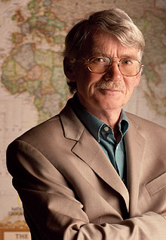
Michael Mann
Sources of Social Power

Slide 17
IEMP MODEL
ideological – control claims of meaning
Rome: e.g. senatorial order controlled state religion
(e.g. conducting divination, interpretation of
Sibylline books, holding priesthoods
economic – control the extraction, transformation,
distribution and consumption of goods
Rome: e.g. senatorial order controlled land distribution,
equestrian order controlled trade and public contracts
military – control the legitimate mobilization of the state’s violence
Rome: e.g. senatorial order led military
political – centralized, institutionalized, territorialized regulation
Rome: e.g. senatorial order held near monopoly on
highest magistracies

Slide 18
ROMAN ARMY
MILITARY POWER
magistrates (generals) with imperium, limited term
seasonal fighting, enrolled those meeting property qualifications
legions (before 100 BCE)
ca.4800 men
ranks of light infantry (hastati)
ranks of heavy infantry (principes)
ranks of veteran infantry (triarii)
adapted foreign tactics and weapons
vs. Samnites and Pyrrhus (300s-200s)
vs. Hannibal and Iberians (Spanish, 200s-100s)
Marian reforms (ca.100) – enrolled lowest census classifications
professional army, drill & discipline
Marius’ mules – non-military equipment
after Augustus – soldiers given pay rather than land

Slide 19
ROMAN ARMY
POLITICAL POWER
rank (census classis) – military/social rank dependent on wealth
Assembly of Centuries – chief lawmaking body, military organization
magistrates (cursus honorum) – elective military posts with additional civil responsibilities
military tribune – lieutenant
quaestor – quartermaster/paymaster
praetor – general with imperium
consul – commander-in-chief, with imperium

Slide 20
ROMAN ARMY
ECONOMIC POWER
Marius’ mules
The footmen are armed with breastplates and headpieces, and have swords on each side; but the sword that is upon their left side is much longer than the other, for that on the right side is not longer than a span. Those foot-men also that are chosen out from the rest to be about the general himself have a lance and a buckler, but the rest of the foot soldiers have a spear and a long buckler, besides a saw and a basket, a pick-axe and an axe, a thong of leather and a hook, with provisions for three days, so that a footman has no great need of a mule to carry his burdens.
Josephus Jewish Wars III.5.5 [93]
civil engineering
camps > settlements
supply lines > roads

Slide 21
ROMAN ARMY
ECONOMIC POWER
veteran colonia – urbanization, replication of Rome
socii (“allies”) – kept local institutions
municipium – Latin rights

Slide 22
ROMAN ARMY

Slide 23
ROMAN ARMY
ECONOMIC POWER
veteran colonia – urbanization, replication of Rome
socii (“allies”) – kept local institutions
municipium – Latin rights
legionary fortresses – replication of Rome
require provisions, settlements develop alongside

Slide 24
LEGIONARY ECONOMY MODEL
(1) tribute/tax money (coinage) sent from provinces to Rome
(2) money sent from Rome to legions
(3) money from legions used to purchase goods from provinces

Slide 25
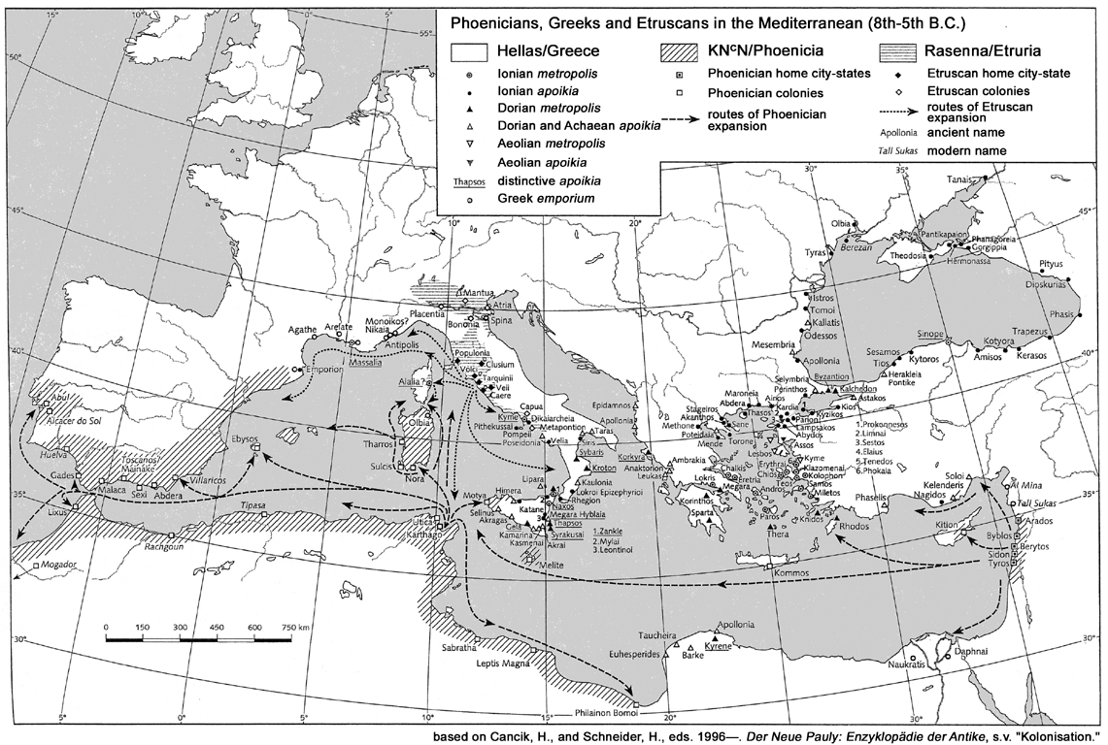
LEGIONARY ECONOMY MODEL
LEGIONS
money
LEGIONS
money
GAUL
(NARBO)
LEGIONS
money
money
NEAR
SPAIN
LEGIONS
ASIA
SICILY
AFRICA
SYRIA
LEGION

Slide 26
ROMAN ARMY
IDEOLOGICAL POWER
college of fetials – proper declaration and cessation of war
purification – suovetaurilia (pig, ram, bull) to Mars
initiation of war season; closure of war season
purification of camp/fortresses by commander
augury – commander could take own auspices (read bird signs),
before battle, also accompanied by haruspices (readers of entrails)
evocatio – “call-over” gods of the enemy (Veii, Carthage)
vows – votive offering from victory spoils > temple, forum
religious calendar – fortresses and camps followed festivals of Rome;
on the other hand, no restriction of personal worship;
spread of Mithraism, Sol Invictus

