Slide 1
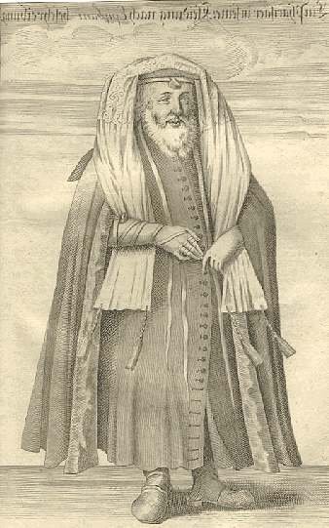
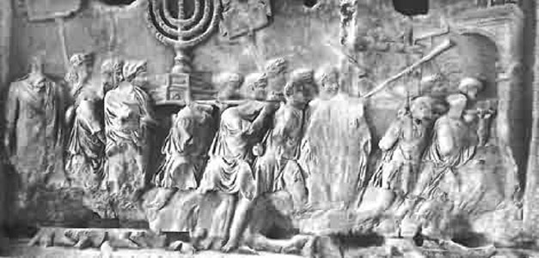
TOLERATION & PERSECUTION, II
• Succession
• Romanization
• Judaism

Slide 2
ROMAN JUDÆA

Slide 3
REVIEW
JULIO-CLAUDIAN DYNASTY
Imp. CAESAR AUGUSTUS 27 BCE – 14 CE
TIBERIUS Caesar Augustus 14-37
• son-in law of A. (married to Julia), son (adopted by A., adoptive father of Germanicus)
CAIUS Caesar Augustus Germanicus (CALIGULA) 37-41
• great-grand nephew of A., adoptive son of Tiberius (son of Germanicus)
Ti. CLAUDIUS Caesar Augustus Germanicus 41-54
• great nephew of A., acclaimed imperator by Praetorian Guard (brother of Germanicus)
Imp. NERO Claudius Caesar Augustus Germanicus 54-68
• great-grand nephew of A., adoptive son of Claudius (grandson of Germanicus)

Slide 4
FLAVIAN DYNASTY
T. Flavius Vespasianus >
Imp. Caesar VESPASIANus Augustus 69-79 CE
• acclaimed imperator by Syrian legions
Imp. TITUS Caesar Vespasianus Augustus 79-81
• inherited
Imp. Caesar DOMITIANus Augustus 81-96
• inherited

Slide 5
IMPERIAL SUCCESSION CRISES • LEGITIMACY
marriage • JULIA to Marcellus > Agrippa > Tiberius
adoption • AUGUSTUS adopts grandchildren, adopts stepson Tiberius
• TIBERIUS adopts Germanicus (over Drusus)
• CLAUDIUS adopts Nero (over Britannicus)
acclamation • PRAETORIAN GUARD acclaims imperator (e.g. Claudius)
• LEGIONS acclaim imperator (e.g. Vespasian, Elagabalus)
hereditary • sons INHERIT title from father (e.g. Titus, Domitian)

Slide 6
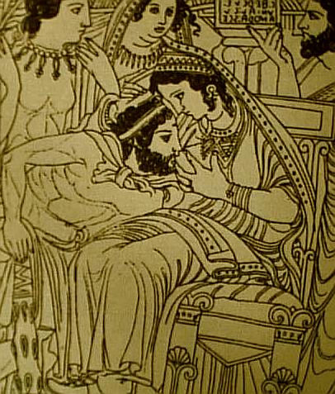
ROMANIZATION
• Religion
SYNCRETISM
Uni-Juno nursing Hercle-Hercules
Etruscan mirror

Slide 7
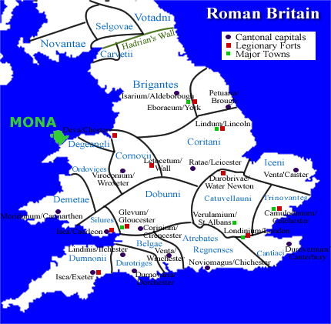
ROMANIZATION
• Religion
DRUIDS
Island of Mona (Anglesey)

Slide 8
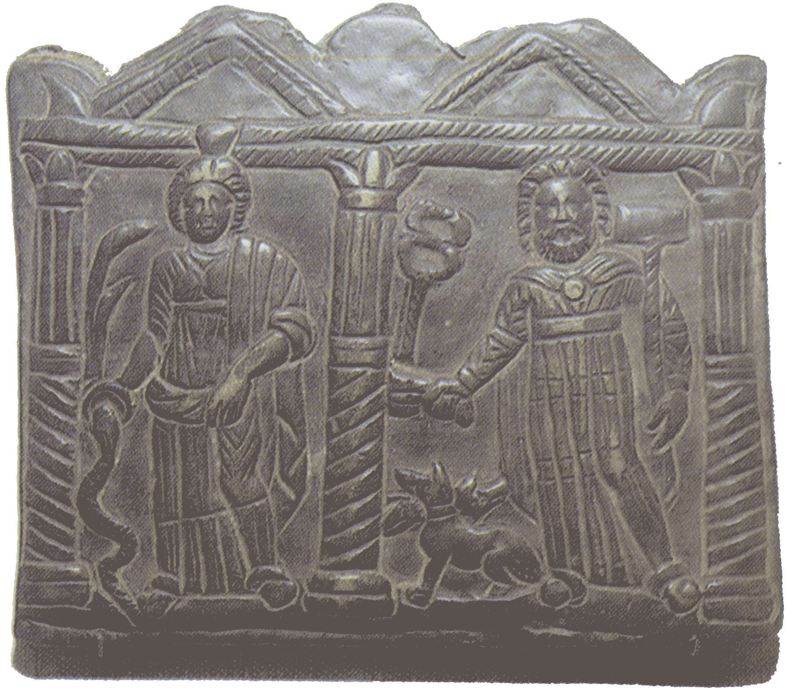
ROMANIZATION
• Religion
• interpretatio Romana — Esus/Teutan = Mercury
• intolerance of superstitio — human sacrifice

Slide 9
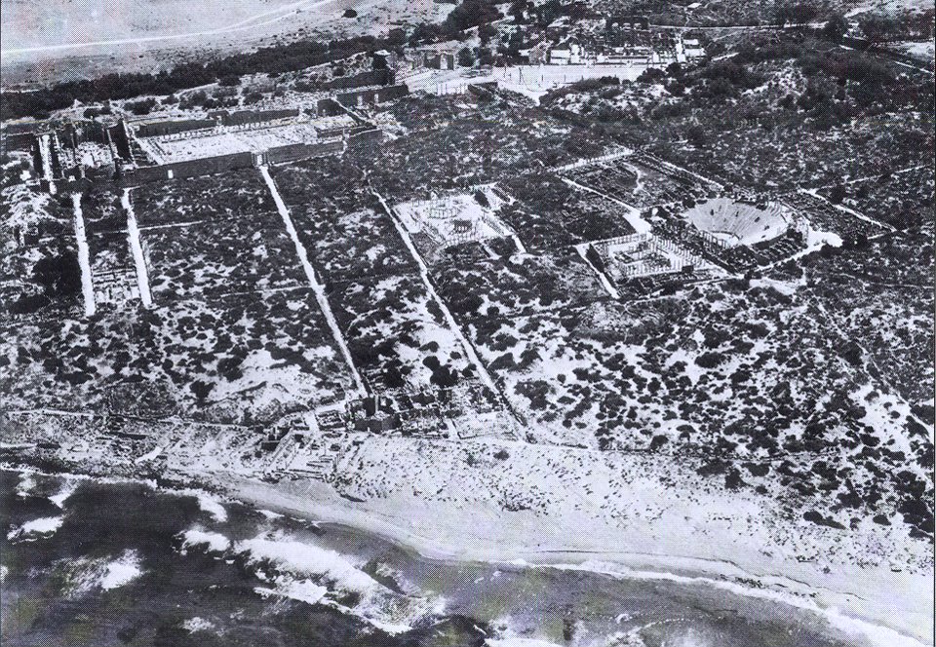
ROMANIZATION
Leptis Magna

Slide 10
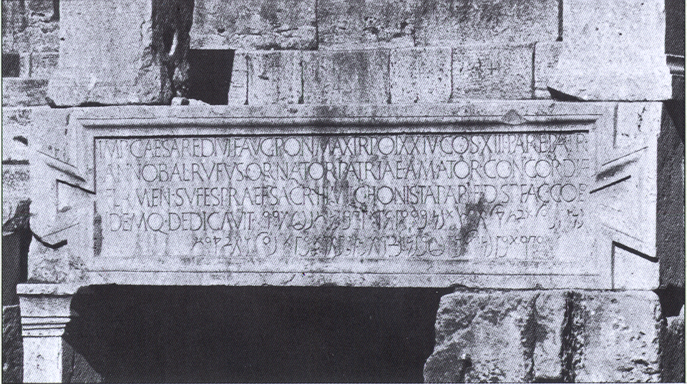
ROMANIZATION • North Africa
Leptis Magna—Latin/Neopunic bilingual dedication

Slide 11
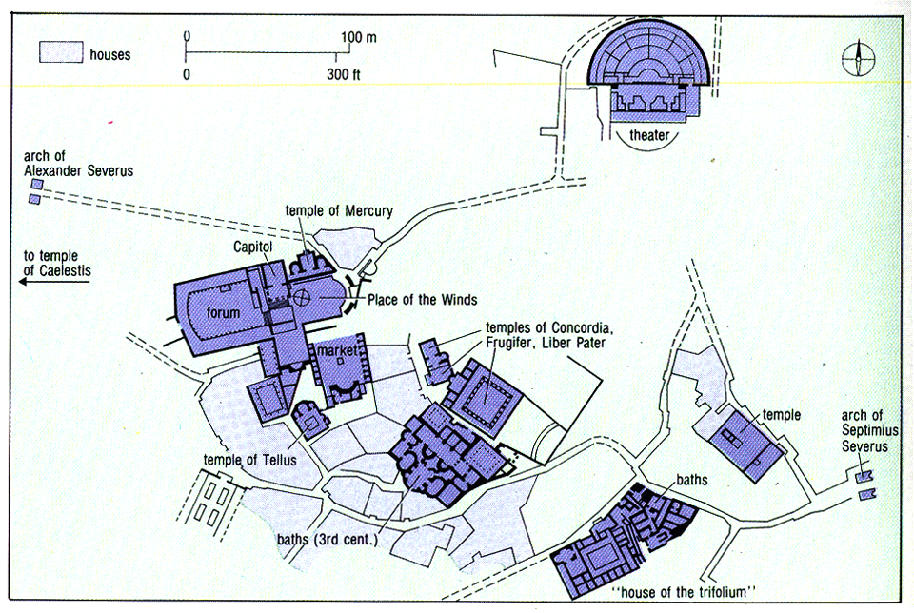
ROMANIZATION
Numidian Dougga
organic (non-grid) plan

Slide 12
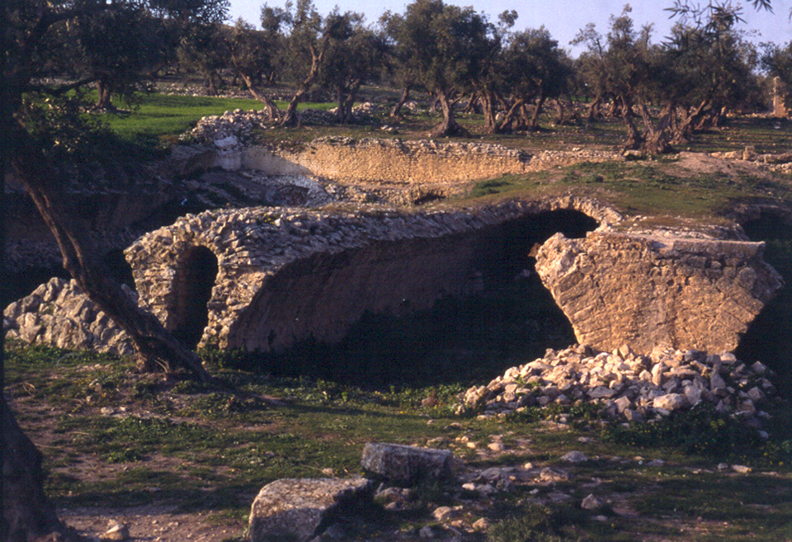
ROMANIZATION
Dougga—water storage

Slide 13
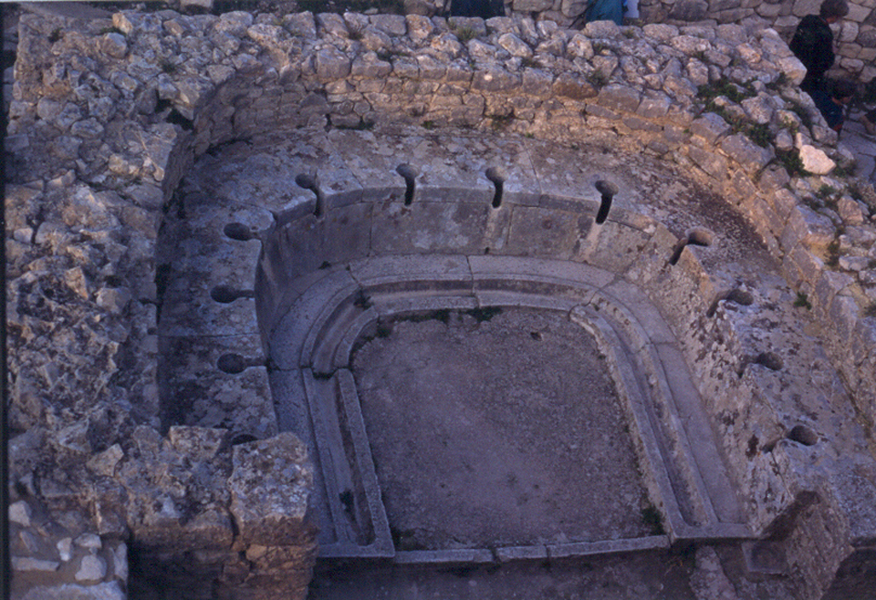
ROMANIZATION
Dougga—sanitation

Slide 14
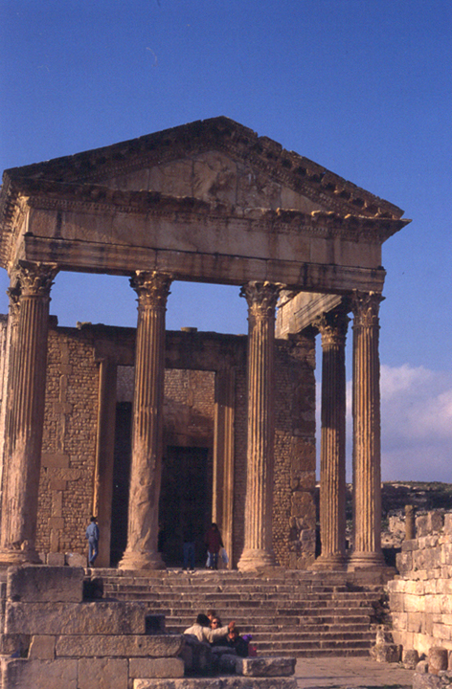
ROMANIZATION
religio
Dougga, Capitoline Triad
• apotheosis of divus Antoninus Pius
• safety of M. Aurelius and L. Verus
interpretatio Romana
Ba’al-Saturnus
Tinnit-Juno Caelestis
intolerance of superstitio — human sacrifice

Slide 15
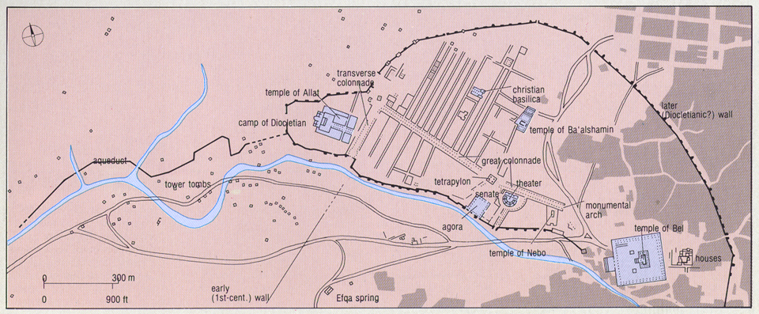
ROMANIZATION • SYRIA
Palmyra

Slide 16
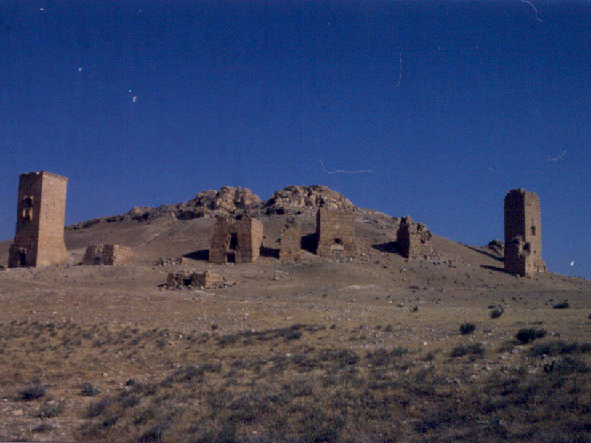
ROMANIZATION
Palmyra—tower tombs

Slide 17
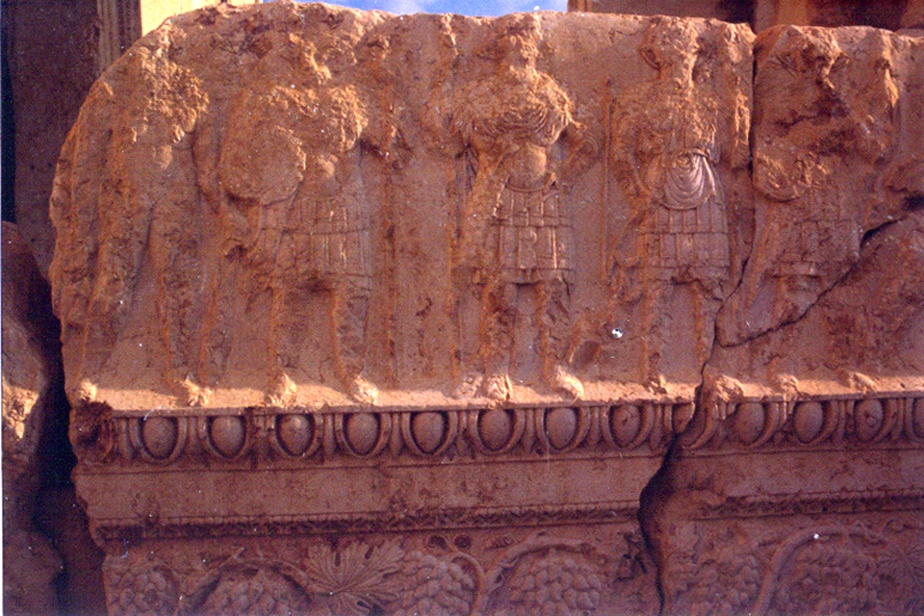
ROMANIZATION
Palmyra—Roman soldiers, frieze, Temple of Bel

Slide 18
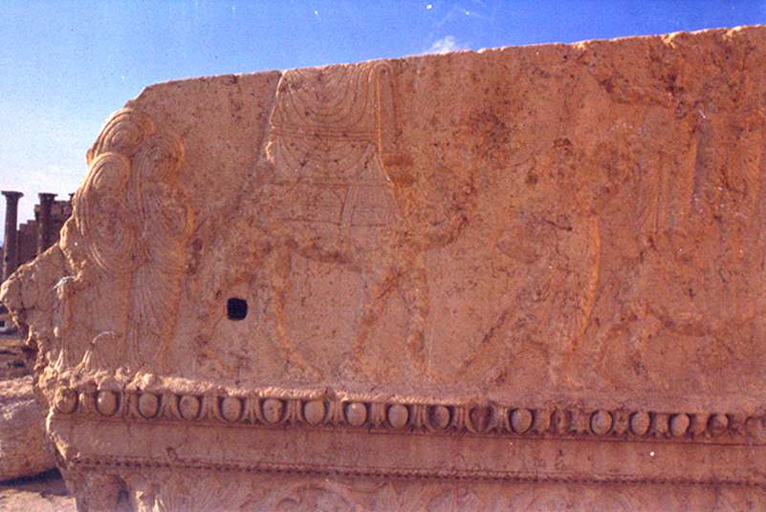
ROMANIZATION
Palmyra—women in caravan, frieze, Temple of Bel
Heliopolis (Ba’albek), non-standard Capitoline triad
Jupiter-Ba’al, Venus-Atargatis, Mercury

Slide 19
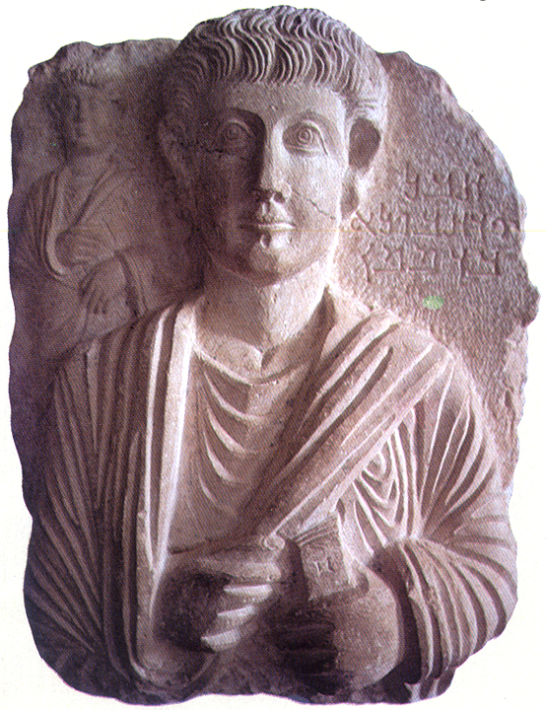
ROMANIZATION
Palmyra—Palmyrene Aramaic

Slide 20
ROMANIZATION

Slide 21
REVIEW / SUMMARY
ROMANIZATION
criteria
putative descent
Romulus, Aeneas (usurped by Julio-Claudian emperors)

Slide 22
REVIEW / SUMMARY
ROMANIZATION
indicia
dress
toga
Latin language
nomenclature tria nomina
law, military, imperial administration
religion
interpretatio Romana - syncretism of religio (not superstitio)
Capitoline triad
imperial cult & cult of Roma
religious calendar
institutions
municipium/colonia modeled on Rome
IIvir (duovir, “two men” = consuls), Senate, assembly
theater (Greco-Roman)
amphitheater (gladiatorial games)
circus (horse races)
bath (aqueducts)
forum (markets, courts)
legion

Slide 23
RELIGIOUS (IN)TOLERANCE
Vegetarianism
ORPHISM – mythical bard Orpheus and his descent into the Underworld
initiation into mysteries
PYTHAGOREANS – Pythagoras of Samos (ca.580-500 BCE)
migrates to Croton in Southern Italy
ascetic, strict rules of conduct, vegetarianism
mathematics (Pythagorean theorem), natural philosophy
transmigration of souls
religious festivals – feast days, animal sacrifice and communal meal
of meat, central act of civic religion and social cohesion
vegetarians refused to participate in state feasts (could consume kin)
depicted as atheism

Slide 24
RELIGIOUS (IN)TOLERANCE
M. Tullius CICERO Against Vatinius 14
PYTHAGOREANS conceal monstrous depraved and foreign (barbari) customs
e.g. offer sacrifices with the entrails of children
• invent where one can not witness
• excessive religiosity (superstitio) > capacity to partake in abhorrent acts

Slide 25
RELIGIOUS (IN)TOLERANCE
Dec. Junius JUVENALis Satires 15
But these days, there is more harmony among snakes. The wild beasts with similar spots spares its relatives. Have you ever heard of a stronger lion robbing another lion of life? Or of a forest where a boar breathed its last under the tusks of a greater boar? The Indian tigress lives with frenzied tigress in everlasting peace. Savage bears agree among themselves. But for human beings it is not enough to have beaten out on the wicked anvil, although the first blacksmiths spent their time and effort on forging rakes and hoes and mattocks and ploughshares only. They didn’t know how to produce swords. We are looking at peoples whose anger is not satisfied by killing someone but who think his torso, arms and face are a kind of food. What, then, would Pythagoras say? Wouldn’t he run off, anywhere, if he now saw these horrors? Pythagoras was the one who abstained from eating all living things as if they were human and who didn’t treat his belly to every kind of bean.
idyllic (noble) vs. feral (savage)

Slide 26
RELIGIOUS (IN)TOLERANCE
BACCANALIA, 186 BCE
covert, nocturnal (no witnesses)
sexual excess, violence (human sacrifice), treachery
human sacrifice > consumption of entrails > conspiratorial oaths (Catiline)

Slide 27
RELIGIOUS (IN)TOLERANCE
Jews practice novel rites antithetical to Roman norms (novi ritus contrarii)
• hold the sacred (traditional Roman religion) as profane
• worship one deity (Saturn)
• worship a golden ass’ head (Egyptian theriolatry, “animal-worship”)
• take their meals apart, sleep apart
• refrain from sex with women outside their group, yet exhibit excessive lust (libido) within their group
P. Cornelius Tacitus Histories V.4
Flavius Josephus Against Apion I.223-226

Slide 28
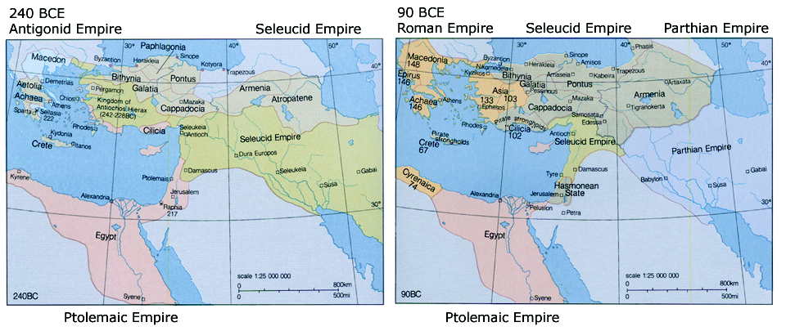
HASHMONEAN KINGDOM OF JUDÆA 165 BCE—63 CE
COELE
“HOLLOW”
SYRIA
JUDÆA

Slide 29
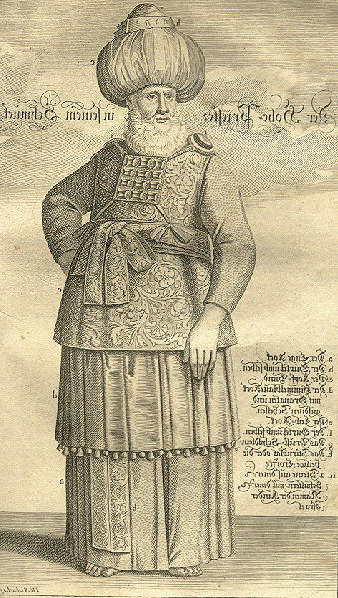
High Priest (sanhedrin) Pharisee

Slide 30
JEWISH POLITICAL/RELIGIOUS SECTS
Pharisees
exact interpretation of Jewish law,
study of the Torah in Hebrew; believe in Fate and resurrection of the dead
Sadducees
denied existence of afterlife,
embraced Hellenism
Essenes
ascetic communities, no marriage,
mystical and messianic
Sicarii
Zealots, assassins
Pharisee

Slide 31
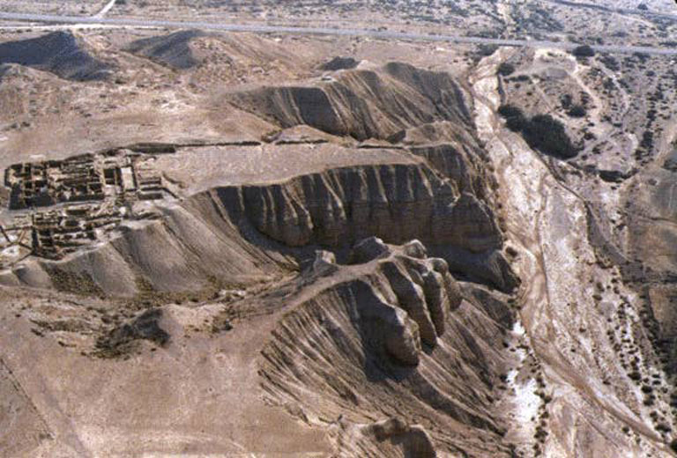
Khirbet Qumran

Slide 32
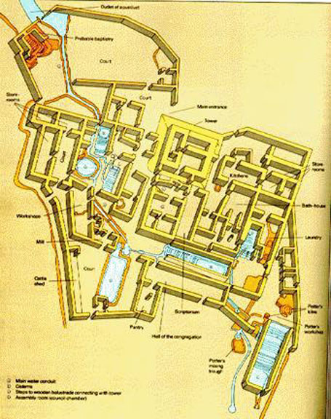
Khirbet Qumran

Slide 33
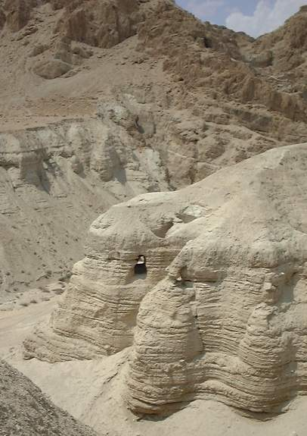
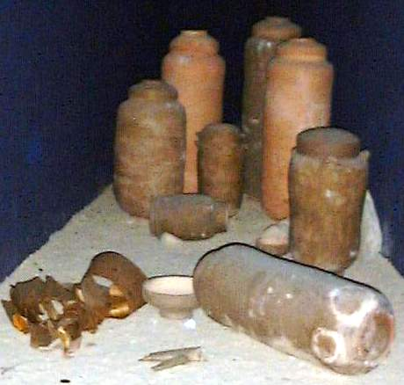
Khirbet Qumran-Dead Sea Scrolls

Slide 34
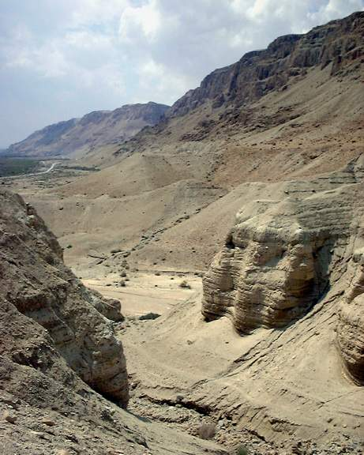
MUSEUM OF THE BIBLE
never pay to visit! why? owned by the Hobby Lobby
• Burwell v. Hobby Lobby
Supreme Court decision allows private companies evade regulation that conflict with religious belief, e.g. providing
birth control
• COVID-19
refused to close stores due to message from God received by founder’s wife
illicit trade in antiquities • clay tablets w/o provenance
• Dead Sea Scrolls w/o provenance
www.nationalgeographic.com/history/2020/03/museum-of-the-bible-dead-sea-scrolls-forgeries/
Khirbet Qumran—caves

Slide 35
REVIEW • FADING SELEUCIDS
Antiochus III the Great • Syrian Wars, 192-188 BCE
last Macedonian kingdom to threaten Rome
Antiochus IV Epiphanes (“Illustrious”), basileus 175-164 188-187 • hostage in Rome
175 • usurps throne with Roman assistance
170 • campaigns against Ptolemy VI Philometor (age 6)
and his mother Cleopatra I Syra
168 • declared basileus of Egypt
168 • met by C. Popillius Laenas outside Alexandria
When the king had read (the decree of the Roman Senate), he said he
wanted to consult with his advisors on these new developments, but
Popillius did something in reply which seemed insolent and arrogant in
the highest degree. With a vine stick which he had in his hand he drew
a circle around Antiochus and told him to give his reply to the message
before he stepped outside of the circle. The king was astounded at this
arrogance. After hesitating for a moment, he said that he would do
everything the Romans asked of him. Polybius 29.27

Slide 36
HASHMONEAN KINGDOM OF JUDÆA 165 BCE—63 CE
Antiochus III the Great • Syrian Wars, 192-188 BCE
last Macedonian kingdom to threaten Rome
Antiochus IV Epiphanes • hostage in Rome 188-178 BCE
temple, toga, gladiators, flattering embassies
attempts invasions of Egypt 170-168 BCE
Hellenization • paideia (greek education)
• gymnasium (nude exercise, reverse circumcision)
• diaspora communities • Greek speaking
• translation of Hebrew Bible • Septuagint (LXX)
Antiochus IV Epiphanes • bans circumcision
• syncretizes worship of YHWH as Zeus (Jupiter)
REVOLT OF THE MACCABEES
JUDAS MACCABEUS (“the Hammer,” 165-160), descendant of Simeon (Hashmonean)
• treaty of friendship and alliance with Rome

Slide 41
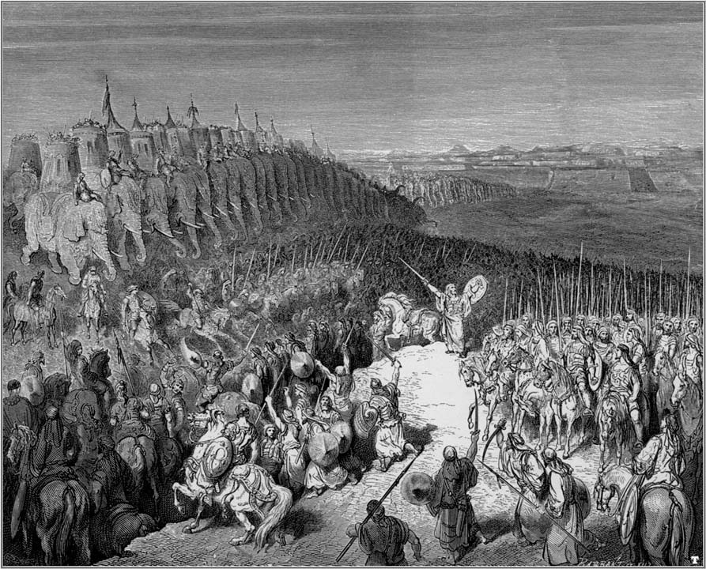
Judas Maccabeus (“the Hammer”)

Slide 42
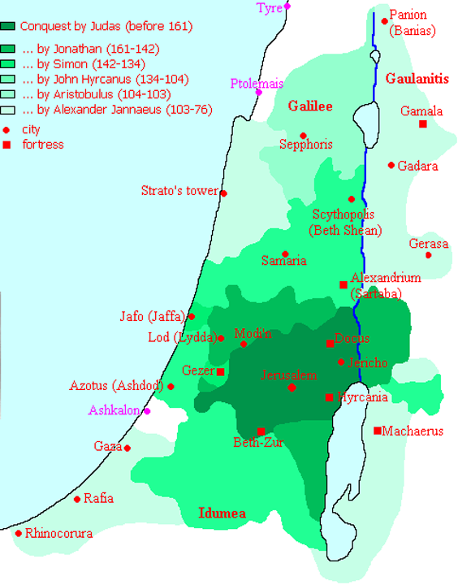

Slide 43
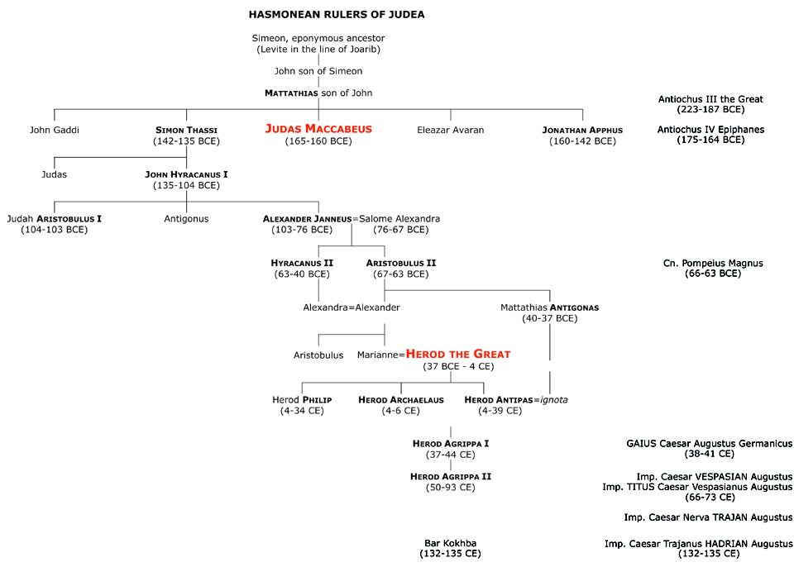

Slide 44
RELIGIOUS (IN)TOLERANCE
Revolt of the Maccabees vs. ANTIOCHUS IV Epiphanes (165 BCE)
A certain Apion reported that when the troops of Antiochus overran the
Temple in Jerusalem, they found a Greek imprisoned within, being fed
dainties; the captive explained that the Jews would annually capture a
foreigner, fatten him up, lead him to a sacred grove, swear an oath
against Greeks as they ate the entrails.
Flavius Josephus Against Apion II.223-226
human sacrifice > consumption of entrails > conspiratorial oaths (Catiline)

Slide 45
RELIGIOUS (IN)TOLERANCE
ANTIOCHUS IV, 165 BCE
forbids circumcision, convert Temple to worship of Zeus

Slide 46
RELIGIOUS (IN)TOLERANCE
ANTIOCHUS IV, 165 BCE
forbids circumcision, convert Temple to worship of Zeus
AUGUSTUS CAESAR, 27 BCE-14 CE
ancient ethnic customs preserved and confirmed (Philo 23)
manumitted Jewish Roman citizens allowed to worship
in Roman synagogues, send tithe to Jerusalem,
receive grain outside Sabbath

Slide 47
RELIGIOUS (IN)TOLERANCE
ANTIOCHUS IV, 165 BCE
forbids circumcision, convert Temple to worship of Zeus
AUGUSTUS CAESAR, 27 BCE-14 CE
ancient ethnic customs preserved and confirmed (Philo 23)
manumitted Jewish Roman citizens allowed to worship in
Roman synagogues, send tithe to Jerusalem, receive
grain outside Sabbath
TIBERIUS, 14-37
suppressed Egyptian, Jewish cults, and astrologers
due to advice of praetorian prefect Sejanus (Philo 24)
respected ancient ethnic customs (Philo 24-25)

Slide 48
RELIGIOUS (IN)TOLERANCE
ANTIOCHUS IV, 165 BCE
forbids circumcision, convert Temple to worship of Zeus
AUGUSTUS CAESAR, 27 BCE-14 CE
ancient ethnic customs preserved and confirmed (Philo 23)
manumitted Jewish Roman citizens allowed to worship in
Roman synagogues, send tithe to Jerusalem, receive
grain outside Sabbath
TIBERIUS, 14-37
suppressed Egyptian, Jewish cults, and astrologers
due to advice of praetorian prefect Sejanus (Philo 24)
respected ancient ethnic customs (Philo 24-25)
CAIUS (CALIGULA), 37-41
insulted HEROD AGRIPPA I, rioting in Alexandria, 38 CE
shift in respect for ancient ethnic customs > imperial cult in Temple

Slide 49
HERODEAN KINGDOM OF JUDÆA 37—93 CE
Herod the Great (37 BCE-4 CE), outsider (Idumean),
set sons of Hashmonean house to Rome
builds Caesarea Maretima
Herod Agrippa I (37-44 CE) – playmate of CAIUS (Caligula)
Caius attempts installation of emperor cult and Capitoline Triad at Temple;
embassy of Philo of Alexandria from diaspora community
revolt averted by death of Caius

Slide 50
RELIGIOUS (IN)TOLERANCE
ANTIOCHUS IV, 165 BCE
forbids circumcision, convert Temple to worship of Zeus
AUGUSTUS CAESAR, 27 BCE-14 CE
ancient ethnic customs preserved and confirmed (Philo 23)
manumitted Jewish Roman citizens allowed to worship in
Roman synagogues, send tithe to Jerusalem, receive
grain outside Sabbath
TIBERIUS, 14-37
suppressed Egyptian, Jewish cults, and astrologers
due to advice of praetorian prefect Sejanus (Philo 24)
respected ancient ethnic customs (Philo 24-25)
CAIUS (CALIGULA), 37-41
insult to HEROD AGRIPPA I, rioting in Alexandria, 38 CE
shift in respect for ancient ethnic customs > imperial cult in Temple
CLAUDIUS, 41-54
expelled Jews from Rome, agitated by Chrestos (Suet.Claud.24)
demanded tolerance in Alexandria

Slide 51
RELIGIOUS (IN)TOLERANCE
ANTIOCHUS IV, 165 BCE
forbids circumcision, convert Temple to worship of Zeus
AUGUSTUS CAESAR, 27 BCE-14 CE
ancient ethnic customs preserved and confirmed (Philo 23)
manumitted Jewish Roman citizens allowed to worship in
Roman synagogues, send tithe to Jerusalem, receive
grain outside Sabbath
TIBERIUS, 14-37
suppressed Egyptian, Jewish cults, and astrologers
due to advice of praetorian prefect Sejanus (Philo 24)
respected ancient ethnic customs (Philo 24-25)
CAIUS (CALIGULA), 37-41
insult to HEROD AGRIPPA I, rioting in Alexandria, 38 CE
shift in respect for ancient ethnic customs > imperial cult in Temple
CLAUDIUS, 41-54
expelled Jews from Rome, agitated by Chrestos (Suet.Claud.24)
demanded tolerance in Alexandria
NERO, 54-68
First Jewish War (66-73 CE), general T. Flavius VESPASIANus

Slide 52
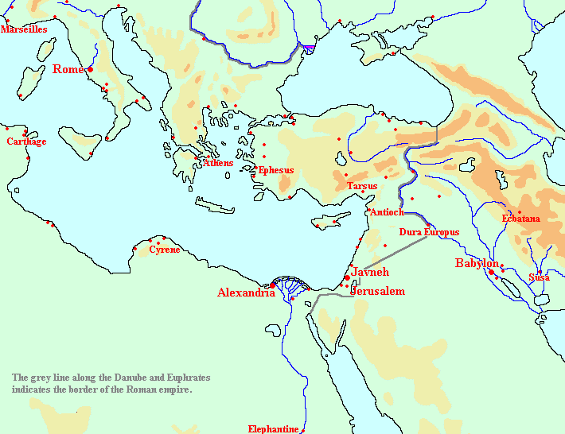
RELIGIOUS (IN)TOLERANCE
Kitos War, 115-117 CE (Second Jewish War)
reign of M. Ulpius Nerva TRAIANus—diaspora communities
of Cyrene, Egypt, Cyprus, Mesopotamia
L. QUIETUS sent to suppress revolt

Slide 53
RELIGIOUS (IN)TOLERANCE
Kitos War, 115-117 CE (Second Jewish War)
reign of M. Ulpius Nerva TRAIANus—diaspora communities
of Cyrene, Egypt, Cyprus, Mesopotamia
L. QUIETUS sent to suppress revolt
Bar Kokhba Revolt, 132-135 CE (Third Jewish War)
reign of Hadrian – plans to rebuild Jerusalem as Aelia Capitolina
forbids circumcision; new Temple dedicated to the Capitoline triad
and imperial cult
Simon Bar Kokhba leads revolt
destruction of Jerusalem, population killed, dispersed, enslaved

Slide 54
ROMAN ARMY & ROMANIZATION
auxiliary contingents – rewarded with citizenship
take on name (tria nomina) of patron

Slide 55
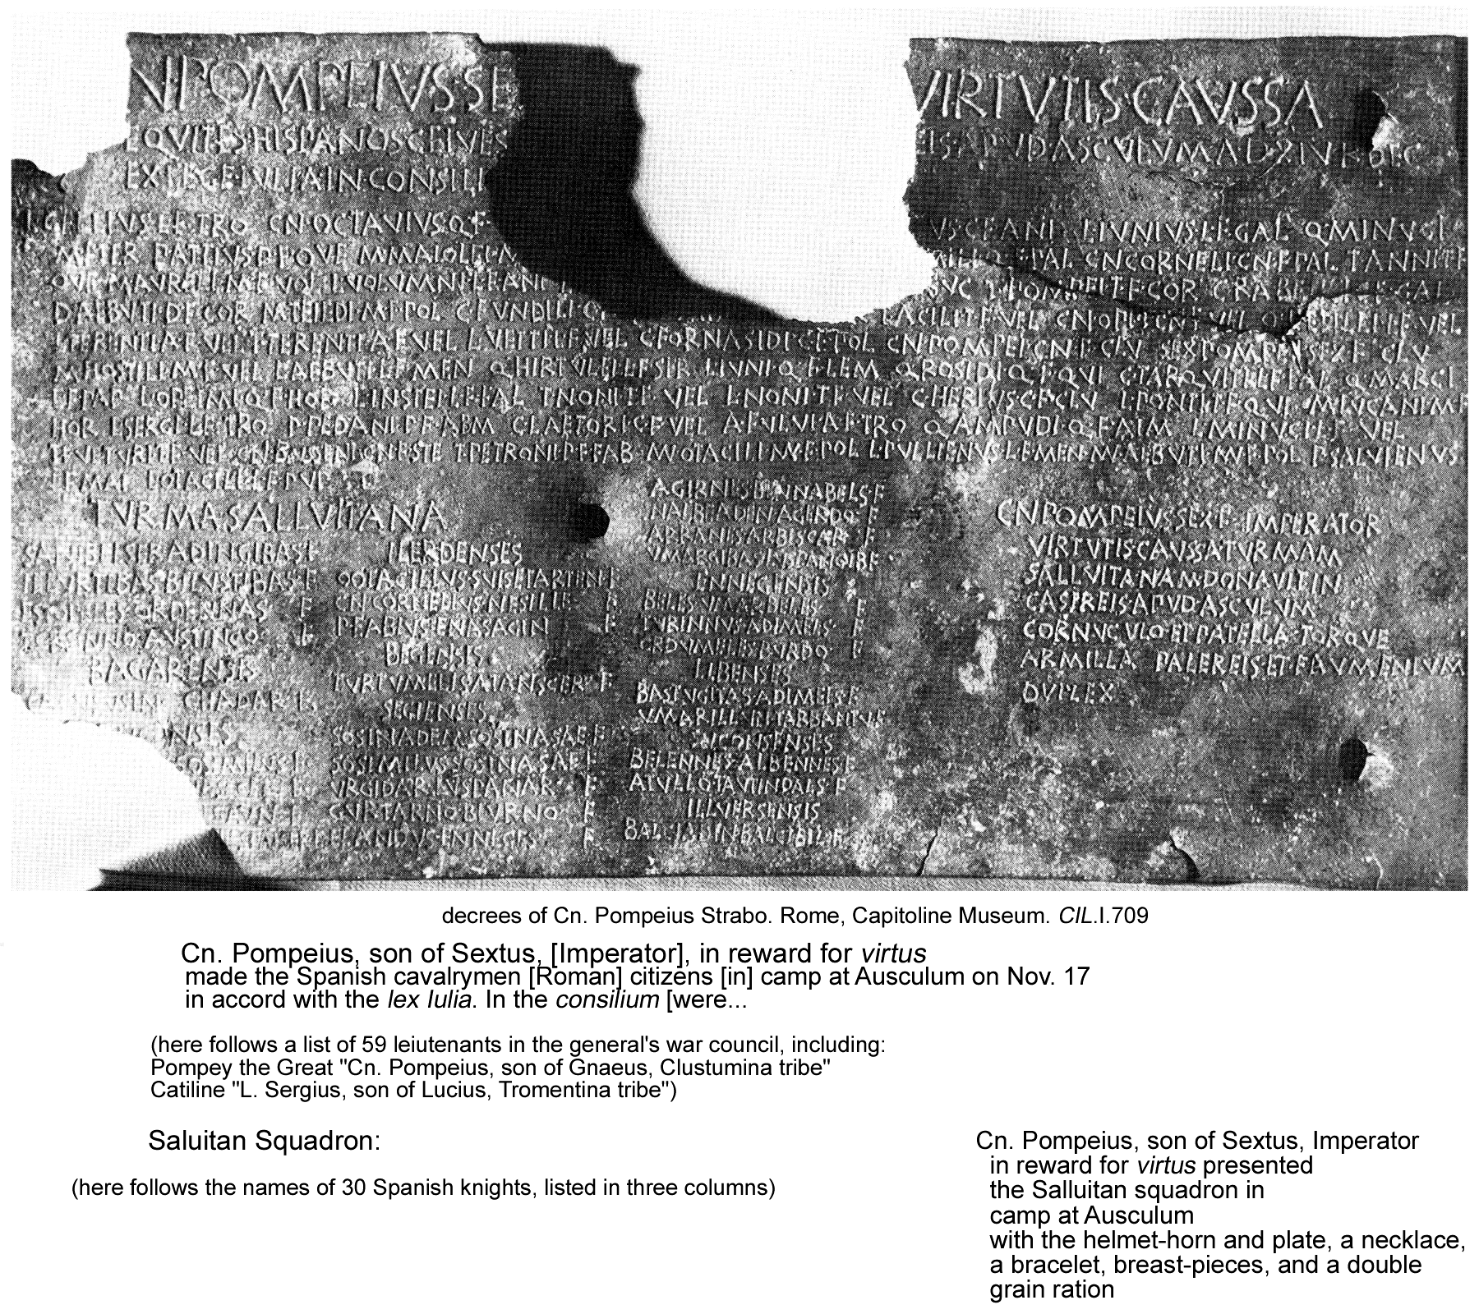
ROMAN ARMY & ROMANIZATION

Slide 56
ROMAN ARMY & ROMANIZATION
auxiliary contingents – rewarded with citizenship
take on name (tria nomina) of patron
Jugurtha
leads Numidian auxiliaries at siege of Numantia (Spain)
Roman client king, defies Rome, 112-105 BCE
vs. Q. Caecelius Metellus and C. Marius

Slide 57
ROMAN ARMY & ROMANIZATION
auxiliary contingents – rewarded with citizenship
take on name (tria nomina) of patron
Jugurtha
leads Numidian auxiliaries at siege of Numantia (Spain)
Roman client king, defies Rome, 112-105 BCE
Arminius (“Hermann the German”)
leads German auxiliaries, becomes Roman citizen
defies Rome • Teutoburg Forest, 9 CE
vs. P. Quinctilius Varus

Slide 58
ROMAN ARMY & ROMANIZATION
auxiliary contingents – rewarded with citizenship
take on name (tria nomina) of patron
Jugurtha
leads Numidian auxiliaries at siege of Numantia (Spain)
Roman client king, defies Rome, 112-105 BCE
Arminius (“Hermann the German”)
leads German auxiliaries, becomes Roman citizen
defies Rome • Teutoburg Forest, 9 CE
C. Julius Florus and C. Julius Sacrovir
lead Gallic auxiliaries, become Roman citizens
defy Rome • Gallic Revolt, 21 CE
take as hostages the sons of Gallic chieftains pursuing a Roman
education; claim victory over “enslavement” by Rome
Tacitus Annals III.41.3

Slide 59
ROMAN ARMY & ROMANIZATION
auxiliary contingents – rewarded with citizenship
take on name (tria nomina) of patron
Jugurtha
leads Numidian auxiliaries at siege of Numantia (Spain)
Roman client king, defies Rome, 112-105 BCE
Arminius (“Hermann the German”)
leads German auxiliaries, becomes Roman citizen
defies Rome • Teutoburg Forest, 9 CE
C. Julius Florus and C. Julius Sacrovir
lead Gallic auxiliaries, become Roman citizens
defy Rome • Gallic Revolt, 21 CE
C. Julius Vindex and C. Julius Civilis
lead Gallic auxiliaries, become Roman citizens (senator’s son!)
defy Rome • Batavian Revolt, 68-70 CE
in the Year of Four Emperors

Slide 60
ROMAN ARMY & ROMANIZATION
auxiliary contingents – rewarded with citizenship
take on name (tria nomina) of patron
Jugurtha
leads Numidian auxiliaries at siege of Numantia (Spain)
Roman client king, defies Rome, 112-105 BCE
Arminius (“Hermann the German”)
leads German auxiliaries, becomes Roman citizen
defies Rome • Teutoburg Forest, 9 CE
C. Julius Florus and C. Julius Sacrovir
lead Gallic auxiliaries, become Roman citizens
defy Rome • Gallic Revolt, 21 CE
C. Julius Vindex and C. Julius Civilis
lead Gallic auxiliaries, become Roman citizens (senator’s son!)
defy Rome • Gallic Revolt, 68-70 CE
You yourselves often command our legions and govern this (Gaul) and
other provinces. You are in no respect excluded or shut out.
Tacitus Histories IV.74

Slide 61
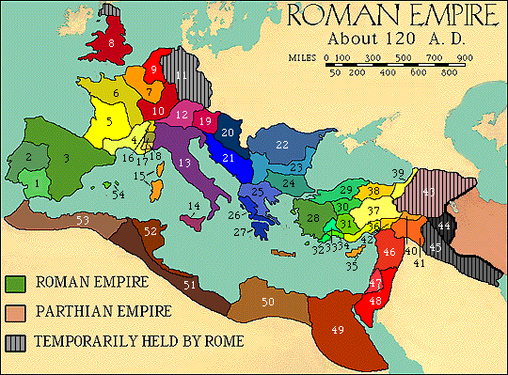
ROMAN ARMY
FREE
CELTS
FREE
GERMANS
CELTS
Gallia
(4-7,16-18)
Brittania (8)
Galatia (30)
GERMANS
Germania
(9-11)
DACIANS
Dacia (22)
PARTHIANS
150BCE-224CE
SASSANID
PERSIANS
226-651CE
DACIANS
PARTHIANS >
SASSANID
PERSIANS

Slide 62
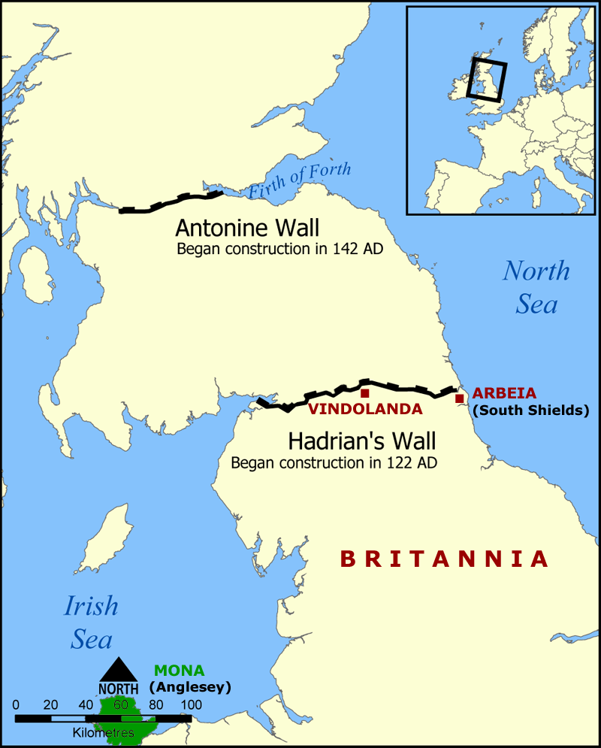
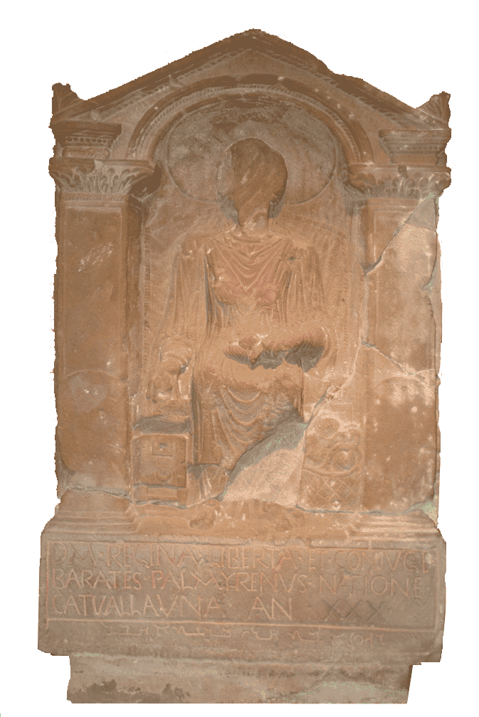
ROMAN ARMY
ROMANIZATION
ARBEIA
Palmyrene inscription

Slide 63
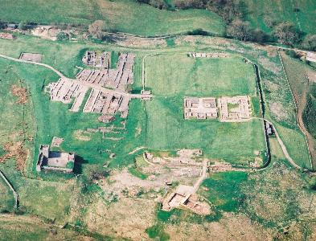
ROMAN ARMY
ROMANIZATION
VINDOLANDA
archive of tablets
• daily life
• auxiliary troops

