Slide 1
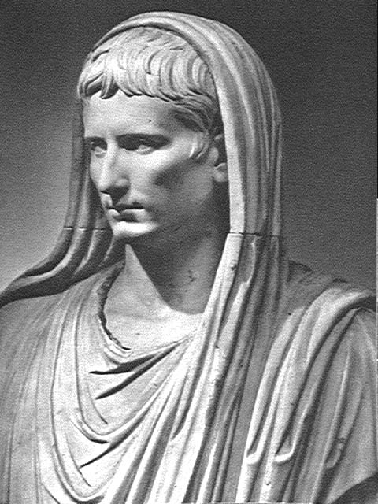
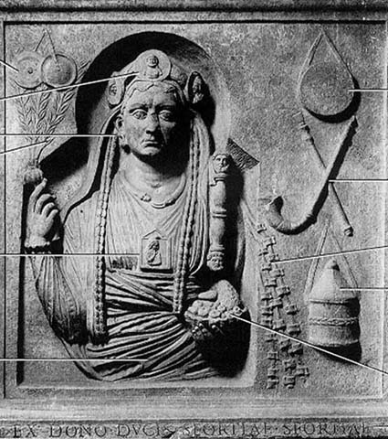
IDEOLOGICAL POWER

Slide 2
EARLY PRINCIPATE
RELIGIO & SUPERSTITIO
• local cult
• imperial cult
• foreign cult

Slide 3
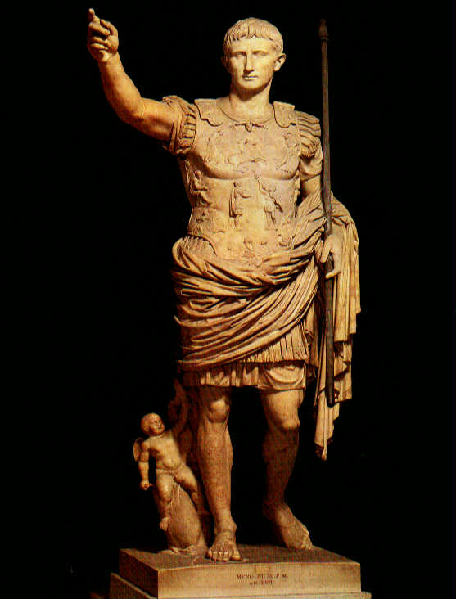
REVIEW
IMPERIAL WOMEN IN THE
HOUSEHOLD OF AUGUSTUS
SCRIBONIA (2nd wife)
• wife, marriage alliance
• mother of Julia the Elder (daughter)
LIVIA (3rd wife)
• wife/advisor, marriage of love
• mother of Tiberius Claudius Nero
and Nero Claudius Drusus (stepsons)
JULIA THE ELDER (daughter)
• wife/prize of M. Marcellus¹ (nephew),
then M. Vipsanius Agrippa² (general
and friend), then Tiberius⁵ Claudius
Nero (stepson, the adoptive son)
• mother of Caius Caesar³, Lucius
Caesar⁴ (adoptive sons), Julia the
Younger, Agrippina the Elder, and
Agrippa Postumus (grandchildren)

Slide 4
The Emperor monopolizes census; legislates morals:
In the consulship of M. Vinucius and Q. Lucretius,
and afterwards in that of P. and Cn. Lentulus, and a
third time in that of Paullus Fabius Maximus and Q.
Tubero, when the Senate and the Roman people
unanimously agreed that I should be elected
overseer of laws and morals (i.e. censor), without a colleague and
with the fullest power, I refused to accept any power
offered me which was contrary to the traditions of
our ancestors. Augustus Accomplishments 6

Slide 5
P. OVIDius Naso
exiled to Tomis (8-ca.18 CE) Pontic, or Black Sea, island
JULIA the Younger strays from marriage** exiled to Trimerus (8-ca.28 CE) Adriatic island
I sing of safe love, permissible intrigue
And there’ll be no offense (crimen) in my song.
Ovid Ars Amatoria I.1
Two offenses (crimina) ruined me – a poem and an error (carmen et error)
I must remain silent about the second fault:
I’m not important enough to re-open your wound, Caesar,
It’s more than sufficient you should be troubled once.
The first then – that I’m accused of being a teacher
of obscene adultery, by means of a vile poem (carmen)…
Ovid Tristia II.207-212
**mother JULIA the Elder strayed, previously exiled to Pandateria (2 BCE-14 CE) Tyrrhenian islan
**daughter AGRIPPINA the Elder will stray, will also be exiled to Pandateria (29-33 CE)

Slide 6
HISTORY
• organization – annalistic
consular years, AUC (from the foundation)
(AUTO)BIOGRAPHY
• organization – topical
antecedents, birth and childhood,
career, achievements, morals (sex),
appearance, death

Slide 7
HISTORY
• organization – annalistic
consular years, AUC (from the foundation)
• Senatorial, political audience
(AUTO)BIOGRAPHY
• organization – topical
antecedents, birth and childhood,
career, achievements, morals (sex),
appearance, death
• popular entertainment

Slide 8
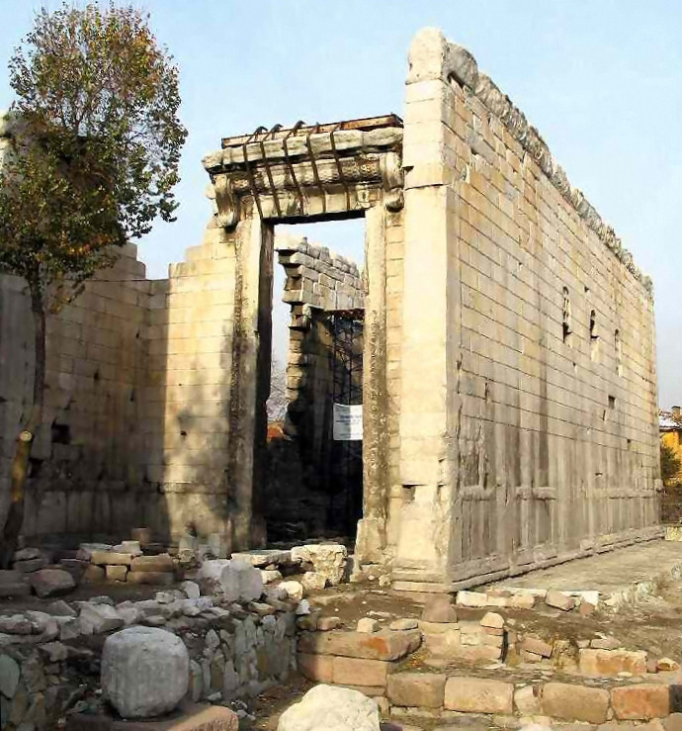
REVIEW
HELLENIZATION & ROMANIZATION
Accomplishments of
the Divine Augustus
(Res Gestae divi Augusti)
Greek and Latin
@ ANCYRA in Galatia

Slide 9
HELLENIZATION & ROMANIZATION
Graecia capta ferum victorem cepit
et artes intulit agresti Latio.
Captive Greece captured the feral victor
and brought the arts into uncultured Latium.
Horace Epistles II.1.156-157
Others will cast more tenderly in bronze
Their breathing figures, I can well believe,
And bring more lifelike portraits out of marble;
Argue more eloquently, use the pointer
To trace the path of heaven accurately
And accurately foretell the rising stars.
Roman remember by your strength to rule
Earth’s peoples—for your arts are to be these:
To pacify, to impose the rule of law,
To spare the conquered, battle down the proud.
Vergil Aeneid VI.847-853 [1145-1154]

Slide 10
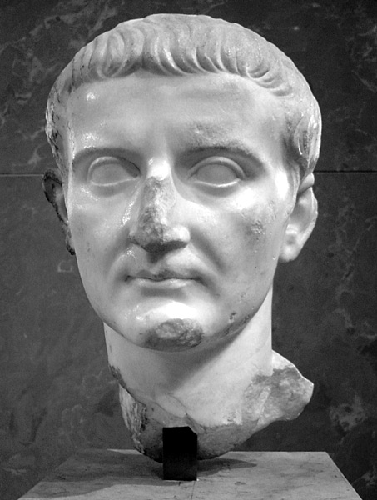
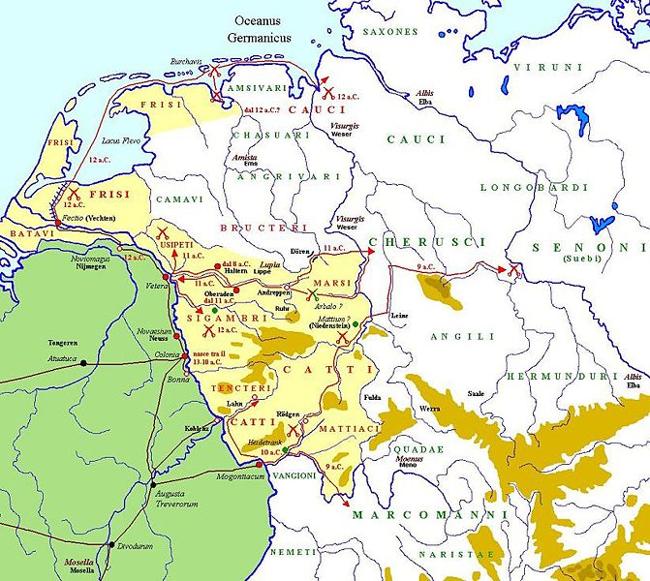
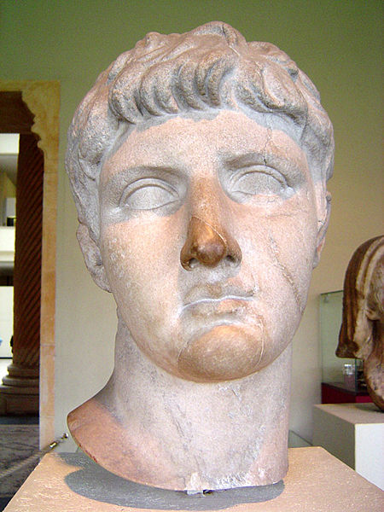
TIBERIUS Claudius Nero
GERMAN CAMPAIGNS • Drusus Germanicus 12-9 BCE
Nero Claudius DRUSUS Germanicus, d. 9 BCE

Slide 11
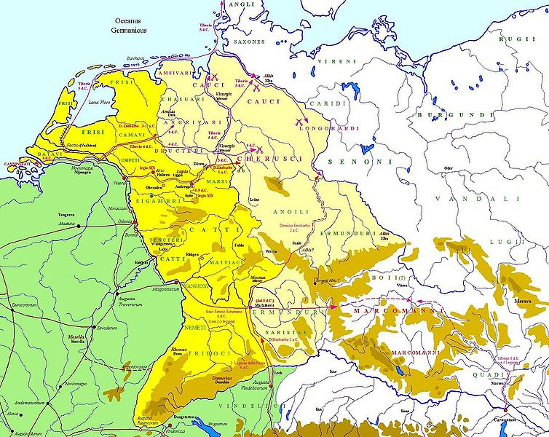
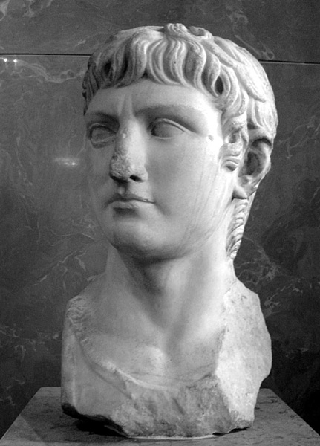
TIBERIUS Claudius Nero
GERMAN CAMPAIGNS • Teutoborg Forest, 9CE
X
P. Quintilius VARUS
vs ARMINIUS (Herman the German)
Nero Claudius Drusus GERMANICUS, d. 19 CE

Slide 12
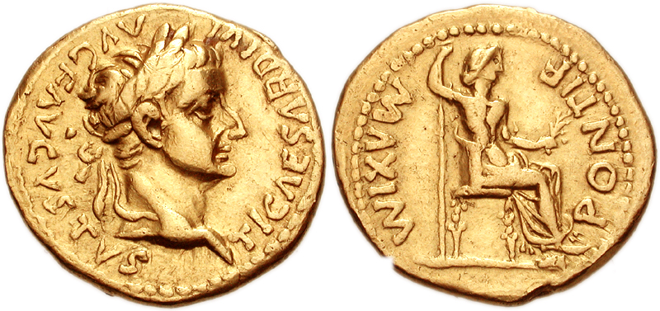
Ti. Claudius Nero > TIBERIUS CAESAR AUGUSTUS, 14-37 CE
IMPERIAL WOMEN IN THE
HOUSEHOLD OF TIBERIUS CAESAR
LIVIA (mother) honored as AUGUSTA
JULIA THE ELDER (2nd wife)
• mother of AGRIPPINA the Elder (wife of Nero
Claudius Drusus GERMANICUS)
The first crime of the new reign was the murder
of Postumus Agrippa (Tiberius’ stepson)…
Tacitus Annales I.6

Slide 13
TIBERIUS CAESAR AUGUSTUS, 14-37 CE
GERMAN CAMPAIGNS • 14-16 CE
Nero Claudius Drusus GERMANICUS, d. 19 CE

Slide 14
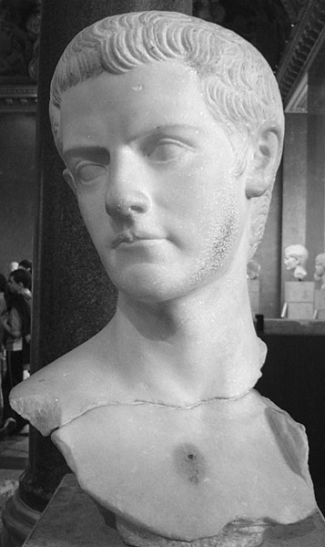
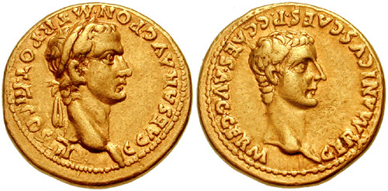
C. Julius Caesar Germanicus > CAIUS CAESAR AUGUSTUS GERMANICUS
(“CALIGULA”), 37-41 CE
IMPERIAL WOMEN IN THE
HOUSEHOLD OF CAIUS CAESAR
AGRIPPINA THE ELDER (mother of Caius)
• wife of Nero Claudius Drusus GERMANICUS
• mother of Julia AGRIPPINA the Younger

Slide 15
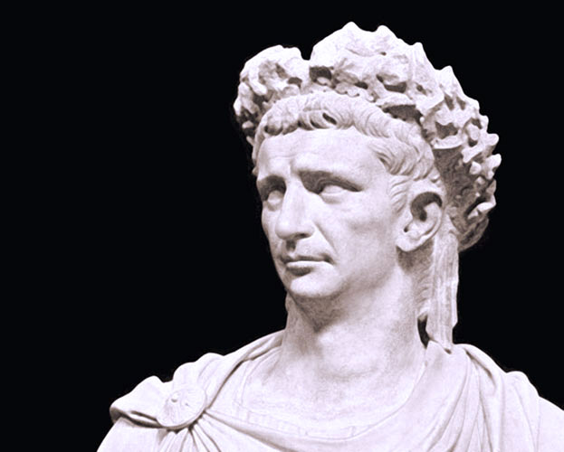
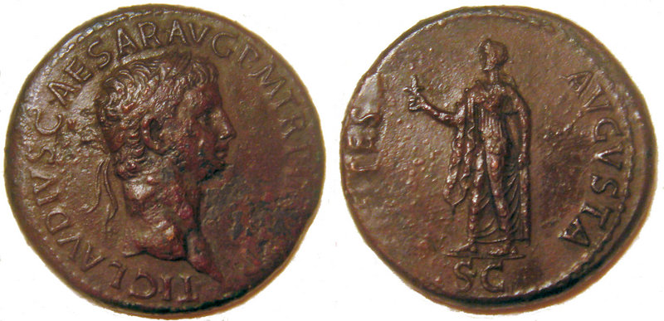
Ti. Claudius Drusus Nero Germanicus > TI. CLAUDIUS CAESAR AUGUSTUS
GERMANICUS, 41-54 CE
IMPERIAL WOMEN IN THE
HOUSEHOLD OF CLAUDIUS CAESAR
AGRIPPINA THE ELDER (mother of Caius & Agrippina)
• sister of CLAUDIUS
JULIA AGRIPPINA THE YOUNGER (niece, his 4th wife)
• wife of Cn. Domitius Ahenobarbus (her 1st husband)
• wife of CLAUDIUS (her 3rd husband)
• mother of L. Domitius Ahenobarbus >
NERO Claudius Caesar Drusus Germanicus

Slide 16
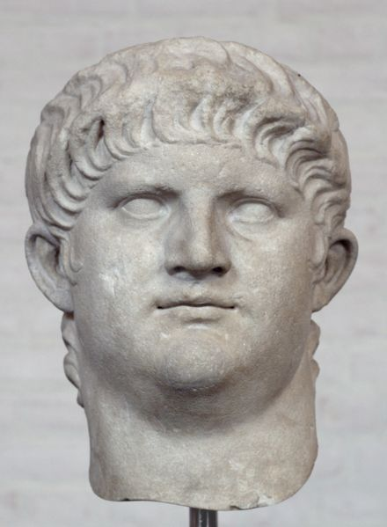
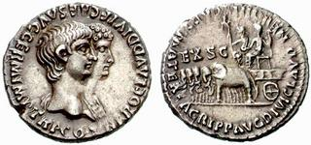
L. Domitius Ahenobarbus > Nero Claudius Caesar Drusus Germanicus >
IMP. NERO CLAUDIUS CAESAR AUGUSTUS GERMANICUS, 54-68 CE
IMPERIAL WOMEN IN THE
HOUSEHOLD OF NERO CLAUDIUS CAESAR
JULIA AGRIPPINA THE YOUNGER (mother)
OCTAVIA (1st wife)
• daughter of CLAUDIUS
POPPAEA SABINA (2nd wife)
• former wife of M. Salvius OTHO
Nero and Agrippina the Younger

Slide 17
ROMAN RELIGION
RELIGION OF PLACE
THE HOME
household gods (lares & penates)

Slide 18
ROMAN RELIGION
RELIGION OF PLACE • pomerium (sacred boundary)
pomerium
Servian Wall

Slide 19
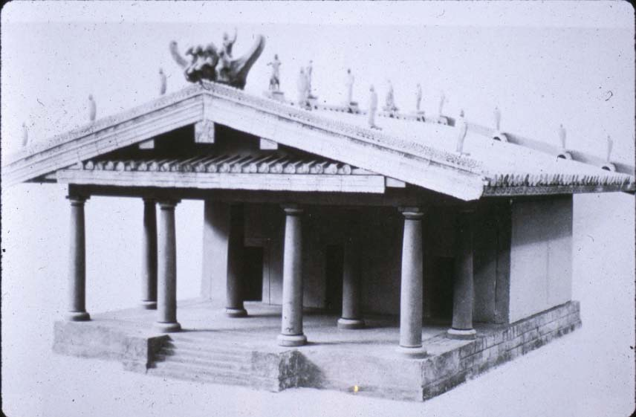
ROMAN RELIGION
RELIGION OF PLACE
THE CITY – CAPITOLINE TRIAD
TINIA-UNI-MENVRA > JUPITER-JUNO-MINERVA (Zeus-Hera-Athena)
Temple of Jupiter Optimus Maximus (ca.500 BCE)

Slide 20
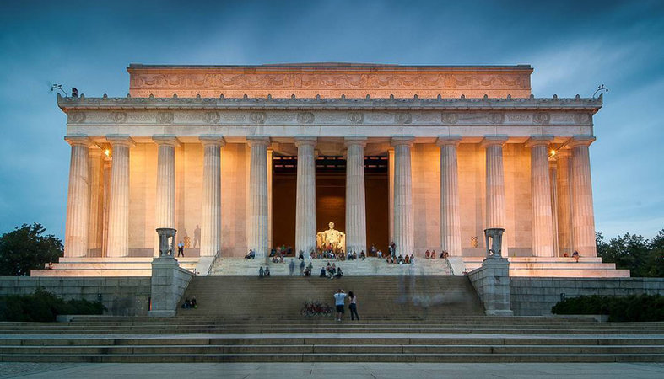
ROMAN RELIGION
RELIGION OF PLACE
THE CITY – CAPITOLINE TRIAD
TINIA-UNI-MENVRA > JUPITER-JUNO-MINERVA (Zeus-Hera-Athena)
Temple of Jupiter Optimus Maximus (ca.500 BCE)

Slide 21
ROMAN RELIGION
RELIGION OF PLACE
THE CITY – CAPITOLINE TRIAD
TINIA-UNI-MENVRA > JUPITER-JUNO-MINERVA (Zeus-Hera-Athena)
Temple of Jupiter Optimus Maximus (ca.500 BCE)

Slide 22
ROMAN RELIGION
RELIGION OF PLACE
THE CITY
Temple of Janus
two-faced god of transition from place to place (gates, doorways)
and from time to time (past to the future)
temple doors closed in time of peace

Slide 23
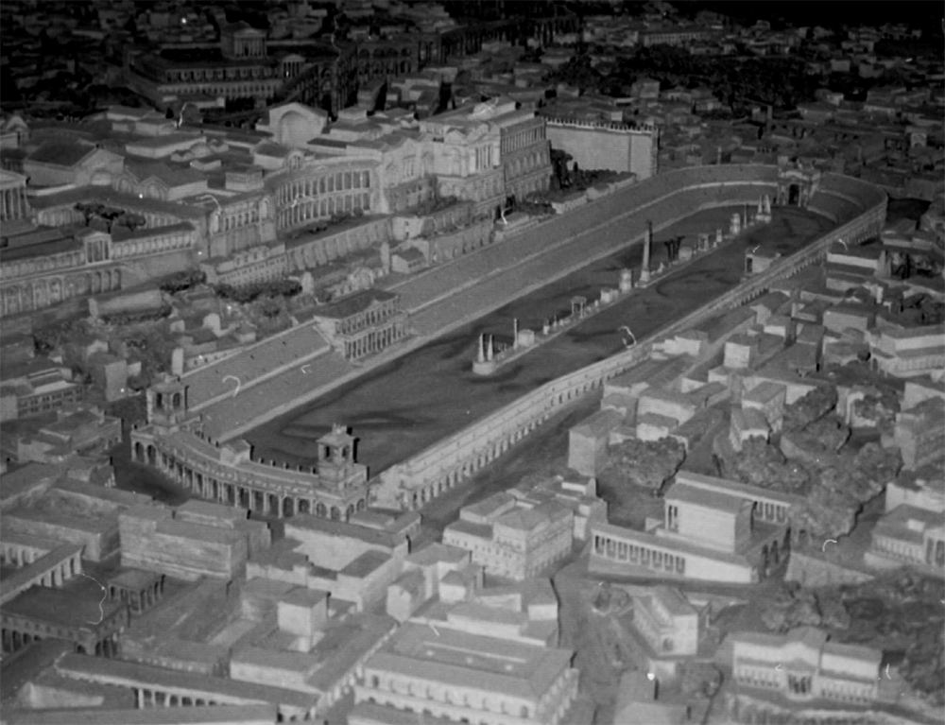
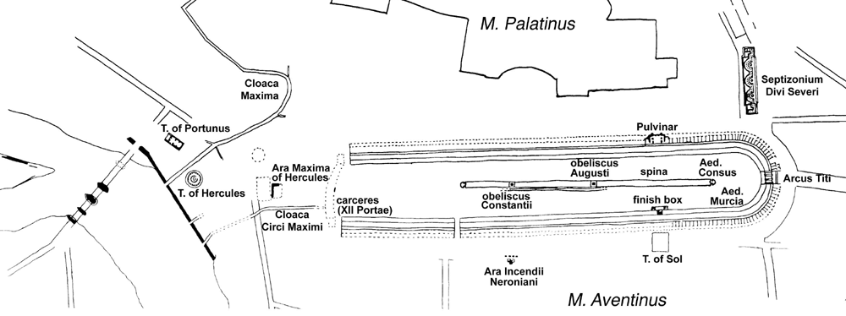
ROMAN RELIGION
RELIGION OF PLACE
THE CIRCUS
TEMPLE OF SOL (Sun)
Shrine of Consus
Festival of the Consualia

Slide 24
ROMAN RELIGION
RELIGION OF PLACE • pomerium (sacred boundary)
Circus of
Caius & Nero
Circus
Circus
Maximus
Circus of Maxentius

Slide 25
ROMAN RELIGION
RELIGION OF PLACE
THE CITY
Festival of the SATURNALIA
For many years they thought to propitiate Dis (Hades) with human heads and Saturn with the sacrifice of men, since the oracle had bidden them:
And offer heads to Hades, and a man (phōta) to the Father [Saturn]
But later, the story goes, Hercules, returning through Italy with the herds of Geryon, persuaded their descendants to replace these unholy sacrifices with others of good omen, by offering to Dis little masks cleverly fashioned to represent the human face, instead of human heads, and by honoring the altars of Saturn with lighted candles instead of with the blood of a man (for the word phōta means ‘lights’ as well as ‘a man’).
This is the origin of the custom of sending round wax tapers during the Saturnalia, although others think that the practice is derived simply from the fact that it was in the reign of Saturn that we made our way, as though to the light, from a rude and gloomy existence to a knowledge of the liberal arts.
I should add, however, that I have found it written that, since many through greed made the Saturnalia an excuse to solicit and demand gifts from their clients, a practice which bore heavily on those of more slender means, one Publicius, a tribune, proposed to the people that no one should send anything but wax tapers to one richer than himself.
Macrobius Saturnalia 1.7.28-33

Slide 26
ROMAN RELIGION
RELIGION OF PLACE
THE CITY
Festival of the SATURNALIA
Here is Caesar and all the line of Iulus.
All who shall one day pass under the dome
Of the great sky: this is the man, this one
Of whom so often you have heard the promise,
Caesar Augustus, son of the deified,
Who shall bring once again the Age of Gold
To Latium, to the land where Saturn reigned
In early times. He will extend his power
Beyond the Garamantes and Indians,
Over far territories north and south.
Vergil Aeneid, Book VI.789-795 [1060-1069]

Slide 27
ROMAN RELIGION
RELIGION OF PLACE
THE CITY
Festival of the ARGEI
Then, too, the Virgin used to throw the wicker effigies of old men from the oaken bridge. There is an ancient tradition, that when the land was called Saturnia these words were spoken by soothsaying Jove: ‘O clans, cast into the water of the Tuscan river two bodies as a sacrifice to the Ancient who bears the sickle.’ The gloomy rite was performed, so runs the tale, in the Leucadian manner every year, until the man from Tiryns came into these fields the sad rites were performed each year in the Leucadian fashion. He hurled citizens of straw into the water. Throw now imitation bodies after the example of Hercules. Some think that the young men used to hurl the feeble men from the bridges, in order that they themselves alone should have the vote. He who believes that after sixty years men were put to death, accuses our forefathers of a wicked crime.
P. Ovidius Naso, Fasti 5.621-662

Slide 28
ROMAN RELIGION
VOWS
Temple of VENUS VICTRIX • THEATER OF POMPEY
spoils from campaign vs. Mithradates VI of Pontus

Slide 29
IDEOLOGICAL POWER
PLEBIAN RIGHTS
own assembly (pass plebescita)
one consul
half aediles
half the priesthoods in the major religious colleges

Slide 30
IDEOLOGICAL POWER
PLEBIAN RIGHTS
own assembly (pass plebescita)
one consul
half aediles
half the priesthoods in the major religious colleges
• college of pontifs (pontifices)
• college of epulones
• college of augurs (augures)
• college of two (later ten, then fifteen) men for sacred actions
(quindecemviri sacris faciundis)
• college of fetials (fetiales)

Slide 31
ROMAN RELIGION
formalism, rationalism and ritual purity
Festival of the AMBARVALIA (walking around the farm), offering to Mars
suovetaurilia – lustral (“purification”) sacrifice of a pig, ram and bull
conclusion of a census, atone for ritual errors, counteract portents

Slide 32
PRIESTLY COLLEGES
• college of pontifs (pontifices) – pontifex maximus in charge of priests of
specific gods (flamines), Vestal Virgins
SYMBOL: ladle, pottery vessel (purification)
flamen Dialis (priest of Jupiter)

Slide 33
PRIESTLY COLLEGES
• college of pontifs (pontifices) – pontifex maximus in charge of priests of
specific gods (flamines), Vestal Virgins
SYMBOL: ladle, pottery vessel (purification)
Temple of VESTA • Vestal Virgins

Slide 34
PRIESTLY COLLEGES
• college of pontifs (pontifices) – pontifex maximus in charge of priests of
specific gods (flamines), Vestal Virgins
SYMBOL: ladle, pottery vessel (purification)
• college of epulones – in charge of sacred festivals (e.g. games)
SYMBOL: libation bowl (libations)

Slide 35
PRIESTLY COLLEGES
• college of pontifs (pontifices) • pontifex maximus in charge of priests of
specific gods (flamines), Vestal Virgins
SYMBOL: ladle, pottery vessel (purification)
• college of epulones • in charge of sacred festivals
SYMBOL: libation bowl (libations)
• college of augurs (augures) • in charge of divination (augury – birds, Etruscan haruspicy – entrails)
SYMBOL: curved staff (to mark templum)

Slide 36
PRIESTLY COLLEGES
• college of pontifs (pontifices) • pontifex maximus in charge of priests of
specific gods (flamines), Vestal Virgins
SYMBOL: ladle, pottery vessel (purification)
• college of epulones • in charge of sacred festivals
SYMBOL: libation bowl (libations)
• college of augurs (augures) • in charge of divination (augury – birds, Etruscan haruspicy – entrails)
SYMBOL: curved staff (to mark the templum)
• college of two (IIviri), later ten (Xviri), then fifteen (XVviri) for sacred actions
(quindecemviri sacris faciundis) • in charge of consulting Sibylline Books
SYMBOL: tripod (Delphi, divination)
• college of fetials (fetiales) • in charge of declaring war

Slide 37
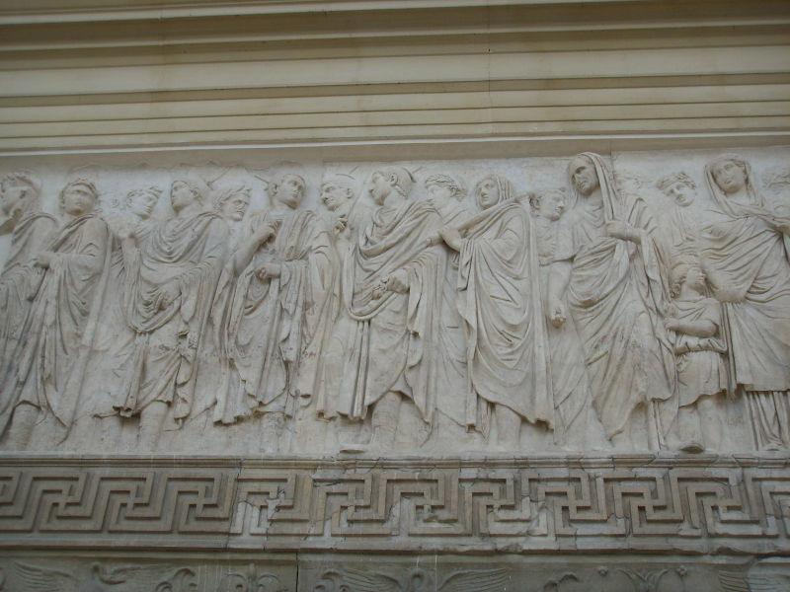
ARA PACIS AUGUSTEA (“Altar of Augustan Peace”), 9 BCE
CAESAR AUGUSTUS
Imp. Caesar Augustus
leads priestly procession
as pontifex maximus

Slide 38
IDEOLOGICAL POWER
Emperor monopolizes pontifex maximus; lifetime priesthood in each college
I have been pontifex maximus, augur, a member of the College of Fifteen (XVviri) for performing sacred rites, on of the College of Seven for sacred feasts (epulones), and Arval Brother, a Titian Brother and a Fetial priest.
Augustus Accomplishments 7
I declined to be made pontifex maximus in succession to a colleague, when the people tendered me that priesthood which my father had held. Several years later I accepted that sacred office when he at last was dead who, taking advantage of a time of civil disturbance, had seized it for himself, such a multitude from all Italy assembling for my election, in the consulship of Q. Lucretius and M. Vinucius, as is never recorded to have been in Rome before. Augustus Accomplishments 10
pontifices
augures
XVviri
epulones

Slide 39
ROMAN RELIGION
ROMAN RELIGION
HEROES > DIVINITY
AENEAS > INDIGES (Lavinium)
LATINUS > JUPITER LATIARIS (Alba Longa)
ROMULUS > QUIRINUS (Rome)
putative ancestors of Julian clan and Rome

Slide 40
.
.
obelisks
.
MAUSOLEUM
.
ARA PACIS • SUN DIAL
obelisk
FIELD OF MARS
FORUM OF AUGUSTUS
ROMAN FORUM
.
.
obelisk
obelisk

Slide 41
ROMAN RELIGION
MONOPOLIZES FULFILLMENT OF VOWS (MONUMENTAL STRUCTURES)
Temple of Mars Ultor (“Avenger”) • Forum of Augustus
campaign against Brutus and Cassius
Aeneas
Romulus

Slide 42
ROMAN RELIGION
MONOPOLIZES FULFILLMENT OF VOWS (MONUMENTAL STRUCTURES)
ARA PACIS AUGUSTEA (“Altar of Augustan Peace”),
in the Campus Martius (“Field of Mars”)

Slide 43
ROMAN RELIGION
ROMAN RELIGION
HEROES > DIVINITY
AENEAS > INDIGES (Lavinium)
LATINUS > JUPITER LATIARIS (Alba Longa)
ROMULUS > QUIRINUS (Rome)
JULIUS CAESAR > DIVUS JULIUS (Roman Forum)
flamen M. Antonius
CAESAR AUGUSTUS > DIVUS AUGUSTUS
flamines
CLAUDIUS CAESAR > DIVUS CLAUDIUS
flamines
ROMANIZATION
TEMPLE TO ROMA
(LIVING) EMPEROR CULT

Slide 44
FOREIGN GODS
interpretatio Romana – translated gods into Roman pantheon
Among the gods, they most worship Mercury. There are numerous images of him; they declare him the inventor of all arts, the guide for every road and journey, and they deem him to have the greatest influence for all money-making and traffic. After him they set Apollo, Mars, Jupiter, and Minerva. Of all these deities they have almost the same idea as all other nations: Apollo drives away diseases, Minerva supplies the first principles of arts and crafts, Jupiter holds the empire of heaven, Mars controls wars. ...The Gauls affirm that they are all descended form a common father, Dis, and say that this is the tradition of the Druids.
Caesar Gallic Wars 6.17-18

Slide 45
FOREIGN GODS
interpretatio Romana – translated gods into Roman pantheon
evocatio – called out by general on the battlefield
Uni-Juno Regina from Veii (390s BCE)
Tinnit-Juno Caelestis from Carthage (146 BCE)

Slide 46
FOREIGN GODS
interpretatio Romana – translated gods into Roman pantheon
evocatio – called out by general on the battlefield
Uni-Juno Regina from Veii (390s BCE)
Tinnit-Juno Caelestis from Carthage (146 BCE)
consultation of Sibylline Books — imported during crises
Aštart-Venus from Eryx (217 BCE)

Slide 47
FOREIGN GODS
MAGNA MATER (CYBELE, 207 BCE)
imported her image (a meteorite) after consulting the Sibylline Books
from Asia Minor
galli – self-castrating priests
imitating Attis, her consort
ecstasy
Festival of the Megalensia
controlled by College of Fifteen

Slide 48
RELIGION & SUPERSTITION
religio – proper, formal, moderate worship and ritual
superstitio – excessive and irrational
• astrology
• magic (poisons and curses)
• seers – Chaldeans (Babylonian) and Magi (Persian/Parthian)
Gymnosophists (Naked-Sages) and Druids (Celtic)

Slide 49
RELIGION & SUPERSTITION
religio – proper, formal, moderate worship and ritual
superstitio – excessive and irrational
• astrology
• magic (poisons and curses)
• seers – Chaldeans (Babylonian) and Magi (Persian/Parthian)
Gymnosophists (Naked-Sages) and Druids (Celtic)
Island of Mona • Druid stronghold
Then urged by their general’s appeals and mutual encouragements not to quail before a troop of frenzied women, they bore the standards onwards, smote down all resistance, and wrapped the foe in the flames of his own brands. A force was next set over the conquered, and their groves, devoted to inhuman superstitions, were destroyed. They deemed it indeed a duty to cover their altars with the blood of captives and to consult their deities through human entrails.
Tacitus Annals XIV.30

Slide 50
FOREIGN GODS
BACCHUS (DIONYSIUS)
Suppression of the BACCHANALIA, 186 BCE
Livy XXXIX
Senatorial decree (senatus consultum) CIL I.2.581
from Greece (from Asia Minor)
Plautus mentions Bacchic rituals in his plays, as well established,
while Livy treats the cult as a novelty
• hidden & nocturnal, conspiratorial
• wine & licentiousness
• men & women, young & old, rich & poor
• ecstatic Bacchic women
outside control of Priestly Colleges

Slide 51
FOREIGN GODS
ISIS
belief, ecstasy and ethical purity
vs. formalism, rationalism and ritual purity
from Hellenized Egypt – Egyptian gods with Greek names (interpretatio Graeca)
did not renounce state cult – pray for the emperor, to Rome, her fleet
salvation religion – death and rebirth (Nile flood)
initiation mysteries
Temple of Isis in Field of Mars
outside control of Priestly Colleges

Slide 52
FOREIGN GODS
MITHRAS (“Undefeated Sun”)
Light (“good”) vs. Darkness (“evil)
from Parthia (Persia)
did not renounce state cult
salvation religion – death and rebirth
initiation mysteries
enigmatic iconography attributed to various grades
popular among military veterans
worshipped in cave-sanctuary (mithraeum), often in private homes
priesthood outside control of Priestly Colleges

Slide 53
FOREIGN GODS
SOL INVICTUS (“Undefeated Sun”; Helios or “El of Byblos”)
imported from Emesa in Syria
henotheism – one god above all others
meteorite brought to Rome by ELAGABALUS
marriage with Juno Caelestis (Tinnit)
cult remains strong through age of the emperor Constantine (ca.300 CE)

