Slide 1
Mythology Memes
Demetrius Teasley

Slide 2
Zeus & Epimetheus after seeing Pandora open the box that Zeus warned her not to open

Slide 3
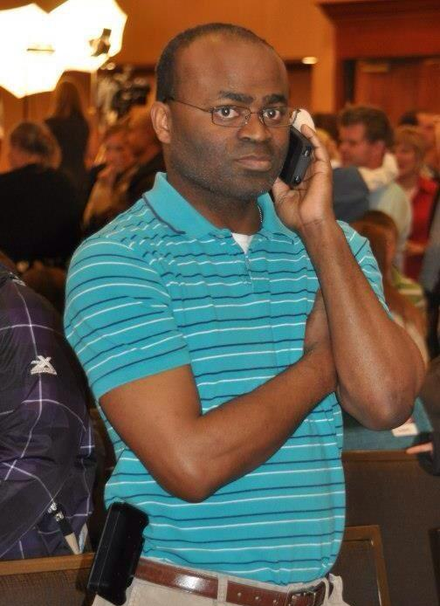
Midas calling the Satyr Silenus & Dionysus after his touch became uncontrollable

Slide 4
Zeus deciding how to punish Prometheus for stealing fire for humans.

