Slide 1
Creative Project for Classical Mythology
By: Jeriah Stewart
Professor Garnard
Classical Mythology
20 November 2020

Slide 2
This meme is used to communicate how people will see something and say its something else that it isn’t. Kronos sees his children and instead of seeing them as children he saw them as foes, so he ate them. This led to his downfall though

Slide 3
This meme is explaining the gods jobs and its kind of making fun of Dionysus, saying he’s a party god. The festival of Dionysus allowed for people to drink and have fun and there were plays performed to him that weren’t traditional tragedies. So, I guess he is the god of fun and getting drunk

Slide 4
This meme is making fun of how Greek mythology is heavily copied by roman mythology. In class we talked about the Aeneid and the Iliad which Rome copied because they didn’t have an epic of their own. I think

Slide 5
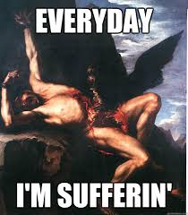
Prometheus helped humans by giving them fire and protecting them from extinction, Due to this he is punished everyday. The everyday I'm suffering is a play on words from the song Party Rock Anthem and the famous lyrics are “everyday I'm shuffling”

Slide 6
Here is another meme making fun of gods jobs. This one is kind of dirty, but the electrician is plugging in holes. The meme is saying Zeus plugs a lot of holes if you know what I mean. He as a lot of sex and children because he can't keep it in his pants.

Slide 7
The End!

