Slide 1
Memes
Ryan Raphael SAJot

Slide 2
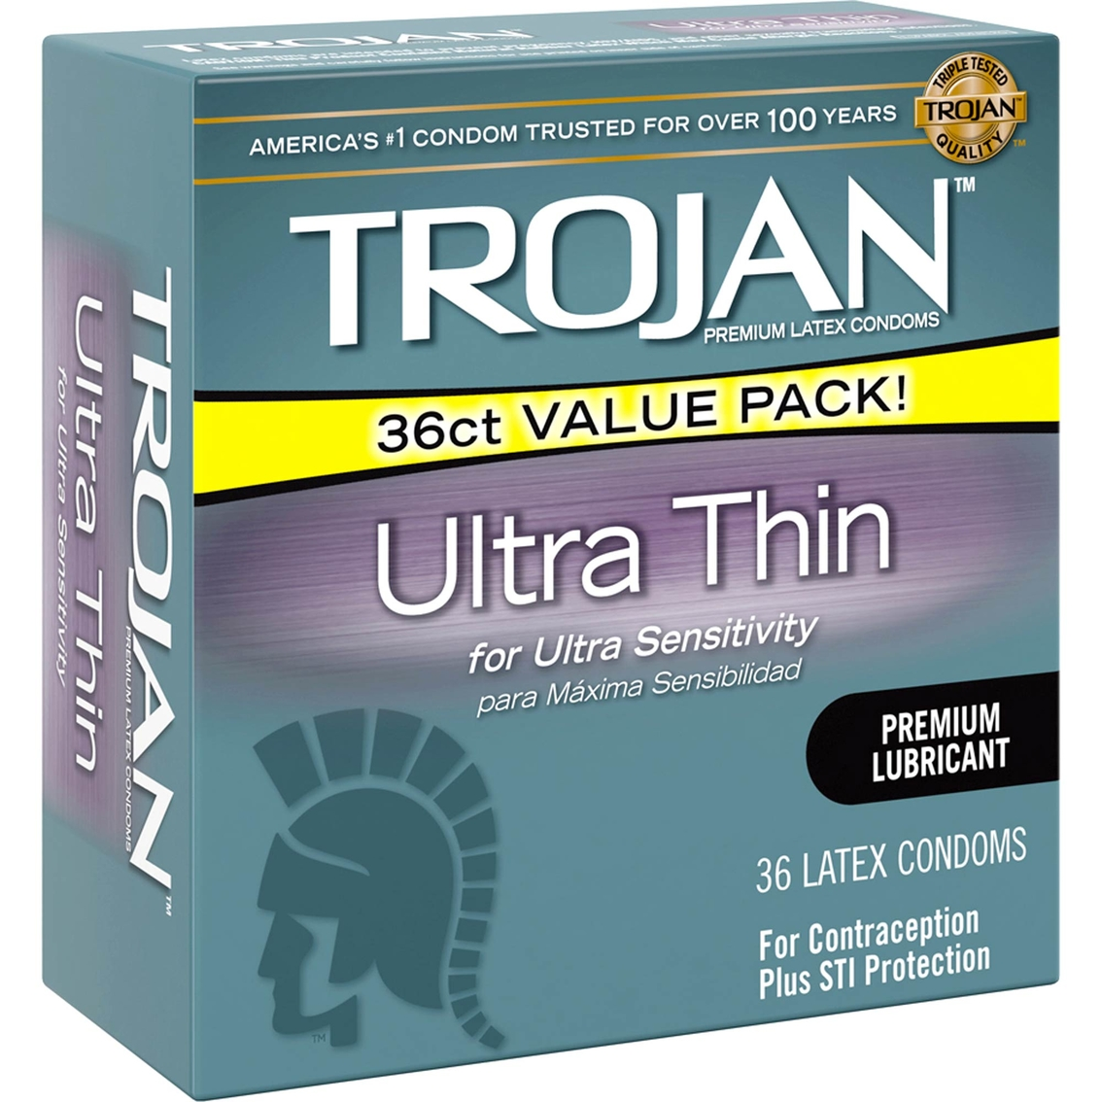
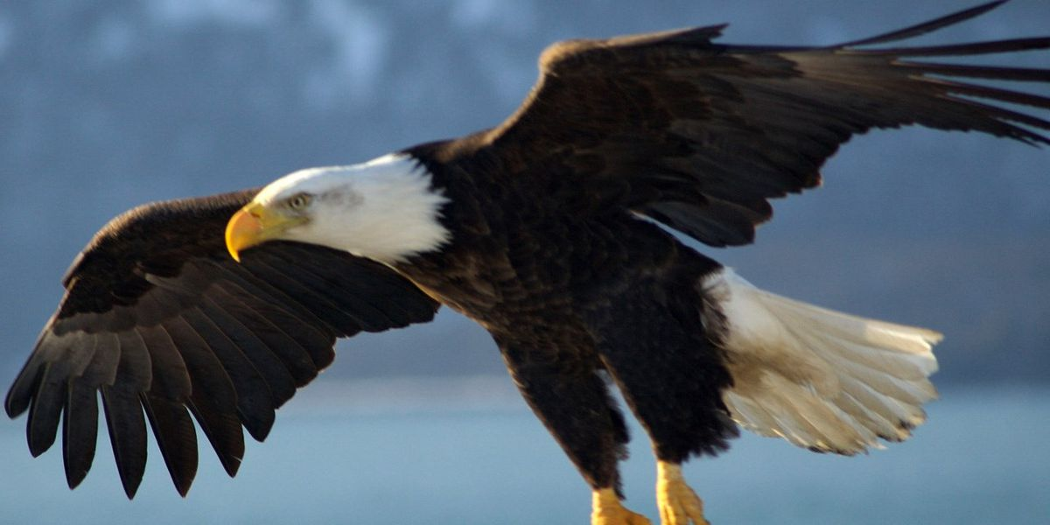
Zeus’ infidelity

Slide 3
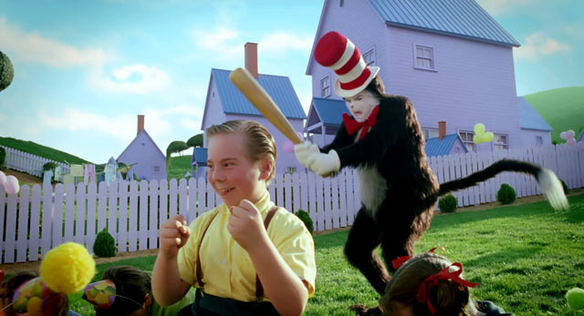
My head hurts
Birth of Athena

Slide 4
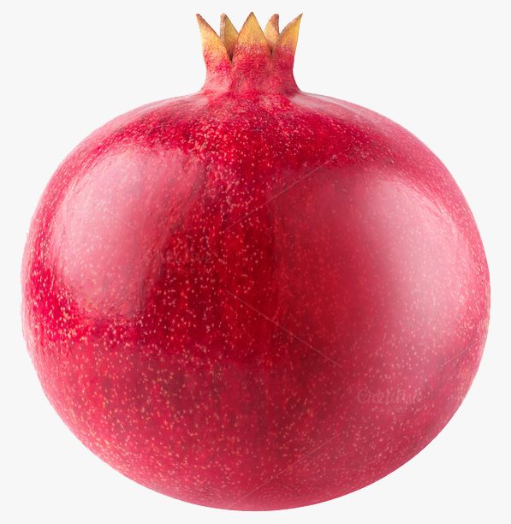
Hades looking at Persephone

Slide 5
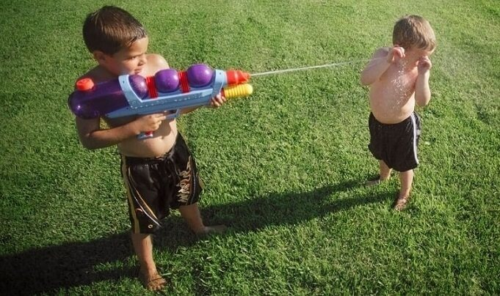
Achilles
Skamander
Theatrical rendition of Achilles vs Skamander

Slide 6
Aeneas’ descendant
Aeneas/Odysseus
Agamemnon
Anchises
Achilles
Aeneas/Odysseus going into the underworld

