Slide 1
🤣Meme Project🤣
Amarachi Nwankwo
Classical Mythology
Please laugh 🥺

Slide 2
Not every character in Greek myth is the son of Zeus 😭

Slide 3
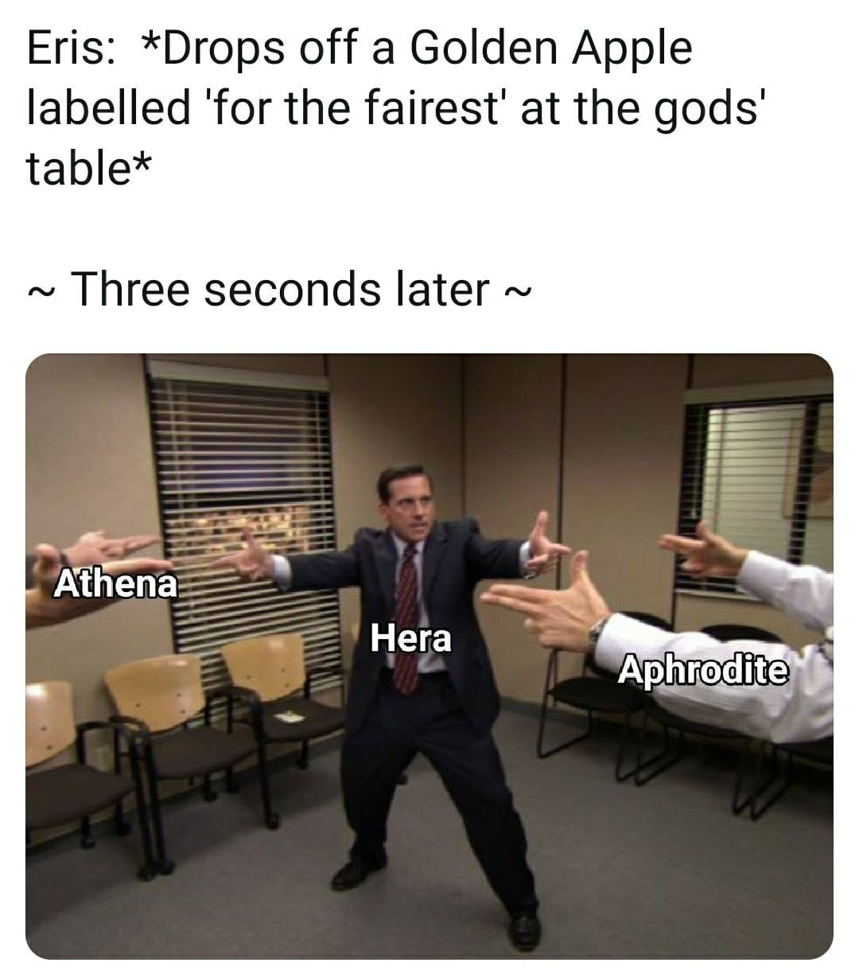
Did you LOL too? 🤠

Slide 4
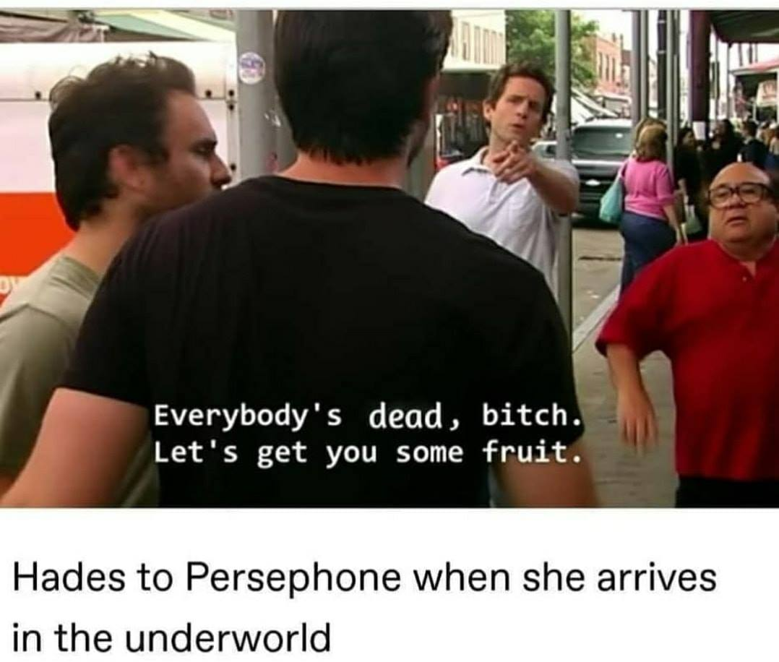
LAUGHING
MY
NERD
ON
🤓

Slide 5
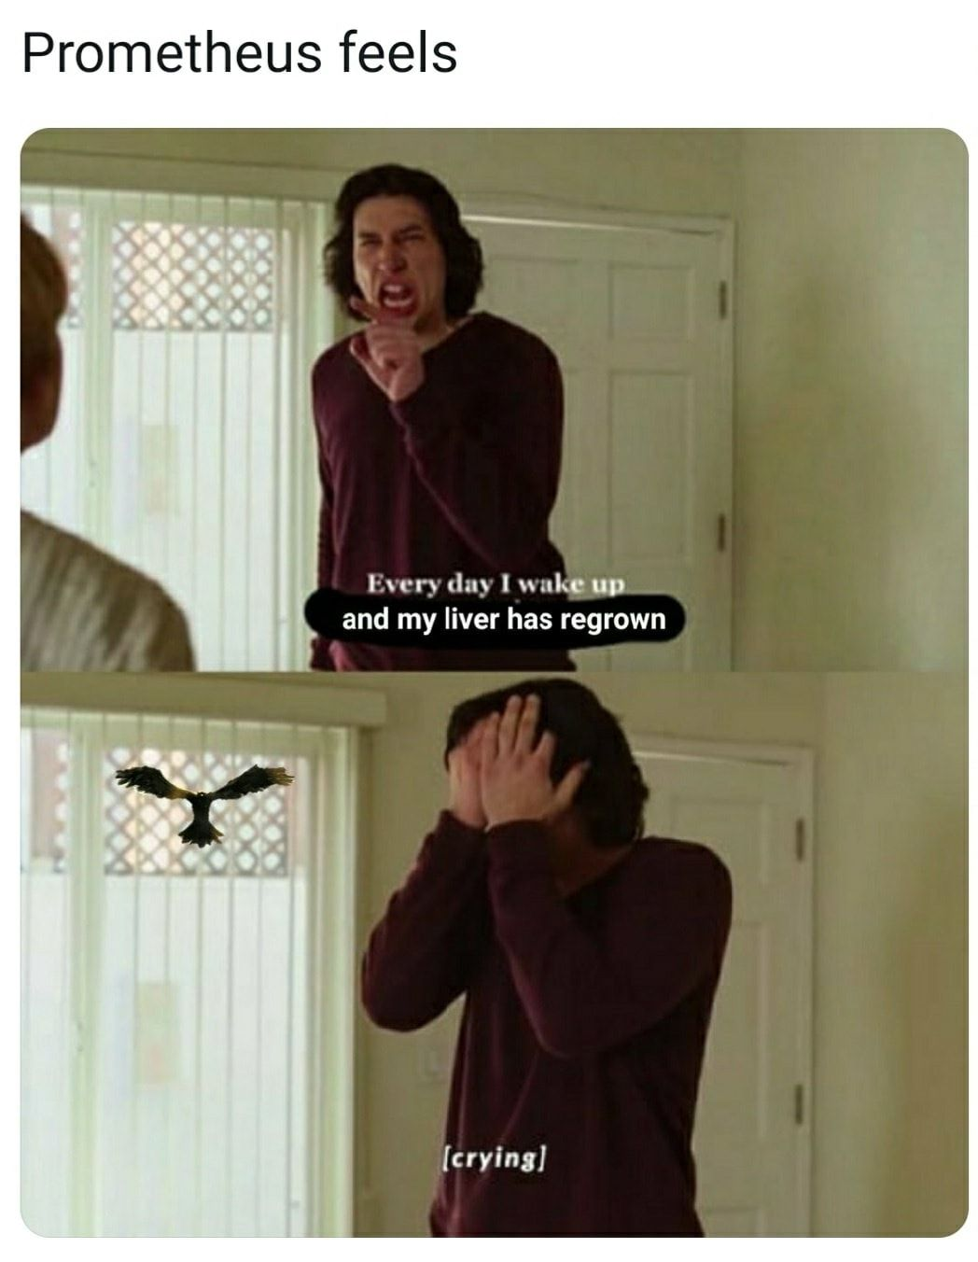
And they just keep getting funnier🤯

Slide 6
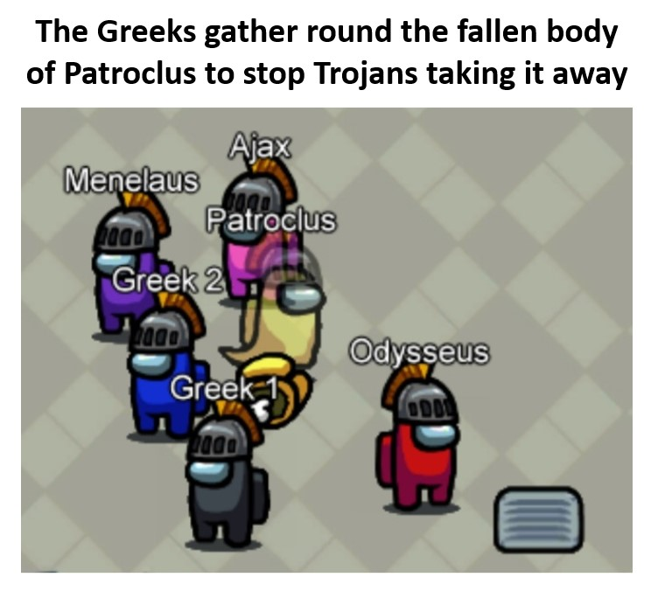
#respectthedead 😔

Slide 7
The end.
Don’t pretend none of those were funny 😐

