Slide 1
Classic Myth Memes
Keianna Nagle

Slide 2
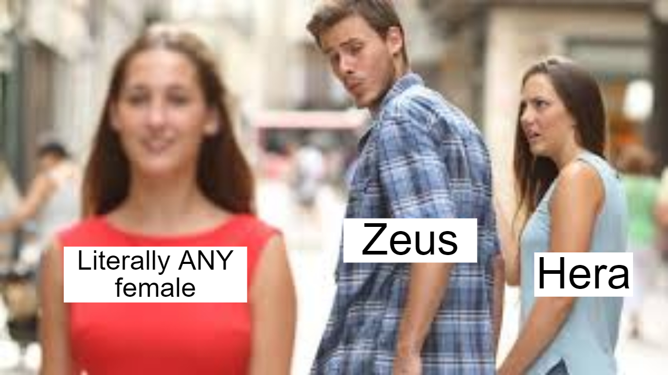
Most stories with Zeus

Slide 3
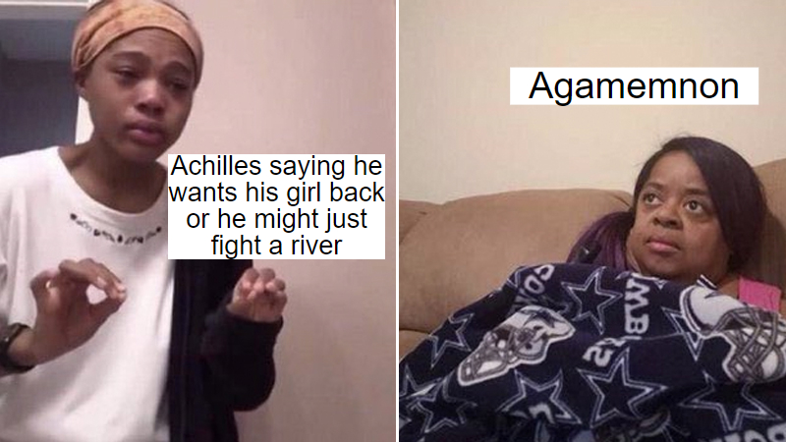
Iliad

Slide 4
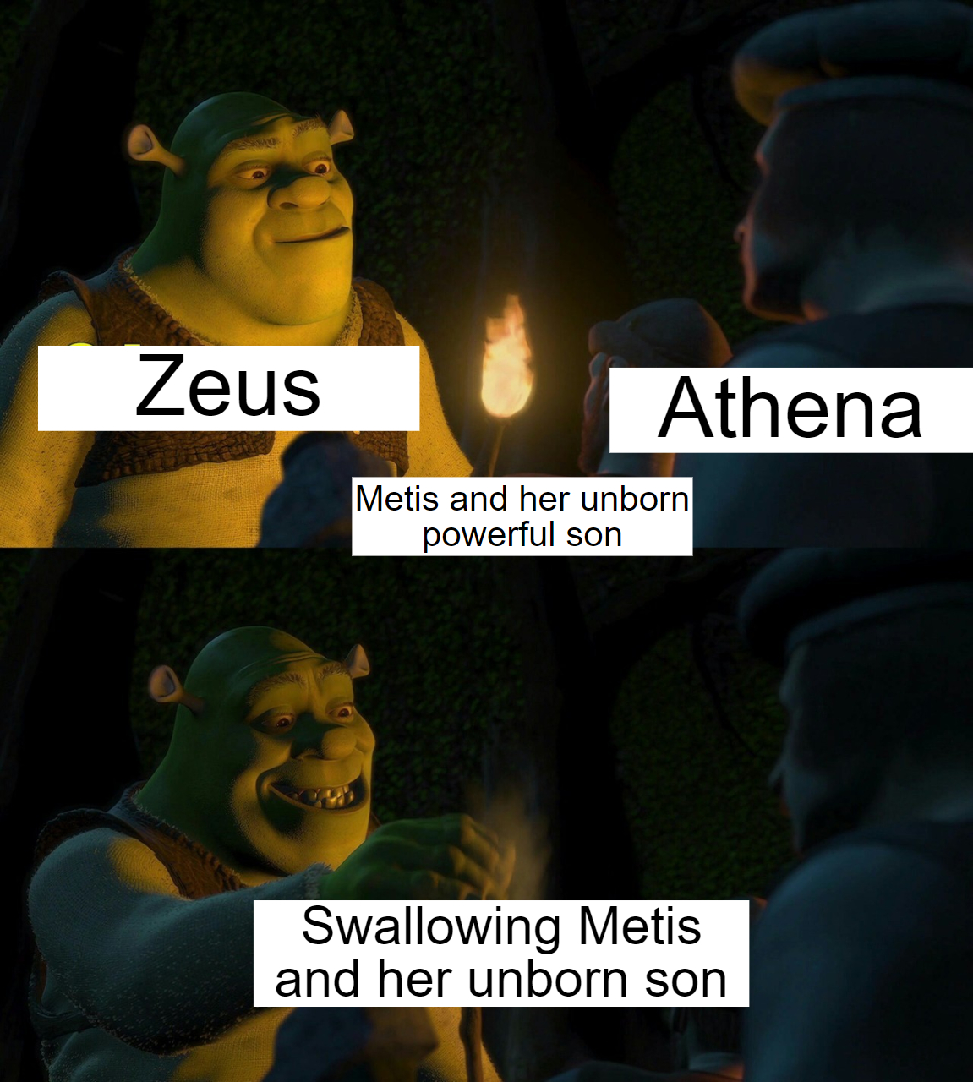
Theogony

