Slide 1
Creative Project Meme Edition
Terry-Ann Lewin
CLAS 109-01

Slide 2
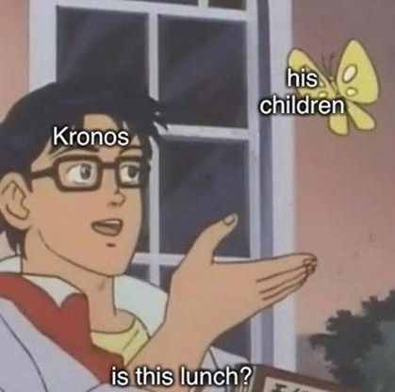
Myth: Theogony

Slide 3
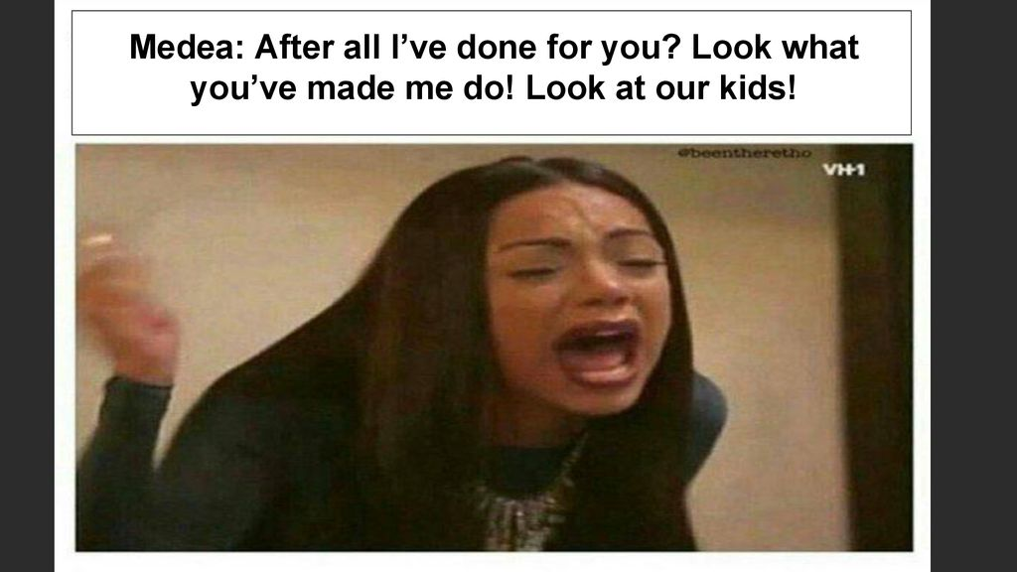
Myth: Medea/ Metamorphoses

Slide 4
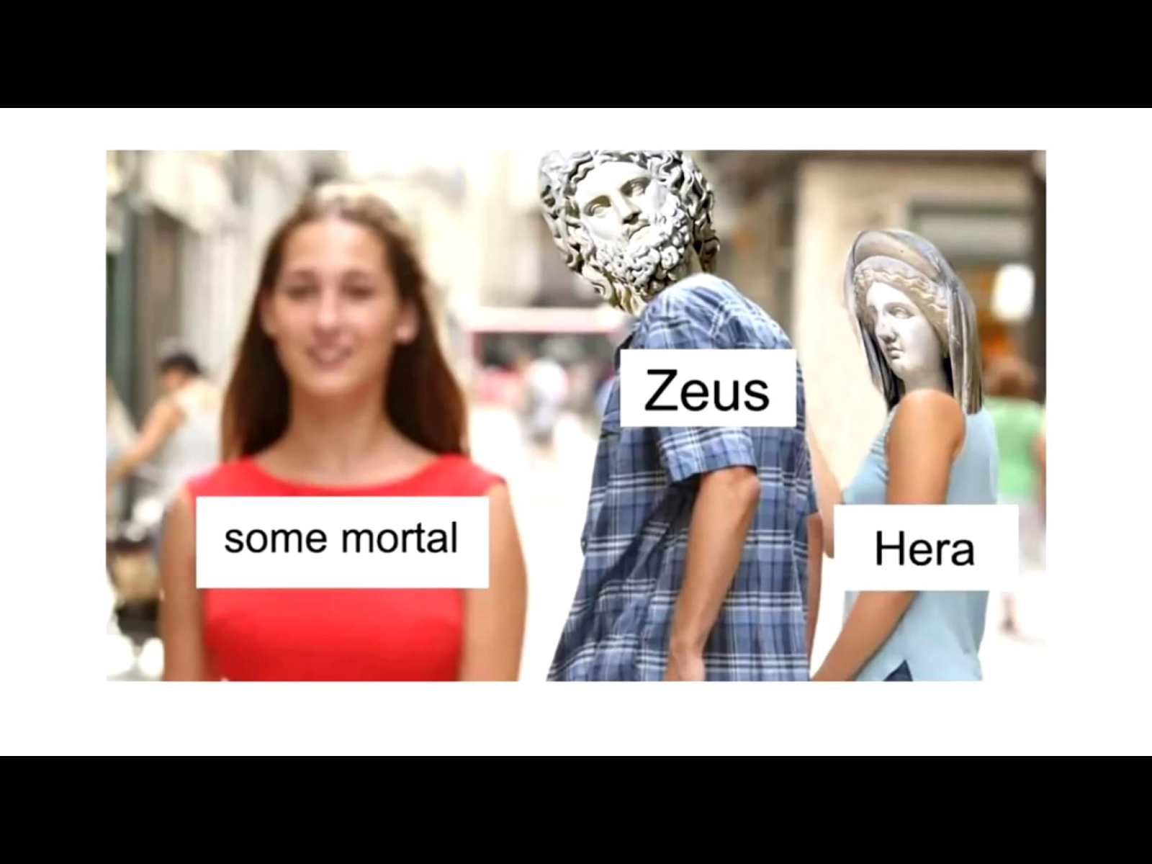
Myth: A LOT!

Slide 5
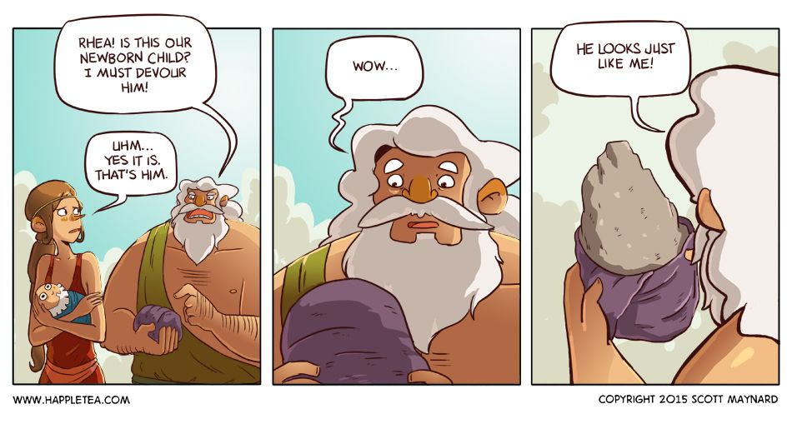
Myth: Theogony

Slide 6
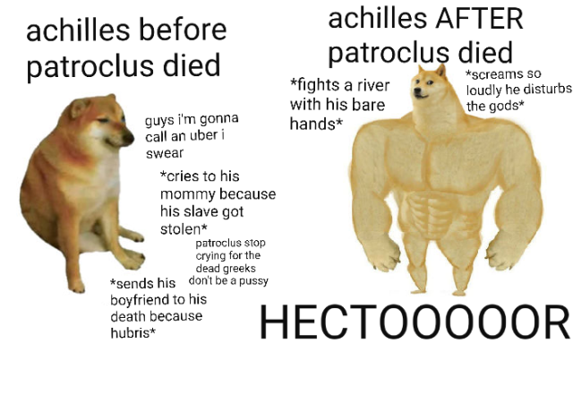
Myth: Iliad

