Slide 1
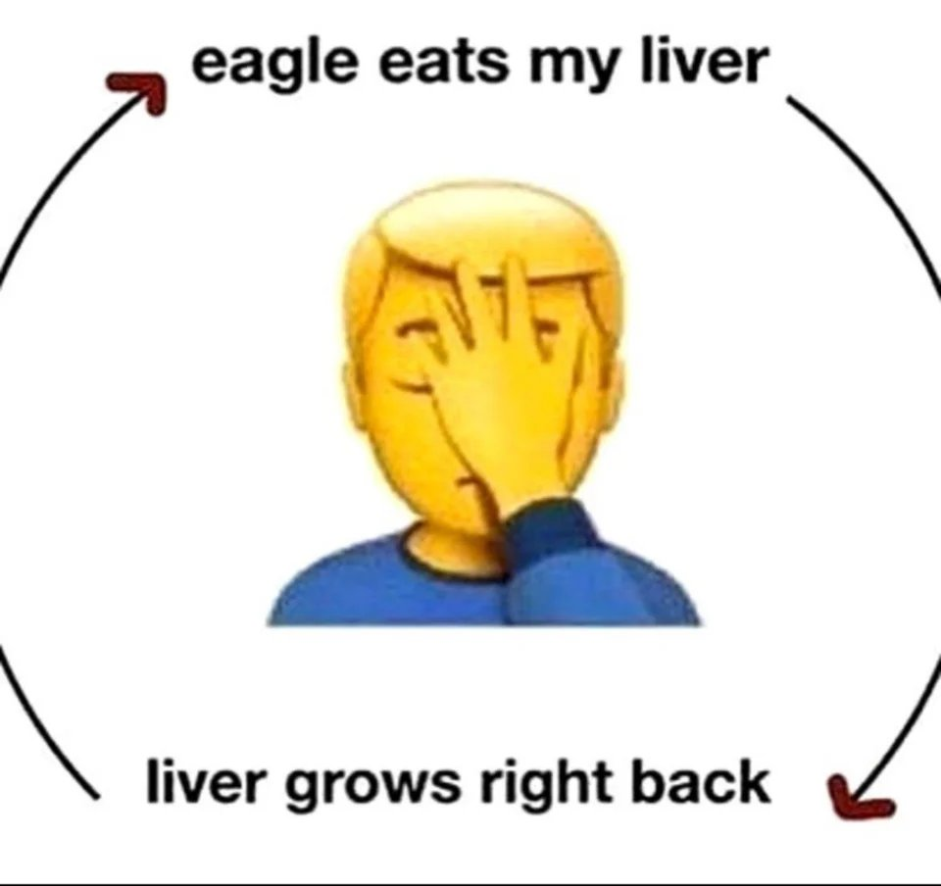
Theogony
Prometheus is punished by Zeus for giving humans fire
“He bound the changeful-planning Prometheus with unbreakable fetters, painful bonds and drove them through the middle of a pillar. And he sent a long-winged eagle upon him. Further, it ate his deathless liver, but there grew back all over during the night as much as the bird of long wings had eaten during the whole whole day.” (520-526)

Slide 2
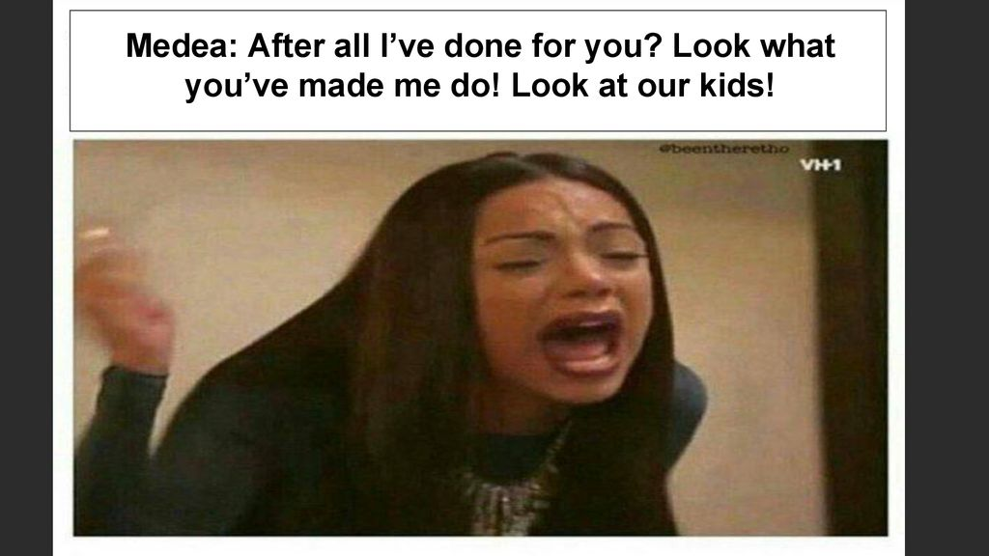
Medea
Jason married the king’s daughter in order to secure a better life for his family
Medea got upset because she sacrificed a lot for him such as killing kings and other things
She decided that the way to get revenge against him would be to kill their children & his new wife

Slide 3
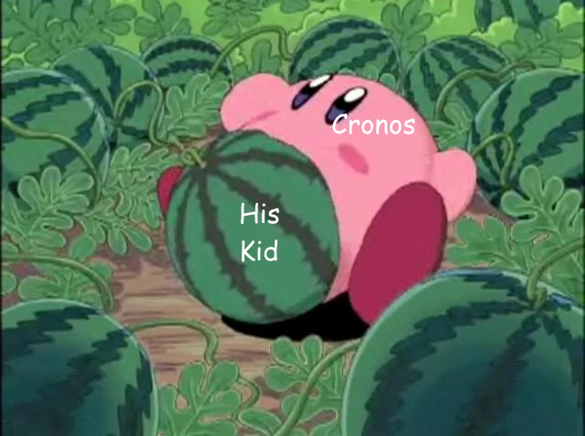
Theogony
Cronos eats his children in order to prevent the prophecy from coming true
Rheia plotted against Cronos to have him defeated
Zeus defeats him & sets all his siblings free

Slide 4
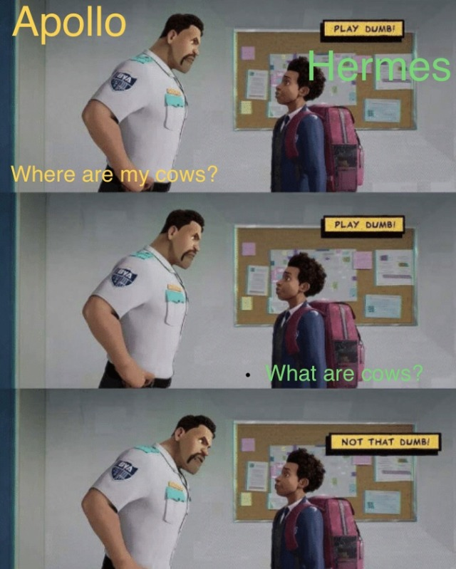
Homeric Hymn to Hermes
Hermes is a baby but is very smart and strong
He steals Apollo’s cows
Apollo confronts Hermes but Hermes plays the dumb newborn baby card. He tells Apollo he hasn’t seen the cattle and doesn’t know anything about it.

Slide 5
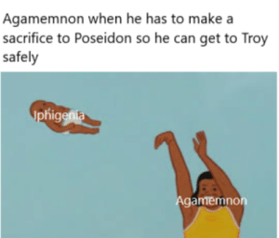
Iphigenia among the Taurians
Artemis
Agamemnon was sailing trying to pass through the sea in order to get to Troy, but he couldn’t
He sacrificed his daughter, Iphigenia, in order to sail by
He sacrificed her for fame & victory

