Slide 1
Samantha Dike
CLAS 109-01
Professor Garnand
November 20, 2020

Slide 2
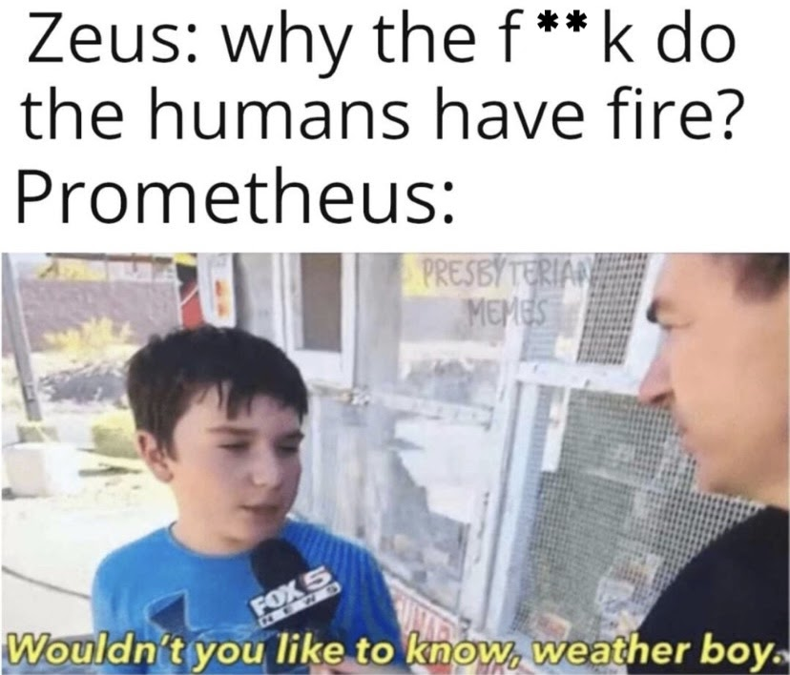

Slide 3
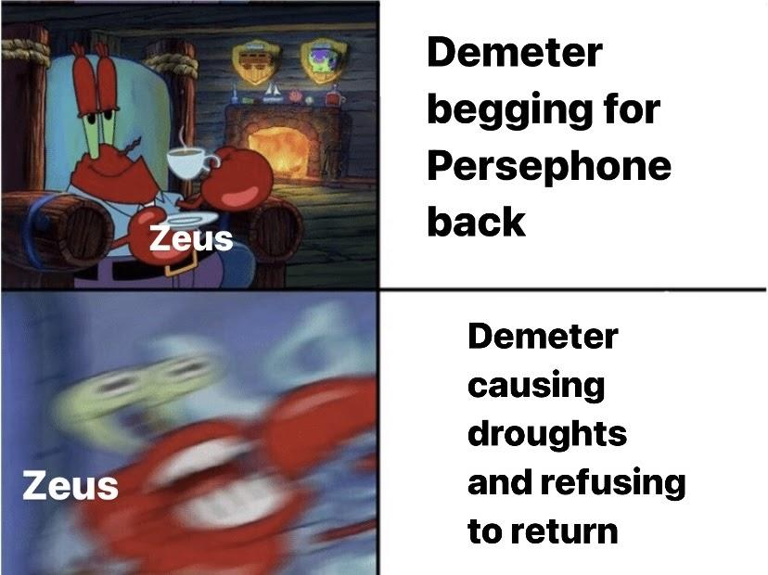

Slide 4
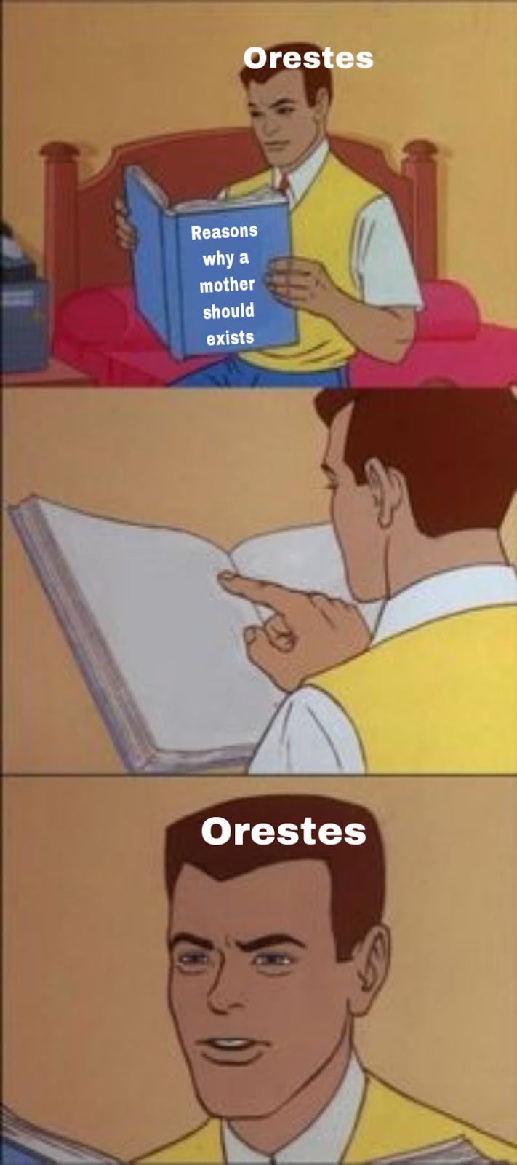

Slide 5
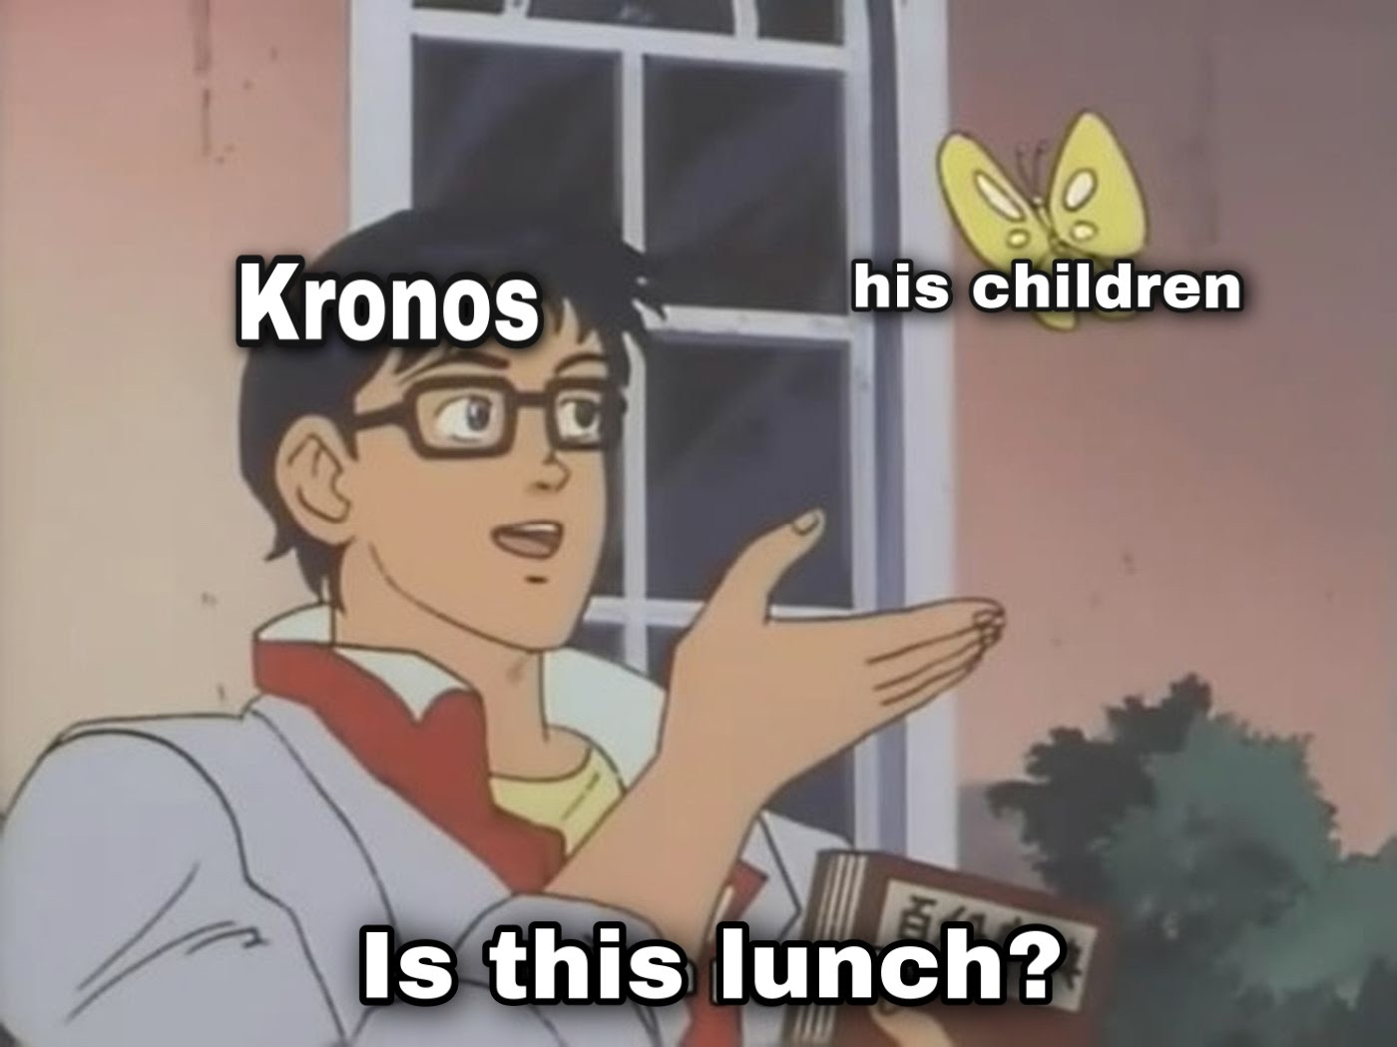

Slide 6
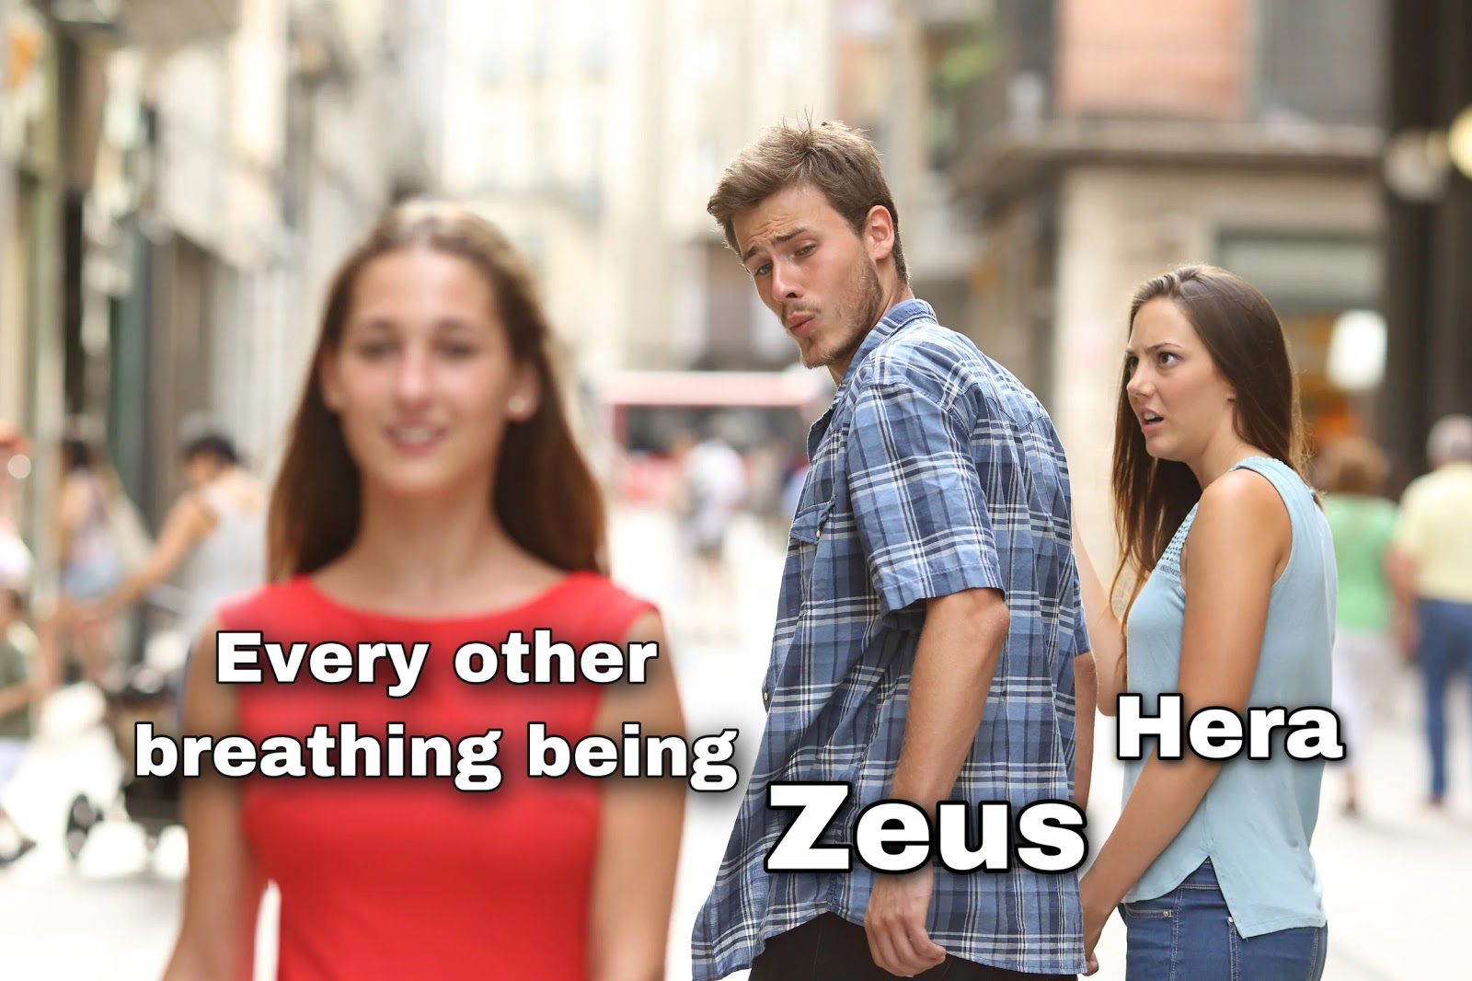

Slide 7
THE END ☺

