Slide 1
Meme Mythos
Mars Burren

Slide 2
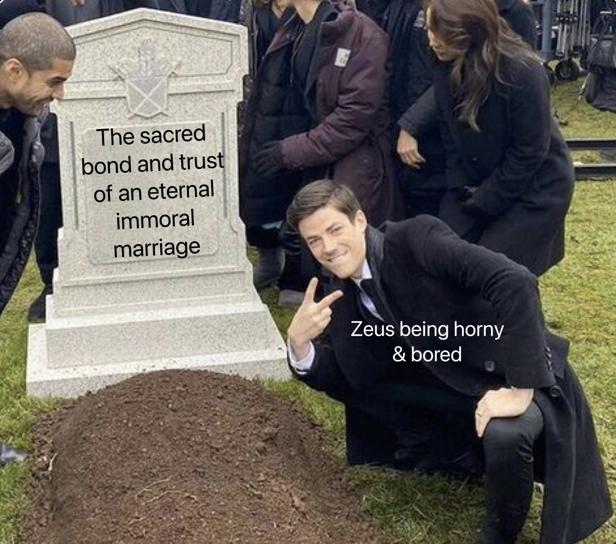
Zeus’ Infidelity, ‘nuff said

Slide 3
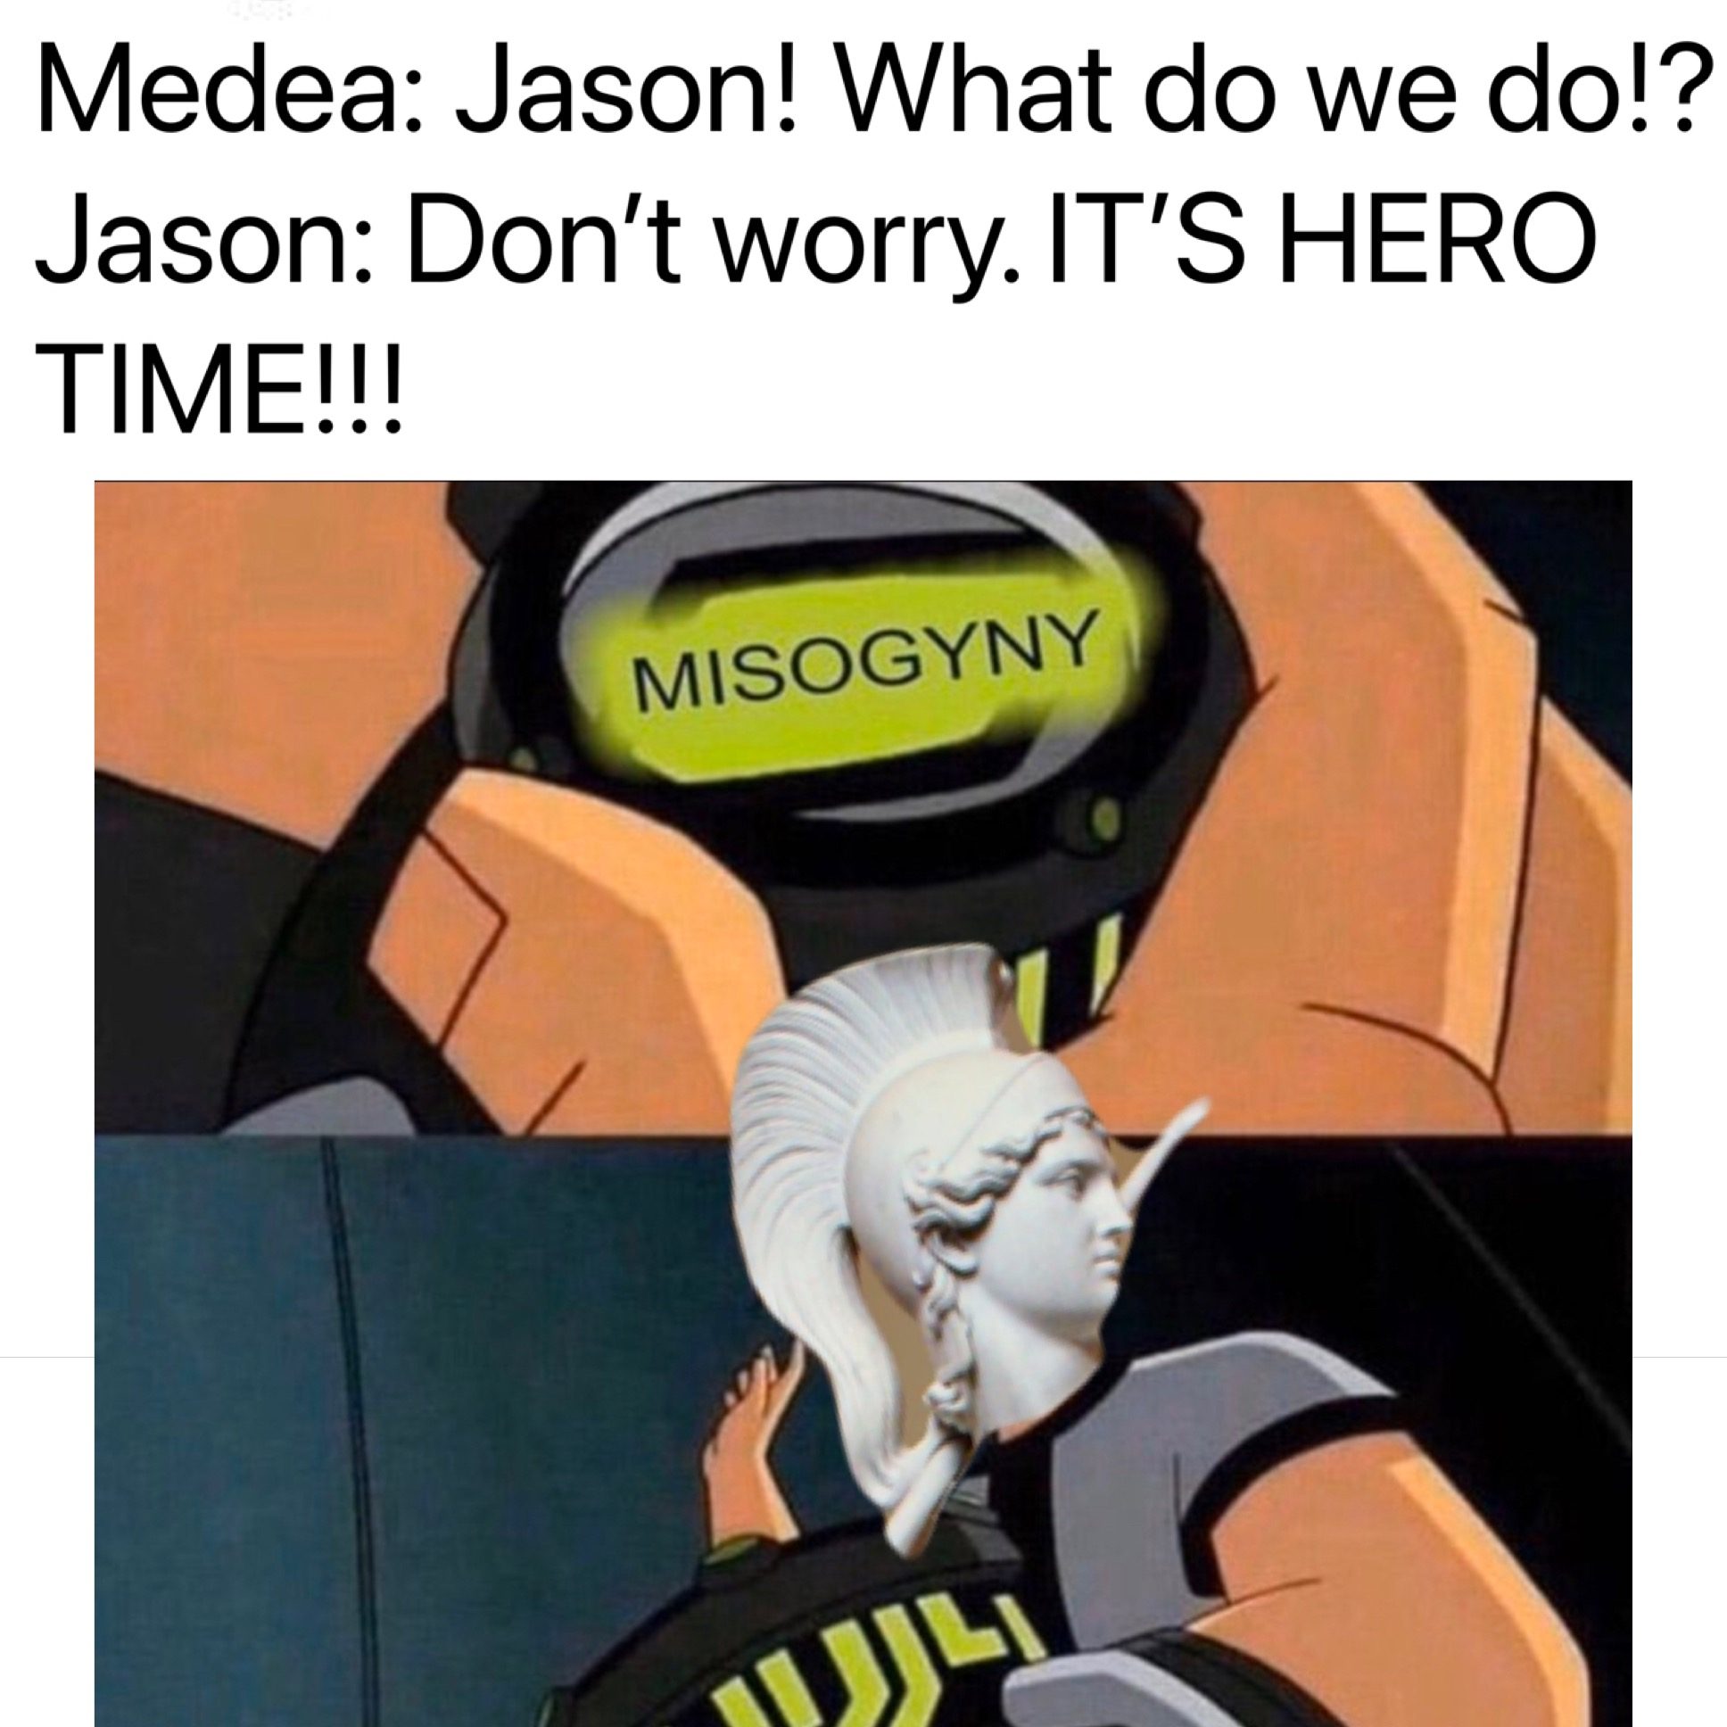
Jason’s “unique” approach to heorics

Slide 4
Demeter’s approach to nursing ala Hymn to Demeter

Slide 5
The God Yaweh can do all! Except maybe a less violent solution to corruption?

Slide 6
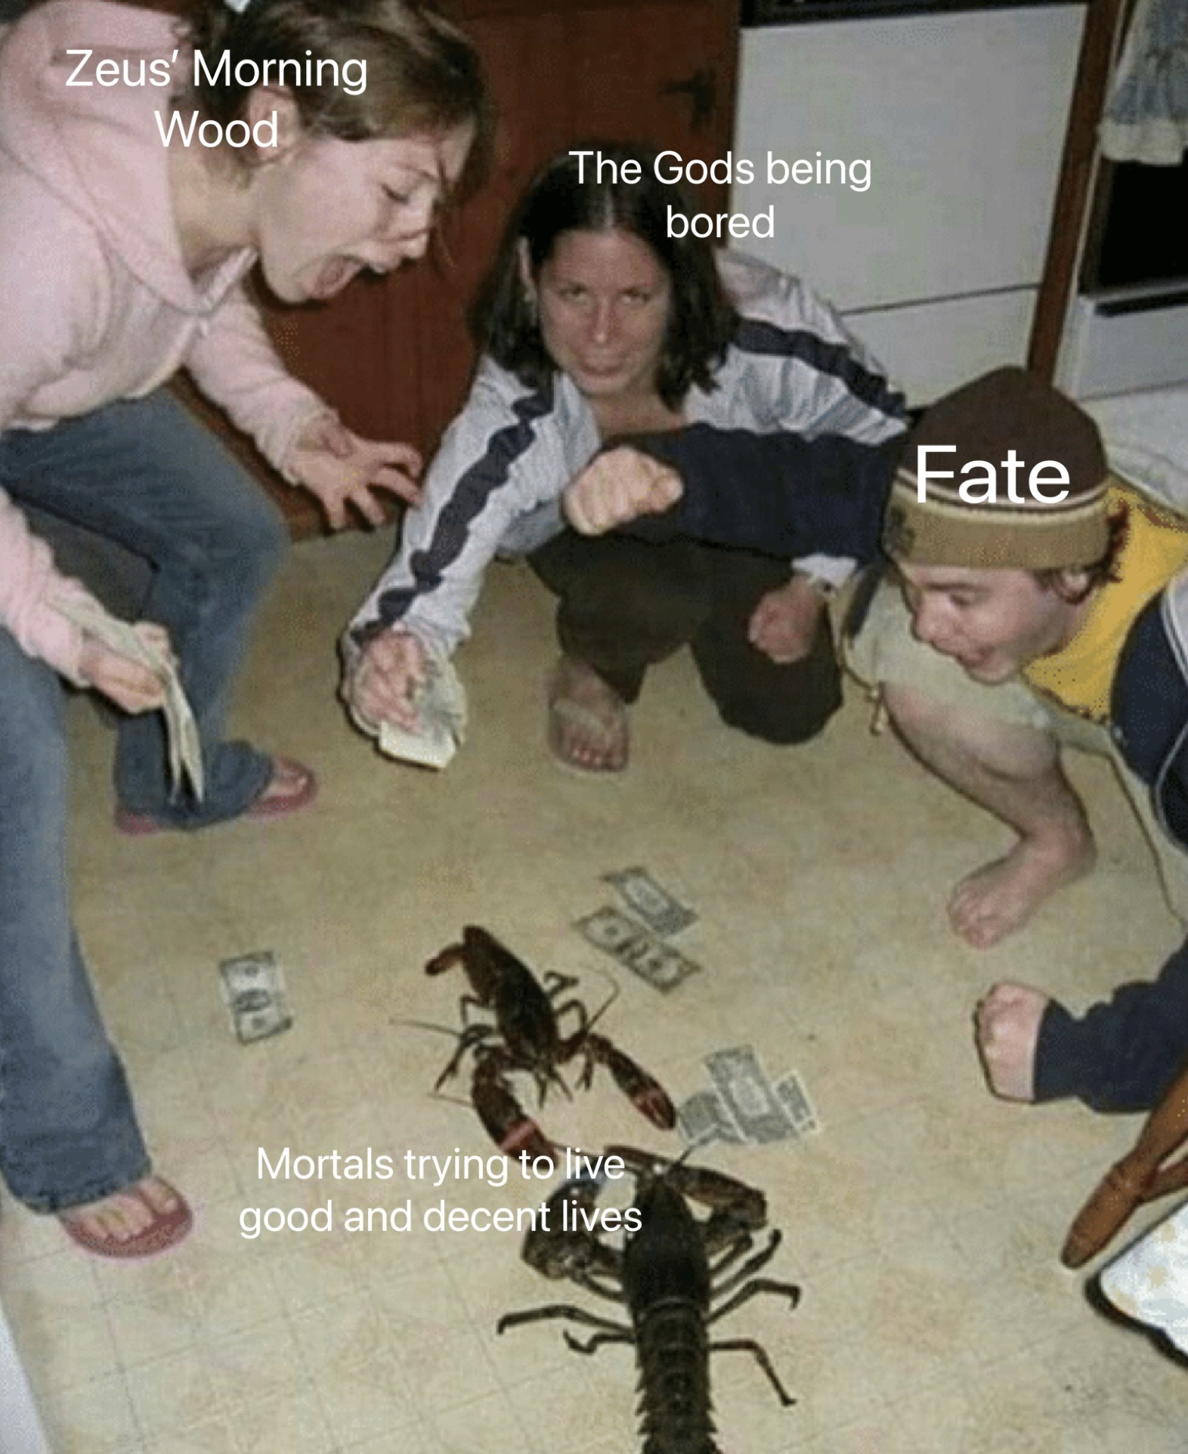
When it comes to leading a life worthy of Elysium, mortals work hard, but the immortals work harder

Slide 7
Hey it ain’t honest work! But hell it’ll make ya cow rich so who cares! It’s only your older brother anyway.

Slide 8
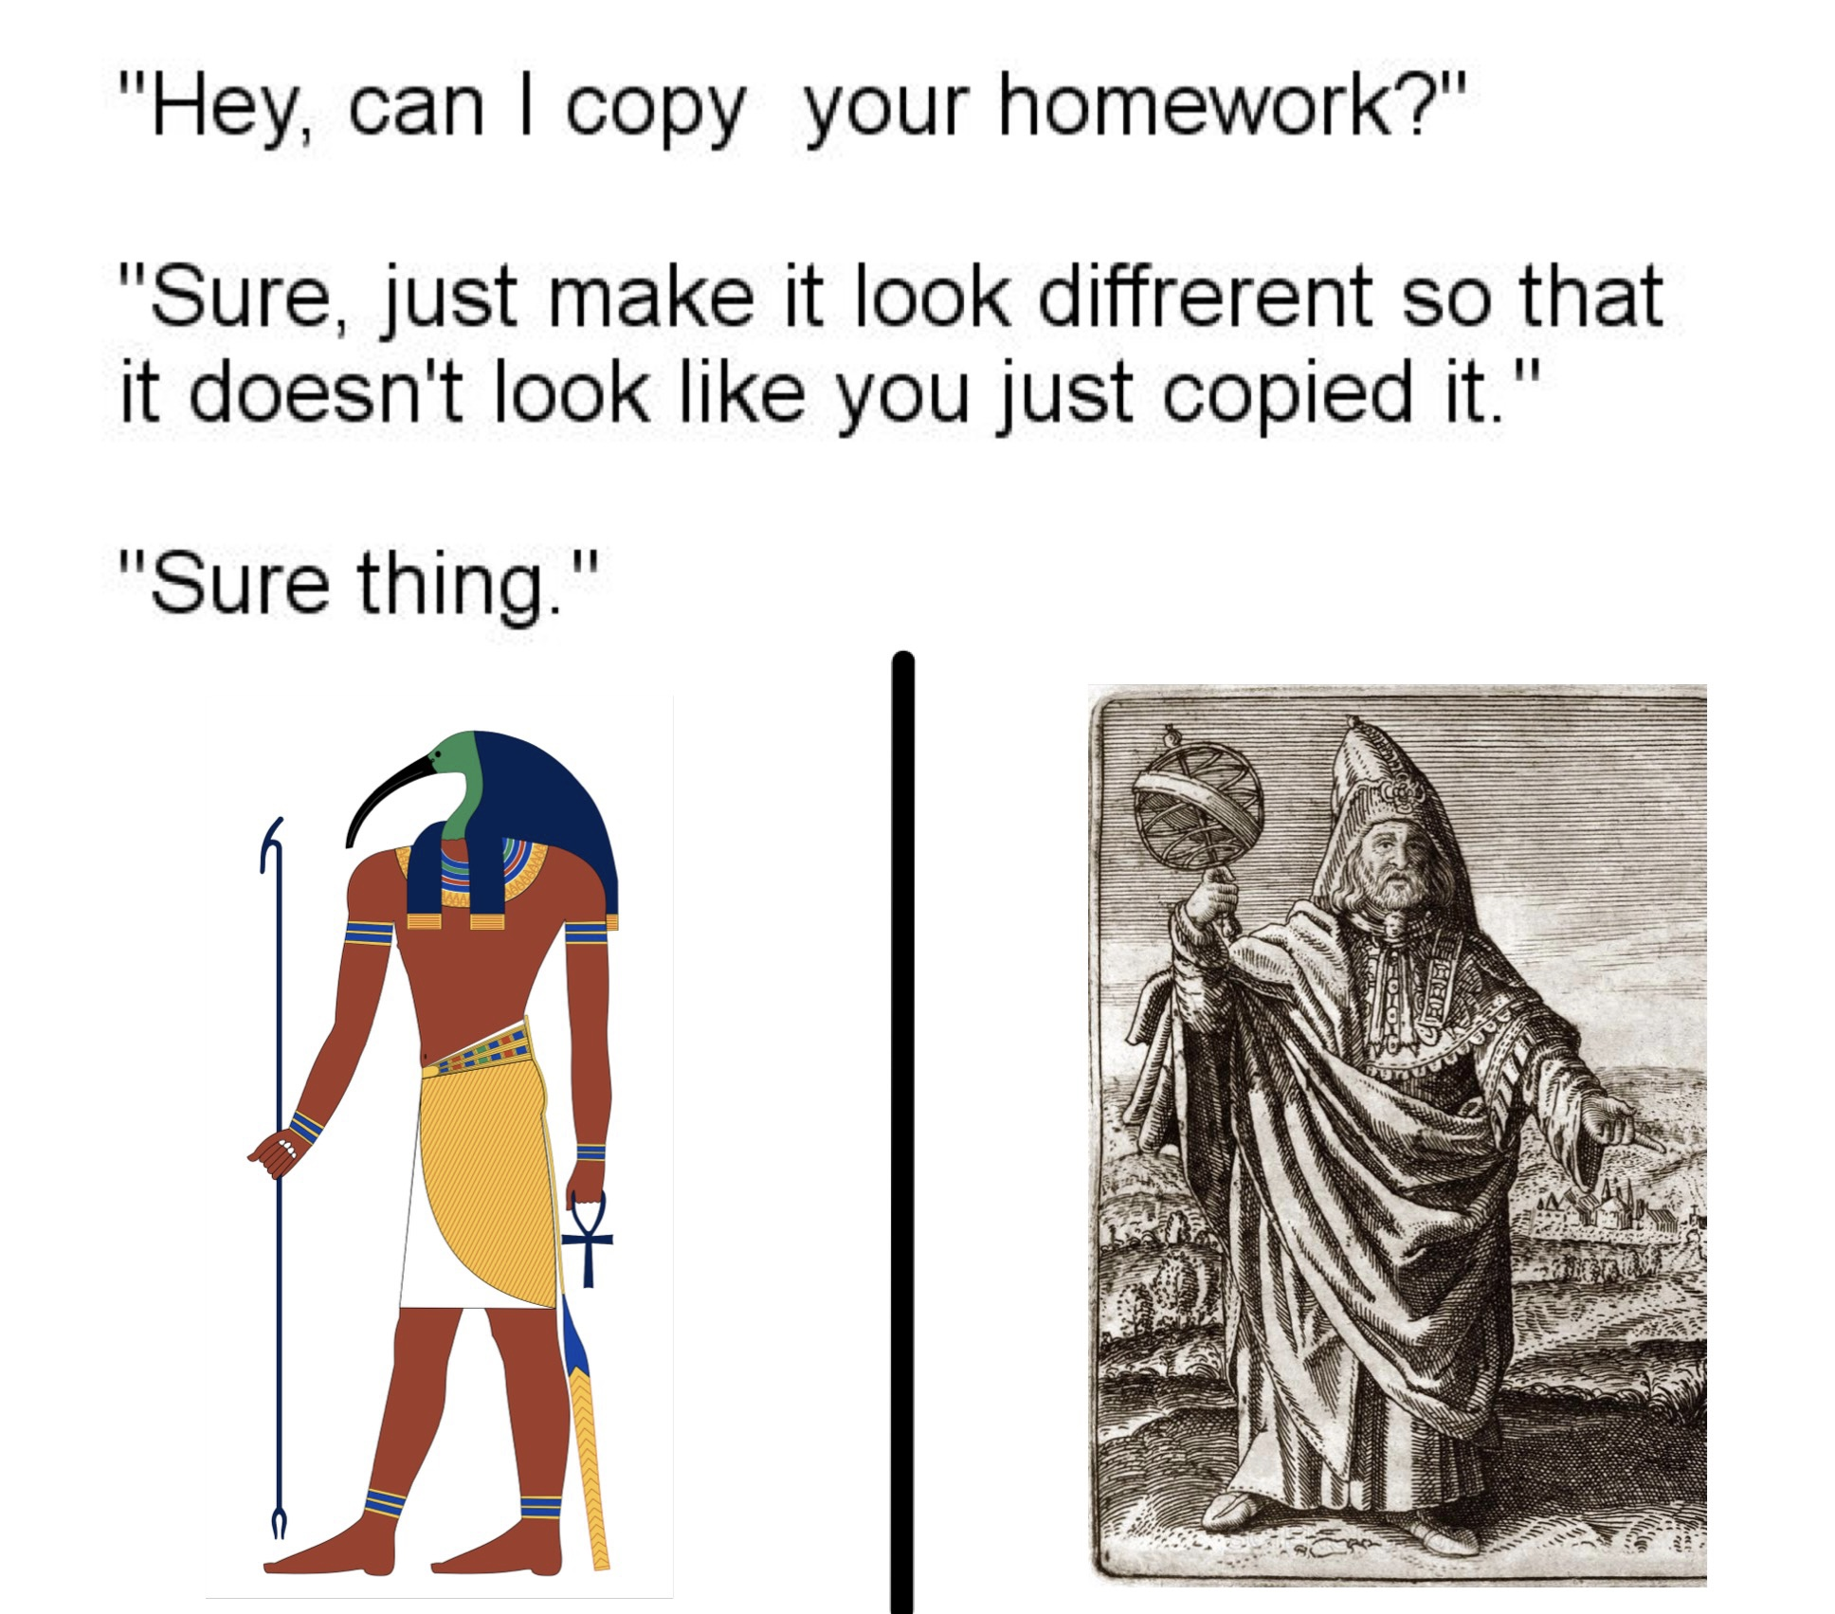
Hm…something about Hermes Trismegistus looks familiar…

